Slide 1
What Valves Do
Steam School Notes | 18 Valves
Valves control fluid flow in piping systems
• Pipe carries fluid
• Fittings direct it
• Valves control it
• Start, stop, regulate, direct flow
• Isolation and throttling
• Pressure control and reverse-flow prevention
• Overpressure protection

Slide 2
Selecting the Right Valve
Steam School Notes | 18 Valves
Valve function determines performance capability
• On-off valve performs poorly for throttling
• Regulation valve damaged if used as stop valve
• Each valve type has specific purpose and limitations
Understanding the purpose and limitations of each valve type is essential for anyone working with steam systems.

Slide 3
Basic Valve Components
Steam School Notes | 18 Valves
Most valves contain the same fundamental parts
Component | Function
Body | Main pressure-retaining component; contains flow passage and piping connections
Bonnet | Covers valve body and supports stem
Stem | Transfers motion from handwheel or actuator to closure element
Seat | Sealing surface against which closure element closes
Disc, Plug, or Ball | Closure element that blocks, permits, or regulates flow
Packing | Prevents leakage around moving stem; adjustable for wear

Slide 4
Valve Position Indication
Steam School Notes | 18 Valves
Visible position indication improves safety and prevents errors
• Operators must determine open, closed, or partial position
• Many designs provide visible indication
• Prevents operating errors during maintenance and isolation

Slide 5
Quarter-Turn Valve Handles
Steam School Notes | 18 Valves
Handle orientation directly indicates closure element position
• Found on ball valves and plug valves
• Handle perpendicular to pipe = valve closed
• Handle parallel to pipe = valve open
Advantage
• Immediate visual verification of position
• Quick determination from distance

Slide 6
Rising-Stem Valves
Steam School Notes | 18 Valves
Exposed stem length indicates valve opening
• Found on gate valves and globe valves
• Stem moves outward as valve opens
• Exposed stem length shows approximate opening
Advantages
• Easy visual confirmation of position
• Position determinable from distance

Slide 7
Non-Rising-Stem Valves
Steam School Notes | 18 Valves
Stem rotates without moving outward during operation
• Stem does not change position as valve opens
• Operator relies on handwheel position or indicators
• Used where headroom is limited

Slide 8
Position Indicators
Steam School Notes | 18 Valves
Dedicated indicators provide reliable position verification
Indicator Types
• Pointer plates
• Mechanical indicators
• Colored markers
• Electrical limit switches
Common Applications
• Actuated valves
• Motor-operated valves
• Control valves
• Remote-operated valves

Slide 9
Why Valve Position Matters
Steam School Notes | 18 Valves
Operating incidents often result from incorrect position assumptions
• Many incidents occur when valve position is misjudged
• Before starting equipment, verify the actual position
Verification Steps
• Identify the correct valve
• Confirm intended position
• Verify actual position visually
Never assume a valve is open or closed based solely on previous operation or labeling.

Slide 10
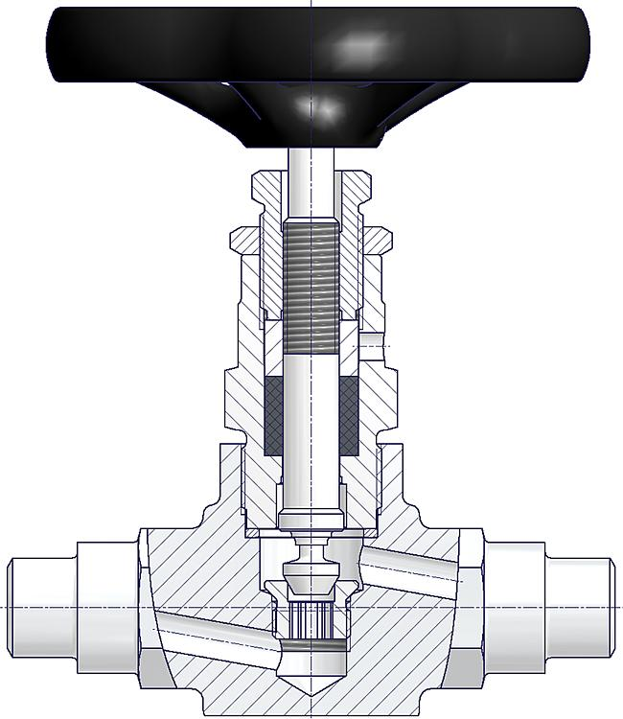
Screwed Bonnet Design
Steam School Notes | 18 Valves
Bonnet threads directly into valve body
• Bonnet threads into body
• Simple and economical design
• Common on smaller valves
Disadvantage
• Limited wrenching surface
• May become difficult to remove after years at elevated temperatures

Slide 11
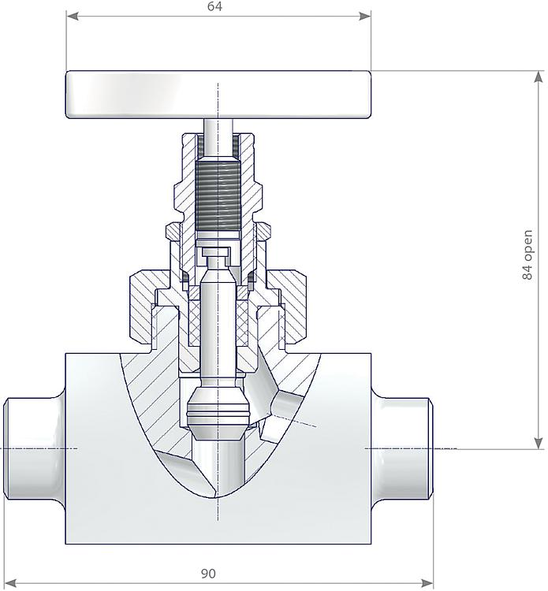
Union Bonnet Design
Steam School Notes | 18 Valves
Union nut provides larger wrenching surface for disassembly
• Body screws into bonnet
• Union nut secures assembly
• Larger wrenching surface than screwed bonnet
Advantage
• Greater mechanical advantage during disassembly
• Easier to dismantle after years of service

Slide 12
Why Bonnet Design Matters
Steam School Notes | 18 Valves
Thermal cycling and periodic maintenance require careful disassembly
• Steam valves operate at 400°F (200°C) or higher
• Repeated heating-cooling cycles tighten threaded components
Periodic Disassembly Required For
• Inspection
• Cleaning
• Seat maintenance
• Packing replacement
• Long-term layup

Slide 13
Service-Friendly Valve Selection
Steam School Notes | 18 Valves
Maintenance ease affects long-term value and reliability
• Consider maintenance requirements alongside operating performance
• Valve easy to inspect and repair provides advantages
• Especially important in steam applications with periodic inspection
Experienced Operators Prefer
• Union-bonnet design for service-friendliness
• Particularly on regularly inspected or thermally cycled valves

Slide 14
Five Primary Valve Functions
Steam School Notes | 18 Valves
Each valve type serves a specific control purpose
• Isolate flow
• Regulate flow
• Prevent reverse flow
• Control pressure
• Protect equipment from overpressure
• Some valves perform multiple functions
• Every valve designed with primary purpose in mind

Slide 15
Isolation Valves
Steam School Notes | 18 Valves
Designed for fully open or fully closed service
• Isolation valves control on-off flow
• Primary function is complete flow blocking or allowing
• Three main types: gate, ball, plug

Slide 16
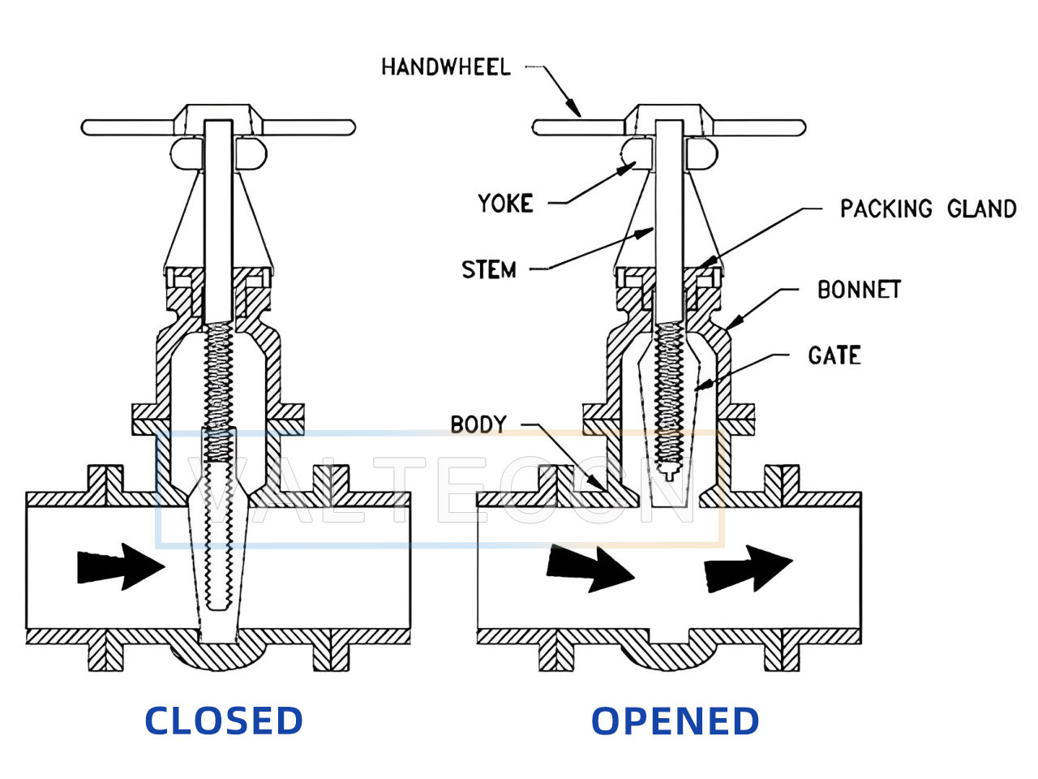
Gate Valves
Steam School Notes | 18 Valves
Wedge gate moves perpendicular to flow path
Characteristics
• Excellent isolation
• Low pressure drop when open
• Poor throttling performance
Advantages
• Minimal flow restriction
• Good shutoff capability
Disadvantages
• Slow operation
• Damage risk when partially open
Gate valves should be either fully open or fully closed.

Slide 17
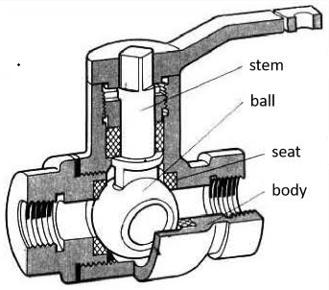
Ball Valves
Steam School Notes | 18 Valves
Quarter-turn rotation of drilled sphere controls flow
Advantages
• Quick operation
• Excellent shutoff
• Compact design
Disadvantages
• Not ideal for precise flow control
• Most common valves in modern steam systems
• Quarter-turn rotates ball between fully open and closed

Slide 18
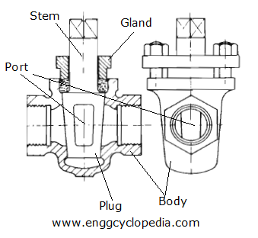
Plug Valves
Steam School Notes | 18 Valves
Tapered or cylindrical plug with drilled passage controls flow
• Quarter-turn operation similar to ball valves
• Used where quick operation and positive shutoff required
• Flow passage drilled through tapered or cylindrical plug

Slide 19
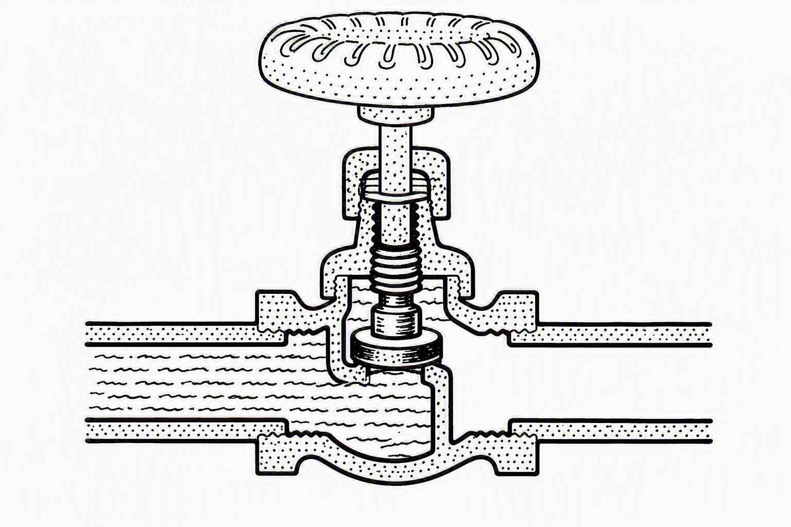
Globe Valves
Steam School Notes | 18 Valves
Disc moves toward or away from seat to regulate flow
Advantages
• Excellent throttling capability
• Good flow control
• Reliable operation
Disadvantages
• Higher pressure drop
• More tortuous flow path
• One of most common throttling valves
• Frequently used where steam flow must be adjusted

Slide 20
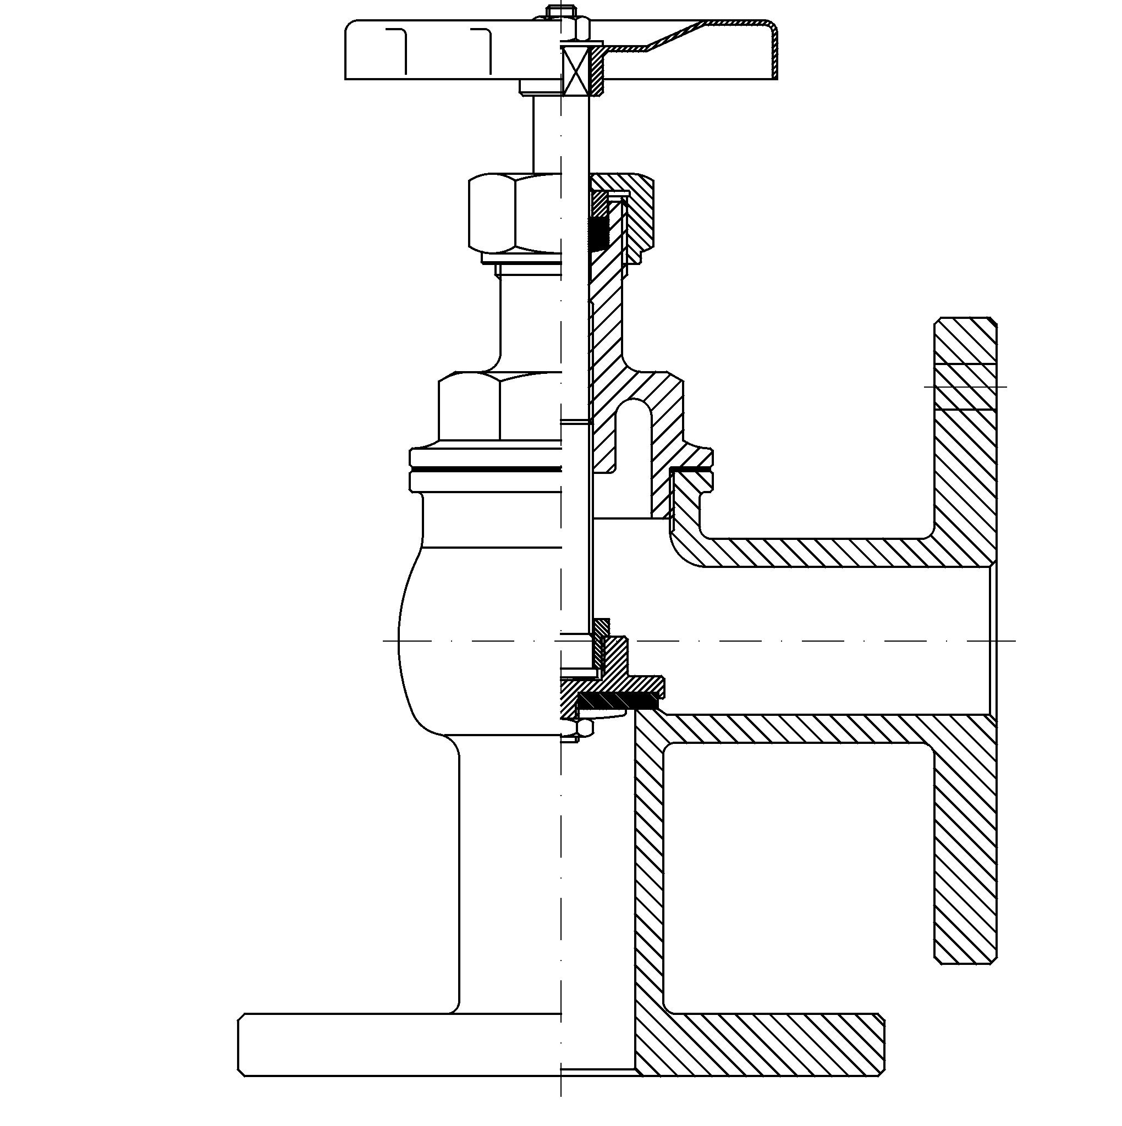
Angle Globe Valves
Steam School Notes | 18 Valves
Globe valve function with 90-degree flow direction change
Advantages
• Good throttling capability
• Eliminates need for separate elbow
• Compact installation
Disadvantages
• Higher pressure drop than straight-through valves
• Combines valve and elbow into single component
• Reduces number of fittings required

Slide 21
Globe Valve Flow Direction
Steam School Notes | 18 Valves
Pressure should enter beneath disc and seat for optimal performance
When Pressure Acts Beneath Seat
• Valve operation requires less force
• Stem packing experiences less pressure
• Valve is easier to control
• Wear is reduced
• Globe valves usually marked with flow-direction arrow
• Must be installed per manufacturer recommendations

Slide 22
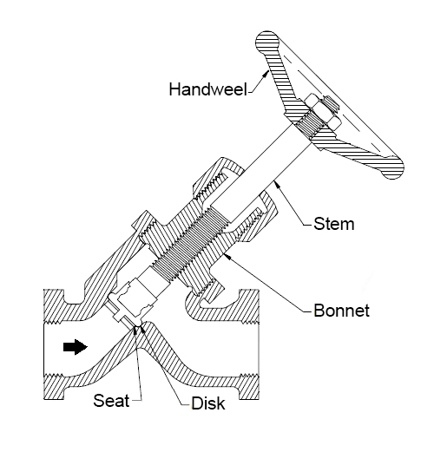
Y-Valves (Y-Globe Valves)
Steam School Notes | 18 Valves
Angled seat and stem reduce pressure loss while maintaining shutoff
Advantages
• Lower pressure drop than standard globe valve
• Excellent resistance to wire drawing and erosion
• Well suited to high-temperature service
• Self-cleaning design
Common Applications
• Boiler blowdown lines
• Continuous blowdown systems
• High-pressure steam service

Slide 23
Needle Valves
Steam School Notes | 18 Valves
Needle-shaped closure element enables precise flow control
• Specialized form of globe valve
• Needle-shaped closure element
• Enables extremely precise flow control
Common Applications
• Instrument connections
• Gauge lines
• Sampling systems

Slide 24
Valve Selection for Flow Regulation
Steam School Notes | 18 Valves
Gate valves unsuitable for throttling service
Partially Open Gate Valve Risks
• Vibration
• Erosion
• Seat damage
• Common mistake is using gate valve to throttle flow
• For flow regulation, use globe or needle valve

Slide 25
Check Valves
Steam School Notes | 18 Valves
Automatically prevent reverse flow without operator action
• Allow flow in one direction only
• Prevent reverse flow automatically
• No operator action required
• Must be installed with flow arrow pointing correctly

Slide 26
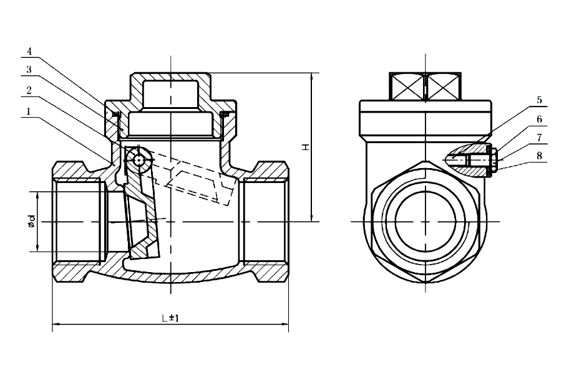
Swing Check Valve
Steam School Notes | 18 Valves
Hinged disc swings open with forward flow and closes on reversal
• Hinged disc swings open with desired flow direction
• Disc closes against seat when flow reverses

Slide 27
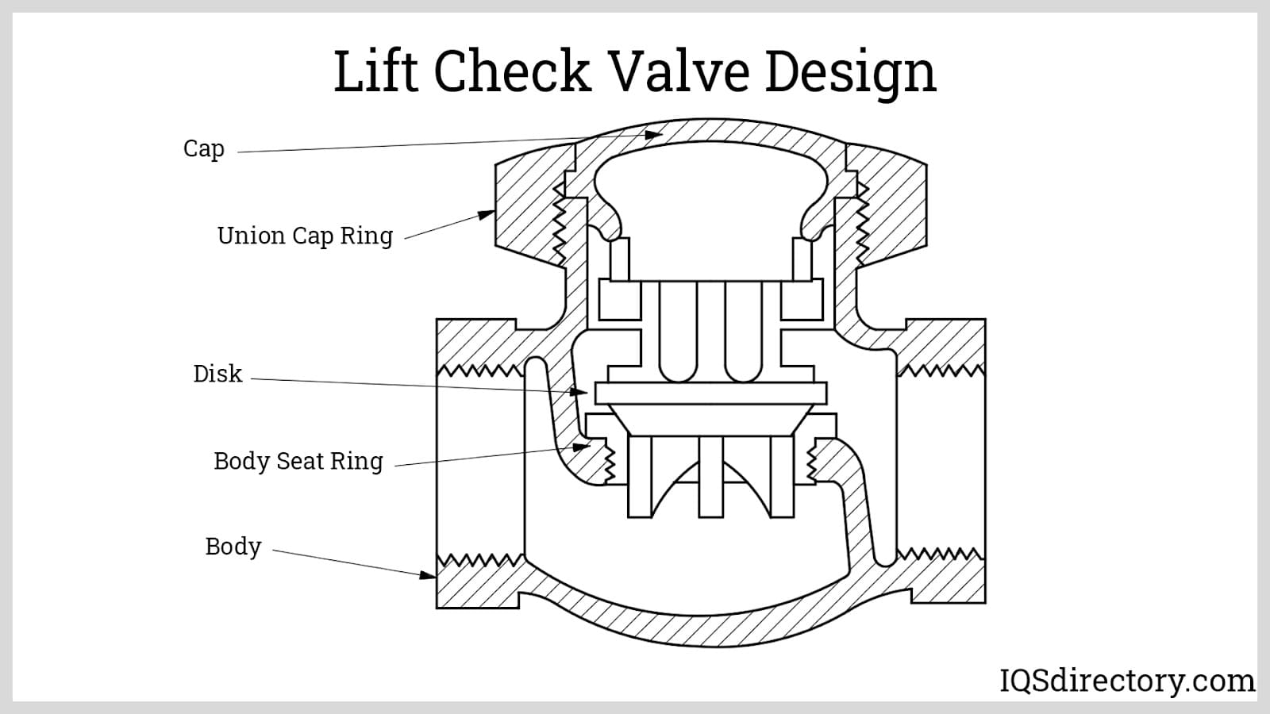
Lift Check Valve
Steam School Notes | 18 Valves
Vertical moving disc lifts with forward flow and seats on reversal
• Flow lifts disc from seat
• Reverse flow forces disc back onto seat

Slide 28
Why Check Valves Matter
Steam School Notes | 18 Valves
Reverse flow causes equipment damage and system upset
Reverse Flow Consequences
• Equipment damage
• Pump damage
• Water hammer
• Process upset
• Check valves installed downstream of pumps
• Critical equipment protection

Slide 29
Pressure Reducing Valves (PRVs)
Steam School Notes | 18 Valves
Automatically reduce high inlet pressure to controlled outlet pressure
• Lowers higher inlet pressure to lower outlet pressure
• Example: 150 PSI steam supply reduced to 30 PSI
• Widely used in steam distribution systems
Benefits
• Improved safety
• More efficient equipment operation
• Better process control
• PRVs do not provide overpressure protection
• Separate safety valve may be required downstream

Slide 30
How a Safety Valve Works
Steam School Notes | 18 Valves
Spring force holds disc closed until system pressure overcomes it
• Remains closed during normal operation
• Calibrated spring holds disc against seat
• As pressure rises, upward force increases
• At set pressure, force overcomes spring
• Disc begins to lift
• Valve pops open rapidly at full lift
• Opens rapidly rather than gradually
• Allows full flow to relieve excess pressure
• Reseats only after pressure falls below set point

Slide 31
Blowdown in Safety Valves
Steam School Notes | 18 Valves
Intentional pressure difference prevents rapid cycling and chatter
• Blowdown is pressure difference between opening and closing
• Allows sufficient pressure drop before reseating
• Example: Set at 150 psi, reseats at approximately 147 psi
• Without blowdown, valve repeatedly opens and closes
• Rapid cycling called chatter
• Chatter causes excessive seat wear and reduced reliability
• Properly functioning valve opens quickly
• Remains open long enough to relieve excess pressure
• Reseats only after sufficient pressure drop

Slide 32
Safety Valve Key Concepts
Steam School Notes | 18 Valves
Set pressure, blowdown, and chatter define valve behavior
• Set Pressure: Pressure at which valve begins to open
• Blowdown: Difference between opening and reseating pressure
• Chatter: Rapid repeated opening and closing from unstable conditions

Slide 33
Why Safety Valves Are Critical
Steam School Notes | 18 Valves
Final line of defense against dangerous overpressure
Without Overpressure Protection
• Boilers may be damaged
• Pressure vessels may fail
• Piping systems may rupture
• Safety valves are most important protective devices
• Never isolate from equipment without approved procedures
Safety valves should never be isolated from the equipment they protect unless specific approved procedures are followed.

Slide 34
Safety Valve Set Pressure Determination
Steam School Notes | 18 Valves
Set pressure determined by Maximum Allowable Working Pressure
• Set pressure not selected arbitrarily
• Determined by equipment Maximum Allowable Working Pressure (MAWP)
• Prevents equipment exposure to excessive pressure
For Historical Boilers, MAWP Determined By
• Non-destructive examination (NDE)
• Inspection of material condition
• Measurement of remaining thickness
• Engineering calculations using boiler formulae
A safety valve must not be adjusted above the MAWP of the equipment it is intended to protect.

Slide 35
Safety Valve Adjustment and Sealing
Steam School Notes | 18 Valves
Certified adjustment and sealing provide assurance of set pressure
• Set pressure adjusted and certified by qualified technicians
• Adjustment performed under approved quality assurance program
• Valve sealed after testing to show integrity
• Seal provides assurance pressure remains certified
• Broken or missing seal requires valve removal and reinspection
• Under normal conditions, modern boiler safety valve rarely operates
• Frequent lifting usually indicates operating problem
• May indicate pressure control issue or valve sizing problem

Slide 36
Historical Boiler Operation and Safety Valves
Steam School Notes | 18 Valves
Modern MAWP may be lower than original design pressure
• Steam traction engines operate differently from modern boilers
• Inspections and engineering assessments may determine lower MAWP
• Operators may work near safety-valve set pressure during normal operation
Example Scenario
• Traction engine driving sawmill
• Steam demand suddenly decreases while boiler producing steam
• May experience occasional safety-valve operation
• Frequent operation affects valve reseat ability
• Increases wear on seating surfaces

Slide 37
Pop Valve Regulation in Historical Boilers
Steam School Notes | 18 Valves
Antique pop valve regulated pressure while protecting government safety valve
• Some jurisdictions permitted antique pop valve as regulating device
• Pop valve set to open at lower pressure than certified safety valve
• Allowed pressure control without repeatedly lifting safety valve
Valve Roles
• Pop valve: Regulating device for normal operation
• Government valve (safety valve): Final overpressure protection
• Government valve only operates if regulator fails
• Term government valve reflects official certification role
• Certified safety valve is ultimate overpressure protection device

Slide 38
Safety Valve Key Takeaway
Steam School Notes | 18 Valves
Safety valve is final overpressure defense based on equipment MAWP
• Safety valve is protective device, not regulating device
• Set pressure determined by equipment MAWP
• Final line of defense against overpressure
A safety valve is the final line of defense against overpressure. It is a protective device, not a pressure-regulating device, and its set pressure is determined by the MAWP of the equipment it protects.

Slide 39
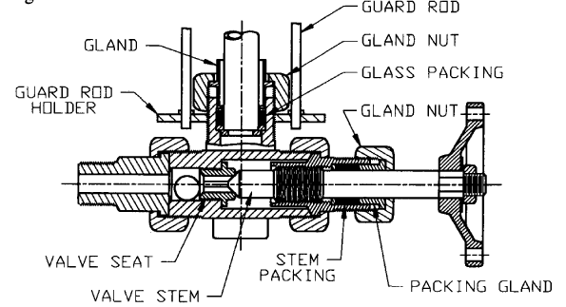
Automatic Gauge Glass Valves
Steam School Notes | 18 Valves
Ball checks restrict flow if gauge glass breaks
• Found in water-column and gauge-glass installations
• Contain small ball checks in flow passage
• Normally remain clear during operation
• If gauge glass breaks, sudden flow increase causes ball to seat
• Restricts or stops steam and water discharge
• Provides additional protection during glass failure
• Additional protection measure, not sole isolation
• Manual shutoff valves must remain accessible

Slide 40
Valve End Connections
Steam School Notes | 18 Valves
Different connection types suit different piping applications
Connection Type | Application
Threaded | Common on smaller piping systems
Socket-Weld | Frequently used for small-bore high-pressure service
Butt-Weld | Common on larger industrial piping systems
Flanged | Used where equipment may require removal or maintenance

Slide 41
Valve Ratings and Markings
Steam School Notes | 18 Valves
Standard markings identify valve specifications and suitability
Typical Markings Include
• Manufacturer
• Size
• Material
• Pressure class
• Flow direction (where applicable)
• CRN (where applicable)
• Markings verify valve suitability for intended service
• Example: 2", 150 class, A216 WCB
• Example: 1", 800 class, A105

Slide 42
Reading Valve Markings
Steam School Notes | 18 Valves
Interpret standard valve markings to verify suitability
Example Marking: ABC / 2 / 300 / A216 WCB
• Manufacturer: ABC
• Size: 2 inch
• Class: 300
• Material: Cast carbon steel (A216 WCB)
• Valve markings important for quality control
• Enable traceability of valve specifications
• Similar to pipe and fitting markings

Slide 43
Valve Installation Verification Checklist
Steam School Notes | 18 Valves
Verify critical specifications before installing any valve
Before Installing a Valve, Verify
• Size
• Material
• Pressure class
• Flow direction
• Intended function
• Valves expensive and critical piping components
• Proper selection and installation affect safety and performance
• Never assume interchangeability based on pipe size alone
Never assume two valves are interchangeable simply because they have the same pipe size.

Slide 44
Chapter 18 Key Takeaway
Steam School Notes | 18 Valves
Valve selection and operation essential for system safety and reliability
• Different valve types designed for different functions
• Functions include isolation, throttling, reverse-flow prevention, pressure control, and overpressure protection
• Understanding each valve's operation and application critical
• Essential for safe and reliable steam system operation
• Proper selection prevents equipment damage and personnel hazards
• Improves overall system performance and safety
Valves control the flow of fluids within a piping system. Different valve types are designed for different functions, including isolation, throttling, reverse-flow prevention, pressure control, and overpressure protection. Understanding how each valve operates and where it should be used is essential for safe and reliable steam system operation.

