Slide 1
Chapter Summary: Stayed Surfaces
Steam School Notes | Chapter 13 Stayed Surfaces
Overview of stayed surface design, analysis, and failure modes
Cylindrical boiler shells resist internal pressure through curved geometry, carrying load as tension
Flat surfaces bulge under internal pressure and require stays to prevent excessive deflection
Stayed surface analysis requires three calculations: pressure load, stay-to-plate connection strength, and stay strength
Allowable pressure is limited by the weakest of these three conditions
Construction factor and stay attachment details significantly affect strength

Slide 2
Pressure Behavior on Curved and Flat Surfaces
Steam School Notes | Chapter 13 Stayed Surfaces
Fundamental structural behavior of cylindrical versus flat surfaces under internal pressure
Cylindrical shells: Internal pressure creates tension in the shell; curved shape naturally resists load; shell resists becoming flatter
Flat plates: Internal pressure causes outward bulging; plate attempts to transform into curved surface; bending stresses become excessive without support

Slide 3
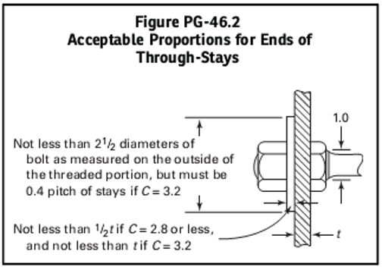
Function and Design of Stays
Steam School Notes | Chapter 13 Stayed Surfaces
Role of stays in flat surface support and three-part strength analysis
Stays transfer pressure load into tension members
Stays prevent excessive plate deflection
Connection details between stay and plate significantly affect strength
Strength of structure often governed by connection details rather than metal strength alone
Three Required Calculations
Load applied to the plate by pressure
Strength of the connection between stay and plate
Strength of the stay itself

Slide 4
Through-Stay Pressure Equation and Construction Factors
Steam School Notes | Chapter 13 Stayed Surfaces
ASME formula for pressure in through-stay configurations with construction factor table
ASME equation reflects that thicker plates resist pressure better and closer stay spacing provides better support
Equations vary between references due to different safety factor incorporation
Older ASME formulas use ultimate tensile strength with explicit factor of safety
Modern NBIC calculations use allowable stress value that includes required safety factor
ASME equation reflects that thicker plates resist pressure better and closer stay spacing provides better support
Equations vary between references due to different safety factor incorporation
Older ASME formulas use ultimate tensile strength with explicit factor of safety
Modern NBIC calculations use allowable stress value that includes required safety factor
Through-Stay Formula Variables and Construction Factors
Pressure Equation
P_{through} = (t² · S · C) / p²
Symbol | Definition
t | Thickness of the stayed surface
p | Stay spacing (centre-to-centre distance between stays)
S | Allowable stress for stayed surface; in NBIC already includes required factor of safety
C | Construction factor based on stay attachment details
C = 2.1 | Welded stays or stays screwed through plates not over 7/16 in. thick and riveted over
C = 2.2 | Welded stays or stays screwed through plates over 7/16 in. thick and riveted over
C = 2.5 | Stays fitted with nuts but without washers
C = 2.8 | Headed or taper-fit stays having true bearing on plate
C = 3.2 | Stays fitted with inside and outside nuts and outside washers meeting Code requirements

Slide 5
Through-Stay Example Calculation
Steam School Notes | Chapter 13 Stayed Surfaces
Worked example of allowable pressure calculation for double-plated through-stay configuration
Example configuration: Boiler with widely spaced through stays connecting double-plated heads fitted with nuts and washers
P_{through} = (t² · S · C) / p² where t = 2 × 0.375, S = 55000/4, C = 3.200, p = 6.500
P_{through} = 585.799 psi

Slide 6
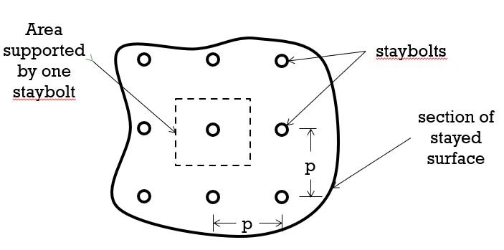
Regular Square-Pattern Staybolts and Tributary Area
Steam School Notes | Chapter 13 Stayed Surfaces
Arrangement, tributary area concept, and pressure equation for regularly spaced staybolts
Staybolts often arranged in regular square pattern on flat surfaces
Each staybolt supports pressure acting on surrounding plate area called tributary area
For uniformly spaced staybolts, tributary area is approximately the square of the stay pitch
ASME Code treats regularly spaced staybolts threaded into plate less than 1/2 inch thick and riveted over same as through stays
Staybolts often arranged in regular square pattern on flat surfaces
Each staybolt supports pressure acting on surrounding plate area called tributary area
For uniformly spaced staybolts, tributary area is approximately the square of the stay pitch
ASME Code treats regularly spaced staybolts threaded into plate less than 1/2 inch thick and riveted over same as through stays
Regular Staybolt Pressure Equation
P_regular = (t² · S · C) / p²
Regular Staybolt Pressure Equation
P_{regular} = (t² · S · C) / p²

Slide 7
Regular Staybolt Example and Stay Spacing Effects
Steam School Notes | Chapter 13 Stayed Surfaces
Regular staybolt pressure calculation and impact of spacing on allowable pressure
Example configuration: Regularly spaced staybolts in thin plate
P_regular = (t² · S · C) / p² where t = 0.300, S = 55000/4, C = 3.200, p = 4.500
P_regular = 195.556 psi
Example configuration: Regularly spaced staybolts in thin plate
P_{regular} = (t² · S · C) / p² where t = 0.300, S = 55000/4, C = 2.1, p = 4.5
P_{regular} = 128.333 psi
Impact of Stay Spacing
Stay spacing appears in denominator as square of pitch
Increased spacing requires each stay to support larger area of plate
Allowable pressure decreases rapidly with increased spacing

Slide 8
Plate Thickness Loss and Pressure Reduction
Steam School Notes | Chapter 13 Stayed Surfaces
Effect of corrosion-related plate thickness reduction on allowable working pressure
As boiler deteriorates through corrosion, stay spacing and construction factor remain unchanged
Principal change is reduction in plate thickness
Plate thickness appears squared in equation; small material losses result in large pressure reduction
Rule of Thumb for Corrosion Effects
Pressure falls approximately with the square of the remaining thickness
Plate thinned to 90% of original thickness has only about 81% of original pressure-carrying capacity

Slide 9
Staybolt Strength Analysis and Load Equation
Steam School Notes | Chapter 13 Stayed Surfaces
Calculation of maximum allowable load based on staybolt diameter and spacing
Stayed surface can fail if plate is too weak for stay spacing or if staybolts themselves are too weak
Staybolt strength must be evaluated separately from plate strength
Each staybolt supports pressure acting on its tributary area, approximately equal to square of stay pitch
Staybolt Load Equation
P_load = (π(d/2)² · S) / (1.100 · p²)
Staybolt Load Equation
P_load = (π(d/2)² · S) / (1.100 · p²)
Staybolt Load Equation Variables
Staybolt Load Equation Variables
Symbol | Definition
P | Maximum allowable working pressure
d | Diameter of the staybolt
p | Staybolt pitch (centre-to-centre spacing)
S | Maximum allowable stress value (11,300 psi in NBIC)

Slide 10
Staybolt Diameter and Spacing Effects on Capacity
Steam School Notes | Chapter 13 Stayed Surfaces
Relationship between staybolt diameter, spacing, and load-carrying capacity
Staybolt strength varies with the square of the diameter; small diameter increase produces significant capacity increase
Staybolt spacing appears squared in equation; increased spacing increases area per stay and reduces allowable pressure
Diameter changes have more dramatic effect on capacity than spacing changes

Slide 11
Governing Pressure Limit for Stayed Surfaces
Steam School Notes | Chapter 13 Stayed Surfaces
Overall strength evaluation and determination of allowable working pressure as minimum of all component strengths
Both plate-strength equation and staybolt-strength equation must be evaluated for stayed surface
Allowable working pressure is determined by weakest element in load path
Three critical elements must resist imposed load: plate between stays, stay-to-plate attachment, and stay itself
Allowable pressure is smallest value produced by applicable calculations
The allowable pressure of a stayed surface is limited by the weakest link in the load path: the plate strength, the stay attachment, or the stay strength itself.
The allowable pressure of a stayed surface is limited by the weakest link in the load path: the plate strength, the stay attachment, or the stay strength itself.

