Slide 1
Chapter Overview: Boiler Safety Features
Steam School Notes | Chapter 3: Boiler Safety Features
Five required safety features protect boiler operation and prevent dangerous overpressure and low-water conditions.
Safety valve: Prevents overpressure by automatically releasing steam at set limit
Pressure gauge: Indicates internal pressure for safe operating range
Fusible plug: Temperature-triggered warning device for low-water protection
Try cocks: Independent water-level check at multiple heights
Water gauge glass: Direct observation of actual boiler water level
Sixth Feature (Common but Not Mandatory)
Water column: Remote assembly combining gauge glass and try cocks for improved visibility and maintenance; not strictly required by code in all cases

Slide 2
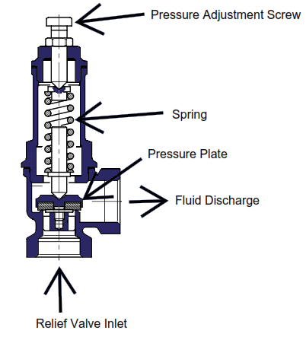
Safety Valve: Design and Function
Steam School Notes | Chapter 3: Boiler Safety Features
A safety valve is an automatic, spring-loaded device that prevents boiler overpressure by releasing steam when pressure reaches the set limit.
Automatic, spring-loaded device fitted to boiler shell
Steam pressure acts on valve disc held shut by adjustable spring
When boiler pressure reaches set pressure, steam force overcomes spring tension
Valve lifts and releases steam rapidly to atmosphere, preventing pressure rise
Once pressure drops below set point (blowdown), spring reseats valve automatically
Key Characteristics
Spring-loaded (modern traction and portable boilers)
Set pressure is sealed—operator cannot adjust it
Opens fully and quickly to prevent dangerous pressure rise
Reseats automatically when pressure falls to safe level
Must be sized to discharge steam faster than boiler can generate it

Slide 3
Why Safety Valves 'Pop': The Two-Area Effect
Steam School Notes | Chapter 3: Boiler Safety Features
Safety valves snap fully open (pop) due to a sudden increase in effective pressure area when the valve cracks open.
Two Effective Areas
Primary seat area: small circular area of valve disc exposed to steam while closed
Secondary (huddling) chamber area: larger annular area exposed only after valve cracks open
The Pop Mechanism
At set pressure, only small seat area exposed: F = P × A₁
When valve lifts slightly, steam rushes into huddling chamber: F = P × (A₁ + A₂)
Sudden increase in effective area (A₂ is larger huddling-chamber area)
Larger force overcomes spring resistance; valve snaps fully open
This rapid, self-reinforcing lift is intentional and required by code

Slide 4
Safety Valve Sizing
Steam School Notes | Chapter 3: Boiler Safety Features
Safety valve capacity is determined by MAWP, heating surface area, and required relieving capacity to discharge steam faster than the boiler generates it.
MAWP determines safety-valve set pressure
Heating-surface area determines required relieving capacity
Together, these specify orifice size needed
Practical rule: size capacity at 7–11 lb/h per square foot of heating surface for historic, hand-fired boilers
Actual valves must be sized using applicable boiler code and manufacturer capacity charts
Heating surface: sum of all wetted boiler surfaces exposed to fire or hot gases—firebox sheets, crown sheet, tubes, and flues
Selecting Orifice Size from Capacity Table
Select row corresponding to the set point
Select column corresponding to the capacity
Obtain orifice from column heading

Slide 5
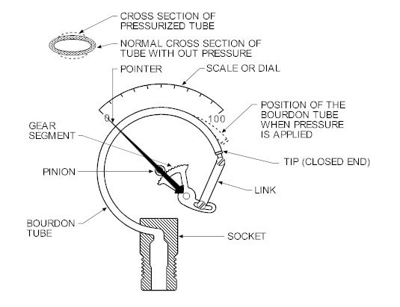
Pressure Gauge: Bourdon-Tube Design
Steam School Notes | Chapter 3: Boiler Safety Features
Bourdon tube converts boiler pressure into a direct needle reading
Steam pressure enters curved Bourdon tube, causing it to straighten
Tube motion transmitted through linkage and gears to rotate needle
Provides direct reading of boiler pressure
Siphon or pigtail forms water seal between boiler and gauge
Water absorbs steam heat; Bourdon tube only sees pressure, not live steam temperature
This greatly extends gauge life
Installation
Gauge siphon mounted above isolation valve, typically quarter-turn style

Slide 6
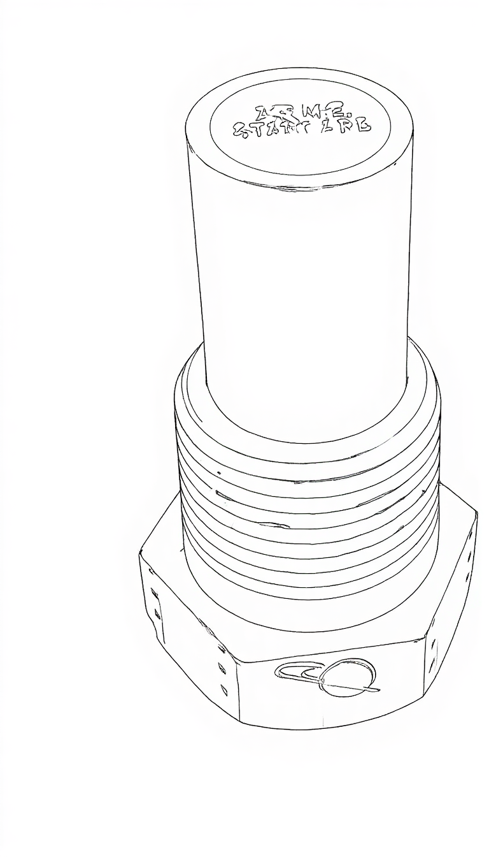
Fusible Plug: Low-Water Warning Device
Steam School Notes | Chapter 3: Boiler Safety Features
Temperature-triggered warning device that vents steam and water into the firebox
Myth vs. Reality
Myth
  Fusible plug melts and dumps water onto fire, putting fire out
Reality
  Discharge is mostly steam, insufficient water to quench fire, and firebox draft blows it away
Bottom line
  Fusible plug is a temperature-triggered warning device, not a fire extinguisher
Design and Operation
Contains low-melting-point alloy on water side of crown sheet
If water level drops and crown sheet overheats, alloy melts out
Creates opening that vents steam and some water into firebox
Produces violent roar and blast of white steam—unmistakable warning
Discharge does not quench fire; amount of water/steam too small and draft overwhelms it
Real purpose: prevent crown-sheet failure by warning before plate reaches critical temperature

Slide 7
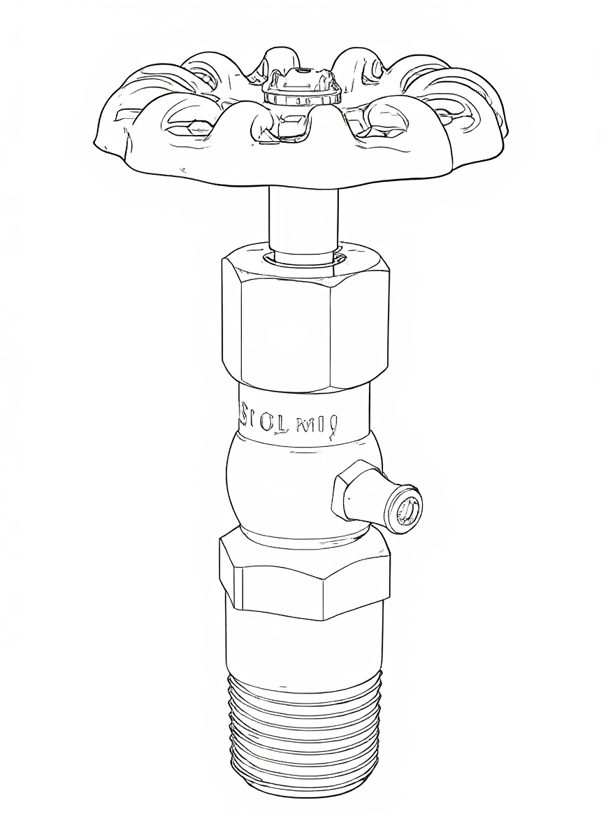
Try Cocks: Independent Water-Level Verification
Steam School Notes | Chapter 3: Boiler Safety Features
Manually operated test fittings to verify true boiler water level and detect false gauge glass readings.
Installed on boiler head at normal waterline, with one above and one below
Verify true water level independently of gauge glass
Mounting try cocks on water column keeps them in same vertical plane as gauge glass
Provides cleaner, more stable indication
Makes it easier to verify true water level without opening fittings directly on boiler shell
Operating a Try Cock—Key Points
Open top try cock first: steady stream of steam indicates water level below that cock
Open bottom try cock next: steady stream of water indicates water level above that cock
Correct water level lies between two cocks
Crack valve open slowly: try cocks discharge forcefully; gentle opening prevents water hammer and scalding spray
Stand to the side: never directly in front of discharge; hot water or wet steam can eject violently
Use short, controlled bursts: long openings waste water and drop level unnecessarily

Slide 8
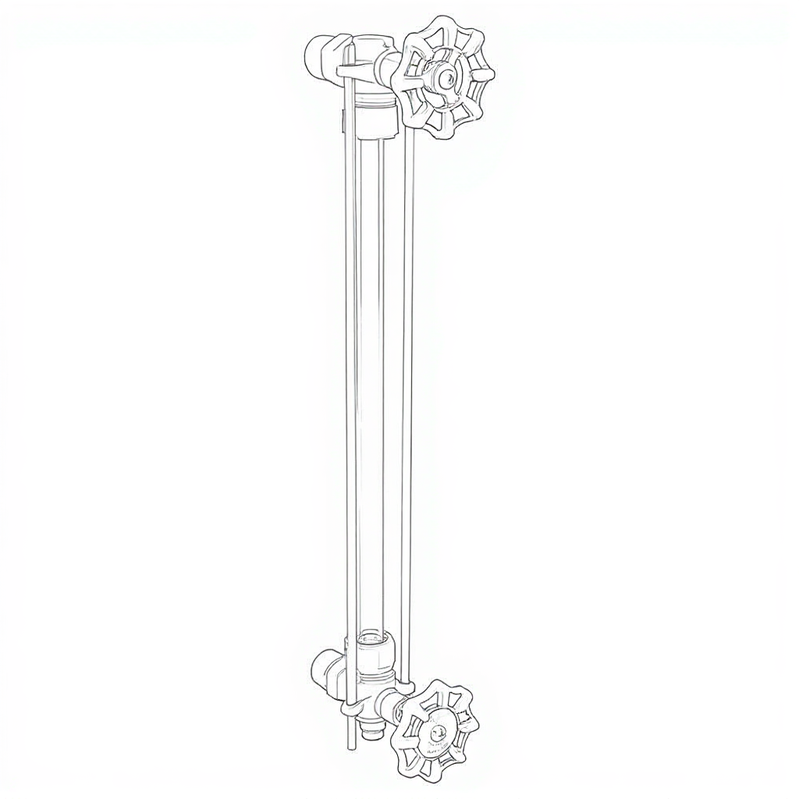
Water Gauge Glass: Direct Water-Level Indication
Steam School Notes | Chapter 3: Boiler Safety Features
A gauge glass is a vertical sight tube that shows actual boiler water level by connecting to both steam and water spaces, creating a pressure-balanced column.
Vertical sight tube mounted on boiler
Connects to boiler through top steam connection and bottom water connection
Water in glass rises and falls to same height as water inside boiler
Open to boiler pressure at both ends
Acts as pressure-balanced column of water
Gives operator direct, continuous indication of water level while boiler is steaming

Slide 9
Proving a Gauge Glass: Preoperational Checks
Steam School Notes | Chapter 3: Boiler Safety Features
Confirm steam reach, water reach, and drain clarity
Gauge glass is proved by momentarily opening each cock
Confirms steam can reach top fitting, water can reach bottom fitting, drain passage is clear
If any passage blocked, glass cannot be trusted
Step 1: Prepare Cocks Before Applying Pressure
Stand to the side of the gauge glass
Confirm steam, water, and drain handles operate smoothly
Ensure drain pipe directed to safe discharge point
Step 2: Blow Down Gauge Using Drain Cock
Confirms drain passage is clear and resets water level
With both steam and water cocks open, open drain cock fully
Observe strong discharge of water followed by steam
Close drain cock; glass should refill to true level

Slide 10
Proving a Gauge Glass: Steam and Water Connections
Steam School Notes | Chapter 3: Boiler Safety Features
Proving the steam and water connections ensures both fittings are unblocked
Step 3: Prove Steam Connection
Ensures top fitting is not blocked by scale or sludge
Close water cock
Open drain cock briefly
Glass should blow clean steam from top connection
Close drain cock
Step 4: Prove Water Connection
Ensures bottom fitting is clear and supplying water
Close steam cock
Open drain cock briefly
Glass should blow solid water from bottom connection
Close drain cock

Slide 11
Return Gauge Glass to Service
Steam School Notes | Chapter 3: Boiler Safety Features
Open steam cock first to prevent water from being forced violently up the glass.
Confirm water level stabilizes at believable height
Opening Under Pressure
If both cocks closed under pressure, open steam cock first
Opening steam cock first prevents water from being forced violently up glass
Crack steam cock slightly
Allow steam to warm and pressurize glass
Once stable, open steam cock fully
Then open water cock slowly to admit water

