Slide 1
Riveted Joints Overview
Steam School Notes | Chapter 12: Riveted Joints
Chapter Summary
Riveted joints classified by application: structural, pressure-tight, and load-bearing steam-tight
Rivet assembly creates clamping force through cooling contraction and field head formation
Common joint types: lap joints, single-cover butt joints, double-cover butt joints, and multi-riveted variants
Joint strength analyzed across multiple failure modes: tearing, shearing, crushing, and margin tearing
Joint efficiency expresses riveted joint strength relative to unperforated plate

Slide 2
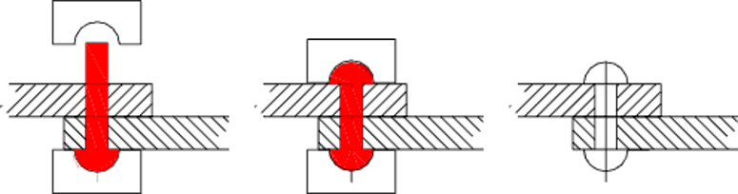
Classification of Riveted Joints
Steam School Notes | Chapter 12: Riveted Joints
Riveted Joint Types and Applications
Structural rivets: used in bridges, beams, and trusses
Pressure-tight rivets: used in tanks and containers where leakage must be prevented
Load-bearing and steam-tight rivets: used in boilers and pressure vessels requiring both load resistance and steam/water-tightness
Rivet Components and Installation
Factory head formed at one end; field length chosen to project beyond plates for field head formation
Heated rivet inserted into prepared hole; factory head supported by bucking bar
Projecting end upset using hammer and rivet set; displaced metal forms field head and clamps plates
Cooling contraction places rivet in tension and compresses plates together, creating clamping force

Slide 3
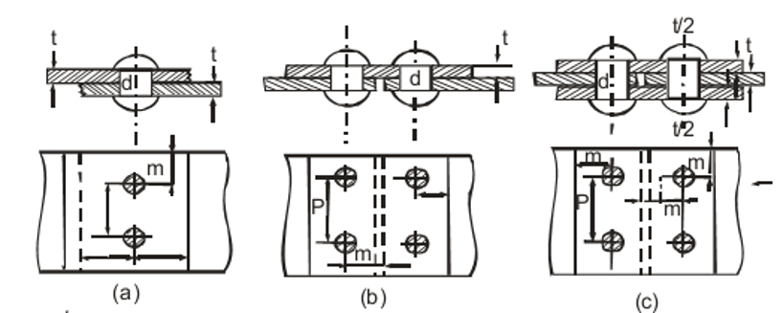
Common Riveted Joint Forms
Steam School Notes | Chapter 12: Riveted Joints
Joint Types and Configurations
Lap joint: plates overlap and are connected by a single row of rivets; rivets transfer load by shear; simple to manufacture but load path is offset, causing plate bending
Single-cover butt joint: plate edges meet and are joined by a single cover strap on one side
Double-cover butt joint: plate edges meet and are joined by cover straps on both sides; load transmitted symmetrically, stronger and more efficient than single-cover
Double-riveted lap joint: lap joint using two rows of rivets; additional rivets increase strength and tightness
Double-riveted butt joint: butt joint using two rows of rivets in staggered pattern; staggering improves efficiency by reducing weakening effect of rivet holes

Slide 4
Riveted Joint Dimensions
Steam School Notes | Chapter 12: Riveted Joints
Geometric Parameters and Definitions
Symbol | Meaning
p | rivet pitch, the distance between adjacent rivets in the same row
m | margin, the distance from the centre of a rivet to the edge of the plate
d | rivet diameter
p_{b} | back pitch, the distance between adjacent rows of rivets
p_{d} | diagonal pitch, the centre-to-centre spacing of staggered rivets measured diagonally
Design Considerations
Selection of rivet diameter, pitch, and row spacing is compromise between strength, tightness, manufacturing cost, and inspection ease
Additional rivet rows increase strength but require more holes, removing metal from plates and increasing construction time

Slide 5
Failure Modes in Riveted Joints
Steam School Notes | Chapter 12: Riveted Joints
Principal Failure Mechanisms
Tearing of plate along section weakened by rivet holes
Shearing of rivets
Crushing of rivets
Crushing of plate at rivet holes or margin
Analysis Principle
Each failure mode analyzed separately to determine load required for failure
Joint strength governed by weakest failure mode
Maximum safe load limited by failure mode requiring smallest load to produce failure
Good design proportions rivets, pitch, and plate thickness so no single mode is excessively weaker than others

Slide 6
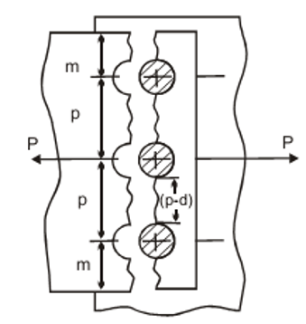
Plate Tearing Analysis
Steam School Notes | Chapter 12: Riveted Joints
Tearing Failure Mode and Calculation
Tearing Mechanism
Line of rivet holes weakens plate similar to perforations in paper
Holes remove part of metal, leaving only material between holes to resist tearing
Width of metal available to resist tearing: (p − d), where p is pitch and d is rivet hole diameter
Tearing Equations
Net tearing area: A_{t} = (p − d) · t
Tearing force: P_{t} = σ_{t} · A_{t}, where σ_{t} is tensile strength of plate material
Example with σ_{t} = 60,000 psi, p = 3.5 in, d = 0.75 in, t = 0.375 in: P_{t} = 61,875 lb force
Plate without hole, identical dimensions: P = 78,750 lb force; reduction due entirely to metal removed for rivet hole

Slide 7
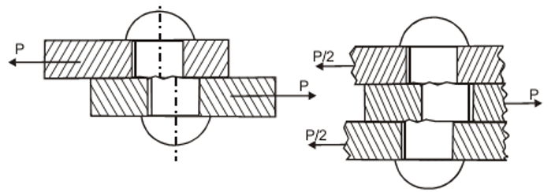
Rivet Shearing Analysis
Steam School Notes | Chapter 12: Riveted Joints
Shearing Failure Mode and Calculation
Shearing Mechanism
Rivet transfers load from one plate to another; if load becomes large enough, rivet may fail by shearing across cross-sectional area
Single shear: load attempts to cut rivet along one shear plane; occurs in lap joints and single-cover butt joints
Double shear: two shear planes must fail before rivet severed; load-carrying capacity approximately twice that of single shear
Shearing Equations
Area resisting shear: A_{s} = π(d/2)², where d is rivet diameter
Single shear load: P_{s} = σ_{r} · π · (d/2)², where σ_{r} is allowable rivet shear stress
Example with σ_{r} = 44,000 psi, d = 0.75 in: P_{s} = 19,438.605 lbf
Double shear load: P_{d} ≈ 2 · P_s; NBIC uses factor of 2; some authorities use 1.75 to account for unequal loading

Slide 8
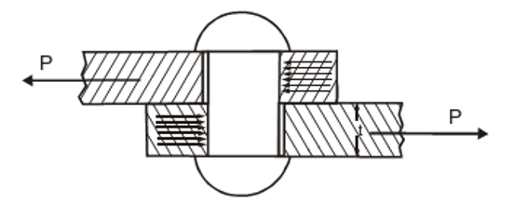
Rivet Crushing Analysis
Steam School Notes | Chapter 12: Riveted Joints
Crushing Failure Mode and Calculation
Crushing Mechanism
As load applied to riveted joint, rivet bears against wall of hole
If bearing pressure becomes excessive, rivet material may be crushed
Differs from shearing: crushing is compression where rivet bears against plate; shearing is cutting across cross-section
Area resisting crushing is projected contact area of rivet:
A_{c} = d · t
Crushing Equations
Crushing strength: P_{c} = σ_{c} · d · t, where σ_{c} is allowable crushing stress of rivet material, d is rivet diameter, t is plate thickness
Example with σ_{c} = 95,000 psi, d = 0.75 in, t = 0.375 in: P_{c} = 26,718.75 lbf
Increasing either rivet diameter or plate thickness increases resistance to crushing

Slide 9
Plate Margin Tearing Analysis
Steam School Notes | Chapter 12: Riveted Joints
Margin Tearing Failure Mode and Calculation
Margin Tearing Mechanism
Rivet placed too close to edge of plate may tear out material between hole and edge
Resisting area consists of two sections of metal, one on each side of rivet hole
Margin Tearing Equations
Total area resisting failure: A_{ms} = 2 · m · t, where m is margin and t is plate thickness
Load required to tear plate margin: P_{ms} = 2 · m · t · σ_{t}, where σ_{t} is tensile strength of plate material
Example with m = 2 in, t = 0.375 in, σ_{t} = 60,000 psi: P_{ms} = 90,000 lbf
Prevention: rivets must be located sufficiently far from plate edge

Slide 10
Summary of Riveted Joint Failure Modes
Steam School Notes | Chapter 12: Riveted Joints
Comparison of All Failure Modes
Failure Mode | Formula | Load (lbf)
Tearing of plate | P_{t} | 61,875
Shearing of rivet | P_{s} | 19,438.61
Crushing of rivet | P_{c} | 26,718.75
Crushing of plate margin | P_{ms} | 90,000
Joint Strength Determination
Safe load of joint governed by weakest failure mode, requiring smallest load to produce failure
Well-designed joint proportions rivets, pitch, margin, and plate thickness so no single mode is excessively weaker
Practical design limited by availability of standard sizes:
  plate thicknesses and rivet diameters available in standard increments;
  rivet spacing limited by practical measurement
Designer must select dimensions from available materials and verify resulting joint is safe and suitable for service

Slide 11
Assumptions in Riveted Joint Analysis
Steam School Notes | Chapter 12: Riveted Joints
Limitations and Simplifications
Equations developed based on simplifying assumptions; real riveted joints do not satisfy all assumptions exactly
In practice:
  loads not perfectly distributed,
  rivets may bend slightly,
  stress concentrations exist around holes,
  friction between plates may carry part of load
Assumptions provide calculations sufficiently accurate for practical boiler design and form basis of traditional riveted-joint analysis

Slide 12
Joint Efficiency Calculation
Steam School Notes | Chapter 12: Riveted Joints
Efficiency Definition and Formula
Efficiency Concept
Load carrying capacity of solid plate: P_{l} = p · t · σ_{t}, where p is pitch, t is thickness, σ_{t} is tensile strength
Solid plate stronger than riveted plate because rivet holes remove material
Joint efficiency: ratio of strength of riveted joint to strength of unperforated plate
Efficiency Calculation
Formula: E = min(P_{t}, P_{s}, P_{c}, P_{ms}) / P_{l}
Uses minimum of calculated failure mode strengths because joint can only carry load of weakest failure mode
Ideal design achieves equal strengths in all modes; in practice, equal strengths cannot usually be achieved due to standard size limitations
Application
Joint efficiencies usually stated on boiler blueprints
When detailed calculations or original drawings unavailable, typical efficiencies may be used
Shell plate between seams has full strength; seams do not; joint efficiency used when determining strength and maximum allowable working pressure

Slide 13
Typical Riveted Joint Efficiencies
Steam School Notes | Chapter 12: Riveted Joints
Standard Efficiencies by Joint Type
Type of Joint | Efficiency (%)
Lap Seam, Single Riveted | 58
Lap Seam, Double Riveted | 74
Lap Seam, Triple Riveted | 78
Butt Strap, Double Riveted | 82
Butt Strap, Triple Riveted | 88
Butt Strap, Quadruple Riveted | 94
Joint efficiency improves with additional rivet rows and with butt joint configurations relative to lap joints, reflecting reduced stress concentrations and more efficient load paths.

