Slide 1
Chapter Overview: Power Measurement
Steam School Notes | Chapter 23: Measurement of Power
Introduction to power measurement concepts in steam engineering
Power is the rate at which work is performed.
During the steam age, power measurements compared engines and evaluated performance.
Early engineers compared engine work to work performed by horses.
This led to the unit known as horsepower, standard for over a century.
Key Topics
Historical development of horsepower as a practical unit
Multiple horsepower definitions for different applications
Measurement methods: drawbar, pulley, and indicated horsepower
De Prony brake for measuring torque and shaft power
Indicator diagrams for estimating cylinder power

Slide 2
Historical Origins: Horsepower Defined
Steam School Notes | Chapter 23: Measurement of Power
Development of horsepower as a measure of engine power
Early Comparisons
Thomas Savery promoted steam engines as replacements for teams of horses in mines and mills.
James Watt refined the concept, seeking a practical and consistent comparison method.
Both engineers addressed the problem of removing water from coal mines.
Mine owners understood the cost of maintaining horses, making horsepower a practical measure of value.
Watt's Definition
One mechanical horsepower = 33,000 foot-pounds of work per minute
Equivalently: 550 foot-pounds of work per second
A 1-horsepower engine can raise 33,000 pounds one foot in one minute
Or raise 330 pounds 100 feet in one minute

Slide 3
Multiple Horsepower Definitions
Steam School Notes | Chapter 23: Measurement of Power
Different horsepower measurements for various applications
Horsepower Variants
Electrical horsepower: equivalent to 746 watts of electrical power
Boiler horsepower: rating of a boiler's steam-generating capacity
Indicated horsepower: power developed within engine cylinders
Brake horsepower: power available at the engine shaft
Drawbar horsepower: useful pulling power at drawbar of locomotive or traction engine
Important Distinction
The horsepower defined by Watt is now known as mechanical horsepower.
Engineers developed additional ratings for specific purposes, each measuring different aspects of performance.
Two machines with same horsepower figure may not refer to same measurement.
Steam engineers must be careful when discussing horsepower ratings, as the same figure may refer to different measurements depending on context.

Slide 4
Horsepower as a Standard Unit
Steam School Notes | Chapter 23: Measurement of Power
Understanding horsepower as a practical comparison metric
Conceptual Basis
Horsepower should not be regarded as measured output of a particular horse.
Actual horse power depends on size, conditioning, duration of work, and ground conditions.
Watt's horsepower is a standard unit allowing machines and animals to be compared on common scale.
Practical measurement focuses on work that can be performed rather than just horsepower number.
Practical Applications
Farmers ask: how many plow bottoms can be pulled through a field
Locomotive engineers ask: how many tons can be hauled up a grade
Such questions lead naturally to concept of drawbar horsepower

Slide 5
Drawbar and Pulley Horsepower
Steam School Notes | Chapter 23: Measurement of Power
Measuring power delivered to loads and stationary machinery
Drawbar Horsepower (DBHP)
For traction engines, tractors, and locomotives, most important measure is power available for useful work.
Drawbar horsepower is power delivered through drawbar when pulling a load.
Determined by measuring: pulling force at drawbar and speed of load movement.
Power is simply product of force and velocity.
DBHP Equation
For measurements in pounds force and miles per hour: hp_{d} = (F×v)/375 where
  F = drawbar pull (lb)
  v = speed (mph)
Constant 375 derived from Watt's definition: 375 = (33000×60)/5280

Slide 6
Drawbar Horsepower Example
Steam School Notes | Chapter 23: Measurement of Power
Calculating drawbar power from force and speed
Worked Example
A tractor produces drawbar pull of 2,025 pounds at 5 miles per hour.
Drawbar horsepower = (2025 × 5)/375 = 27 hp

Slide 7
Pulley Horsepower and Power Loss
Steam School Notes | Chapter 23: Measurement of Power
Power delivered through belt pulleys to stationary machinery
Pulley Horsepower
Traction engines performed second role as stationary power plants.
When operating threshing machine, sawmill, elevator, or pump, power delivered through belt pulley.
This useful output known as pulley horsepower.
Power lost in gears, bearings, wheels, wheel slip, and rolling resistance.
Drawbar horsepower always less than power available at engine shaft.
Rating Implications
Same machine may have different pulley and drawbar horsepower ratings.
Difference depends on how power is used and mechanical losses involved.

Slide 8
Marketing Power Designations
Steam School Notes | Chapter 23: Measurement of Power
How horsepower ratings were used in equipment advertising
Steam Traction Engine Ratings
Traction engines commonly carried two power ratings (e.g., Case 18–50, Case 22–65, Case 28–80).
First number represented boiler horsepower: measure of boiler's steam-generating capacity.
Second number represented belt (pulley) horsepower: useful power for driving stationary machinery.
Gasoline Tractor Ratings
Early gasoline tractors adopted different convention.
Machines advertised using drawbar horsepower and belt horsepower.
Example: Case 20–40 indicated approximately 20 drawbar hp and 40 belt hp.
Ratings reflected two principal jobs: pulling implements and operating stationary machinery.
Horsepower ratings in advertisements and engine nameplates must be interpreted carefully. They may refer to boiler, indicated, brake, pulley, or drawbar horsepower depending on manufacturer and period.

Slide 9
Testing Engines: The Winnipeg Tractor Trials
Steam School Notes | Chapter 23: Measurement of Power
Scientific measurement methods for comparing engine performance
Historical Context
Winnipeg Tractor Trials held between 1908 and 1913.
Originally conceived as industrial exhibition at principal railhead serving prairie provinces.
Agricultural researchers from Manitoba Agricultural College introduced scientific testing methods.
Event evolved from machinery exhibition into controlled engineering experiment.
Became forerunner of better-known Nebraska Tractor Tests after First World War.
Key Innovation
Independently verified performance figures carried more weight than advertising claims.
Tests required way to measure power delivered at engine shaft: measurement of torque.
Solution developed by French engineer Gaspard de Prony nearly a century earlier.

Slide 10
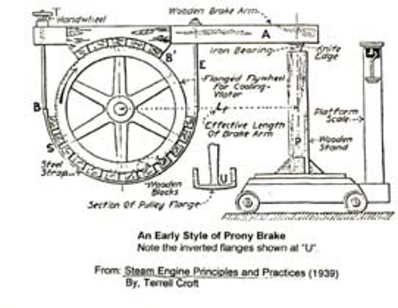
The De Prony Brake: Design and Function
Steam School Notes | Chapter 23: Measurement of Power
Measuring torque and shaft power using friction brake method
Basic Principle
De Prony brake developed by Gaspard Clair François Marie Riche de Prony in 1826.
Simple device capable of measuring torque produced by rotating shaft.
Remained widely used method throughout nineteenth and early twentieth centuries.
How It Works
Friction brake wrapped around rotating drum or flywheel.
Friction between brake and rotating surface attempts to carry brake assembly around with shaft.
Lever arm attached to brake resists this motion.
Force at end of lever measured using scale or force-measuring device.
Arrangement converts engine torque into two directly measurable quantities: force and distance.

Slide 11
Torque and Power Relationships
Steam School Notes | Chapter 23: Measurement of Power
Mathematical relationships between torque, speed, and horsepower
Torque Equation
Torque T = F × L, where F = measured force, L = length of brake arm.
Each revolution, measured force travels distance equal to circumference = 2πL.
If shaft rotates at r rpm, distance traveled in one minute = 2πL×r.
Work performed each minute = F × 2πL × r foot-pounds.
Horsepower from Brake Measurement
Horsepower = (2πFLr)/33000, where L in feet, r in rpm, F in pounds.
Allows engineers to determine brake horsepower using only scale, lever arm, and tachometer.

Slide 12
Convenient Shortcut for De Prony Calculations
Steam School Notes | Chapter 23: Measurement of Power
Simplified horsepower calculations using practical brake arm length
Arm Length Optimization
Practical engineers preferred convenient arithmetic rather than complicated calculations.
If brake-arm length chosen so 2πL is convenient multiple of 33,000, equation simplifies.
Commonly used arm length of approximately 63 inches (5.25 ft) produces convenient relationship.
Simplified equation: hp = (r × F)/1000, where r in rpm, F in pounds.
Practical Rule
At 250 rpm, each 4 pounds indicated on scale corresponds to approximately 1 horsepower.
Simple rule allowed engineers and test officials to determine power quickly without extensive calculation.
Made de Prony brake particularly useful at field tests like Winnipeg Tractor Trials.

Slide 13
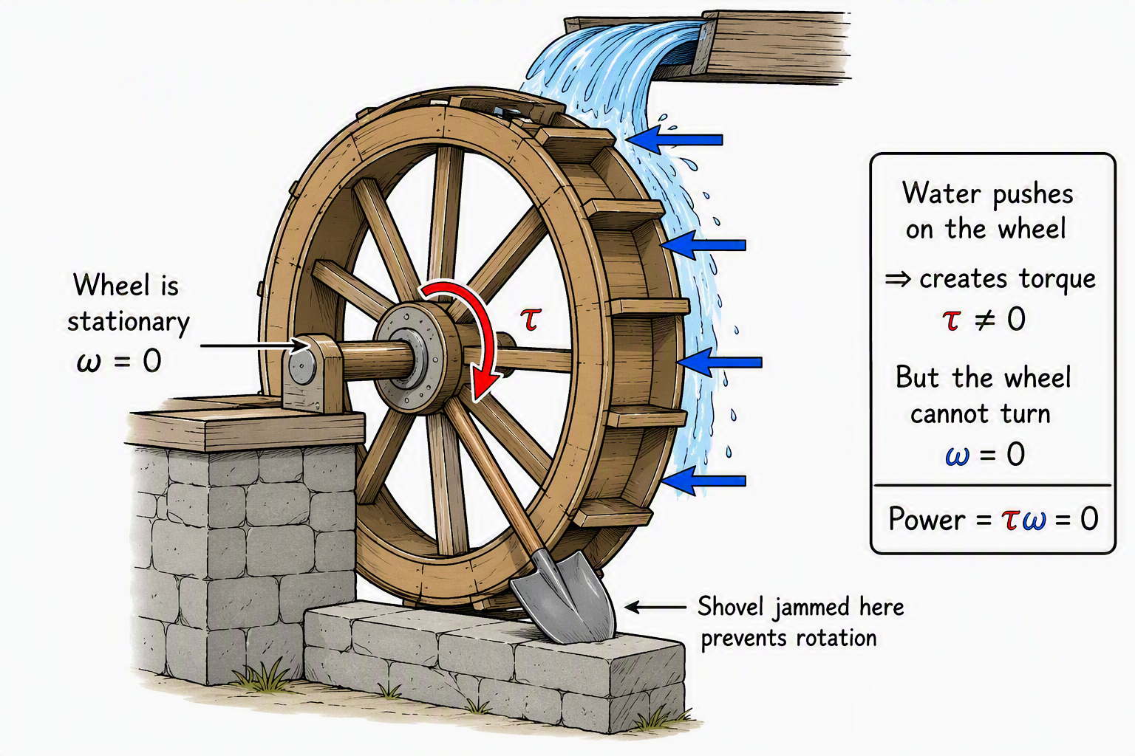
Distinguishing Torque and Horsepower
Steam School Notes | Chapter 23: Measurement of Power
Understanding the difference between twisting force and rate of work
Key Differences
Torque is a twisting force. Applied at end of wrench on bolt produces torque.
Horsepower is rate at which work is performed.
Steam engine may produce large torque while turning slowly.
Another engine may produce smaller torque but turn much faster.
Both may produce same horsepower.
Water Wheel Analogy
Torque answers question: 'How hard is it pushing?'
Horsepower answers question: 'How fast is work being done?'
Engine producing torque but not rotating does no work.
Horsepower at zero speed is zero regardless of torque produced.

Slide 14
Practical De Prony Brake Implementation
Steam School Notes | Chapter 23: Measurement of Power
Engineering solutions for heat management in brake testing
Heat Management
Large horsepower measurements generate enormous quantities of heat.
Simple friction band design requires both lubrication and cooling.
Historically, beef tallow commonly used as lubricant for brake band.
Tallow reduced wear, prevented chatter, provided reasonably consistent coefficient of friction.
Modern Cooling Methods
Many modern Prony brakes use hollow brake wheel resembling steel tire.
Cooling water continuously introduced into wheel while operating.
Centrifugal force distributes water around inside of rotating wheel.
Water absorbs heat generated by friction; internal pickup collects and removes water.
Simple arrangement allows substantial power absorption without overheating.

Slide 15
Indicated Horsepower: Cylinder Power Measurement
Steam School Notes | Chapter 23: Measurement of Power
Estimating power from pressure measurements within engine cylinder
Indicator Method
De Prony brake determines power by measuring torque at engine shaft.
Steam engineer has another option: measure pressure within cylinder using steam indicator.
Possible to estimate power produced directly by piston: indicated horsepower (IHP).
Indicator diagram provides information needed to estimate average pressure during stroke.
Pressure to Power
Once average pressure known, force on piston calculated from: Force = Pressure × Area.
Work during one stroke: Work = Force × Distance.
Multiply by number of strokes per minute gives horsepower within cylinder.

Slide 16
Boiler Pressure vs. Cylinder Pressure
Steam School Notes | Chapter 23: Measurement of Power
Understanding pressure losses between boiler and piston
Pressure Losses
Boiler pressure gauge measures pressure available within boiler.
This is not necessarily same pressure acting on piston.
Steam passes through dry pipe, throttle, governor, steam chest, valve passages, admission port.
Each restriction causes pressure drop; engineers call these losses 'wire drawing'.
Effective Cylinder Pressure
Pressure available to perform work in cylinder generally lower than boiler gauge pressure.
Indicator card records pressure actually acting on piston.
Indicator card more useful tool for determining engine power.
Boiler gauge tells engineer what pressure is available.
Indicator card tells engineer what pressure piston actually receives.

Slide 17
PLAN Formula for Indicated Horsepower
Steam School Notes | Chapter 23: Measurement of Power
Simple approximation method for calculating cylinder power
The PLAN Formula
Complete analysis requires exact area enclosed by indicator diagram.
Practical estimate obtained by replacing curved expansion line with simple geometric shapes.
Formula: HP = (PLAN)/33000
where P = effective cylinder pressure (psi), L = stroke length (ft), A = piston area (in²), N = power strokes per minute.
Example Case 22-65 Engine
Operating conditions: cylinder pressure 100 psi, cutoff 33% of stroke, stroke 11 in, bore 10 in, speed 225 rpm.
Assume full cylinder pressure first one-third of stroke, then falls linearly to zero.
Mean effective pressure P = (1/3)(100) + (2/3)(50) ≈ 67 psi.
Stroke length L = 11/12 = 0.917 ft.
Piston area A = π(10/2)² = 78.5 in².
Power strokes per minute N = 2 × 225 = 450 (double-acting engine).
HP = (67 × 0.917 × 78.5 × 450)/33000 ≈ 65.5 hp.

Slide 18
Indicator Diagram Analysis: Practical Results
Steam School Notes | Chapter 23: Measurement of Power
Accuracy of simple approximation method for power estimation
Approximation Accuracy
Using simple approximation of indicator diagram, estimated output approximately 65 horsepower.
Remarkably close to rated output of Case 22-65.
Result illustrates power of indicator diagram method.
Significance
By estimating mean effective pressure and applying PLAN formula, steam engineer obtains accurate estimate.
Uses only few dimensions and straightforward arithmetic.
Long before electronic sensors and computerized data acquisition, engineers analyzed performance.
Analysis used only pressure measurements, geometry, and arithmetic.

Slide 19
Summary: Three Methods of Power Measurement
Steam School Notes | Chapter 23: Measurement of Power
Overview of drawbar, brake, and indicated horsepower approaches
Three Measurement Methods
Drawbar horsepower measures power delivered to the load.
Brake horsepower measures power delivered at the shaft.
Indicated horsepower measures power produced within the cylinder.
Comprehensive Picture
Each method tells part of the story.
Together they provide complete understanding of engine performance and efficiency.
Simple indicator diagram combined with engine dimensions allows steam engineer to estimate power with surprising accuracy using only pressure measurements, geometry, and arithmetic.

