Slide 1
Pipe Markings and What They Mean
Steam School Notes | 16 Piping
Pipe markings identify material, size, and manufacturing details
• ABC PIPE
• ASTM A106 GR B
• ASME SA106 GR B
• NPS 2 SCH 80
• SMLS
• HEAT 12345

Slide 2
Common Pipe Markings
Steam School Notes | 16 Piping
Markings identify manufacturer, specification, grade, size, schedule, method, and heat number
Term | Definition
Manufacturer Name | Identifies who produced the pipe
ASTM / ASME Specification | Identifies material standard; ASME designation adopted for pressure-retaining equipment
Grade | Identifies material grade; Grade B commonly used in steam piping
NPS (Nominal Pipe Size) | Indicates nominal pipe size such as 1", 1-1/2", or 2"
Schedule | Indicates wall thickness such as Schedule 40 or Schedule 80
Manufacturing Method | ERW (Electric Resistance Welded), SMLS (Seamless), EFW (Electric Fusion Welded)
Heat Number | Unique identifier linking pipe to steel mill production records and material test reports

Slide 3
Why the Heat Number Matters
Steam School Notes | 16 Piping
Heat number links pipe to Material Test Report confirming compliance
• Heat number identifies unique batch of steel from production
• Material Test Report (MTR) contains material properties and test results
• Matching heat number to MTR verifies correct material was supplied
• Inspector can confirm specification, chemical composition, and mechanical test results
Heat number is the link between physical pipe and documentation proving its compliance.

Slide 4
Why Pipefitters Should Care
Steam School Notes | 16 Piping
Preserving pipe markings maintains material traceability
• Markings indicate size, wall thickness, material, and manufacturing method
• Markings provide traceability to Material Test Report
• Good shops transfer heat number to cut pieces to preserve traceability
• Without markings, proving material compliance becomes difficult or impossible
Pipe markings are its identity card; preserving them is as important as making a good fit-up or weld.

Slide 5
Schedule 40 vs. Schedule 80
Steam School Notes | 16 Piping
Outside diameter constant; schedule determines wall thickness and inside diameter
• Nominal pipe size (NPS) is a designation, not actual measurement
• For given NPS, outside diameter (OD) remains constant regardless of schedule
• As wall thickness increases, inside diameter (ID) decreases
• Schedule 80 has thicker walls, greater pressure tolerance, and smaller flow area

Slide 6
Common Small-Bore Pipe Dimensions
Steam School Notes | 16 Piping
Pipe dimensions vary by NPS and schedule
NPS | OD (in.) | Sch 40 Wall (in.) | Sch 40 ID (in.) | Sch 80 Wall (in.) | Sch 80 ID (in.)
1/2" | 0.840 | 0.109 | 0.622 | 0.147 | 0.546
3/4" | 1.050 | 0.113 | 0.824 | 0.154 | 0.742
1" | 1.315 | 0.133 | 1.049 | 0.179 | 0.957
1-1/4" | 1.660 | 0.140 | 1.380 | 0.191 | 1.278
1-1/2" | 1.900 | 0.145 | 1.610 | 0.200 | 1.500
2" | 2.375 | 0.154 | 2.067 | 0.218 | 1.939

Slide 7
Internal Flow Area Reduction
Steam School Notes | 16 Piping
Schedule 80 pipe has significantly smaller flow area than Schedule 40
NPS | Sch 40 Area (in²) | Sch 80 Area (in²) | Reduction
1/2" | 0.304 | 0.234 | 23.00%
3/4" | 0.533 | 0.432 | 18.90%
1" | 0.864 | 0.719 | 16.80%
1-1/4" | 1.496 | 1.283 | 14.20%
1-1/2" | 2.036 | 1.767 | 13.20%
2" | 3.356 | 2.953 | 12.00%

Slide 8
Flow Area Impact on Velocity
Steam School Notes | 16 Piping
Smaller flow area increases steam velocity and pressure loss
• Schedule 80 pipe carries steam 20-30% faster than Schedule 40 for same flow rate
• Increased velocity results in greater pressure loss, noise, and potential erosion
• 1/2" Schedule 80 carries steam about 30% faster than 1/2" Schedule 40
• 1" Schedule 80 carries steam about 20% faster than 1" Schedule 40
• V = Q / A
• Reduction in area always results in increase in velocity when flow rate remains constant
A 1/2" Schedule 80 pipe has roughly 23% less flow area than a 1/2" Schedule 40 pipe; even at 2" there is about 12% reduction. Pipe schedule affects pressure rating and system performance.

Slide 9
Threaded Pipe Connections
Steam School Notes | 16 Piping
Threaded connections created by helical grooves machined into pipe and fitting
• Threaded pipe common before welded systems became standard
• Still frequently used for small-bore steam piping (2" NPS and below)
• Mating threads pull components together creating pressure-tight joint
• Connection tightens as pipe is screwed into fitting

Slide 10
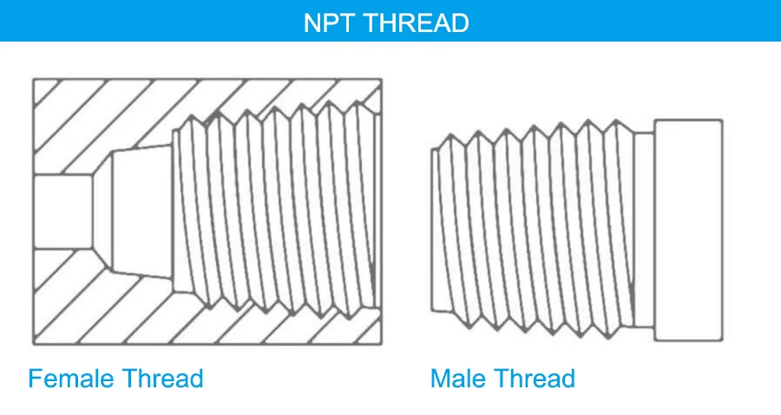
National Pipe Thread (NPT)
Steam School Notes | 16 Piping
NPT threads are tapered and wedge together under tightening
• Most common thread form used in North America is National Pipe Taper (NPT)
• NPT threads are tapered; both male and female become narrower toward end
• As connection tightens, threads wedge together creating seal
• Taper approximately 1 in 16, meaning diameter changes 1 inch over 16 inches

Slide 11
How Threads Are Cut
Steam School Notes | 16 Piping
Pipe threads cut using manual ratchet or powered threading machine
• Cut the pipe square
• Ream the inside to remove burrs
• Secure the pipe in the threader
• Apply cutting oil
• Advance the die head onto the pipe
• Cut until the thread reaches proper length
• Clean and inspect the threads
Properly cut thread will:
• Have a smooth finish
• Show no torn or flattened crests
• Allow hand-tight engagement for several turns
• Tighten progressively as taper engages

Slide 12
Thread Engagement and Seal Location
Steam School Notes | 16 Piping
Seal forms along flanks of tapered threads as they wedge together
• Common misconception: seal occurs at end of pipe
• Seal forms along flanks of tapered threads during tightening
• Metal-to-metal contact and slight deformation produce primary seal
• Thread sealants lubricate and fill microscopic leak paths

Slide 13
Schedule 80 Threads Compared to Schedule 40
Steam School Notes | 16 Piping
Thicker walls produce deeper, stronger threads in Schedule 80
• Schedule 80 pipe develops deeper, stronger threads than Schedule 40
• More metal remains beneath thread root in Schedule 80
• Thread strength increases with thicker walls
• Resistance to thread damage improves
• Connection better suited to higher-pressure service
Schedule 80 threaded piping often specified where pressure, temperature, or mechanical stresses exceed Schedule 40 limits.

Slide 14
Thread Sealants
Steam School Notes | 16 Piping
Sealants fill leak paths and lubricate threads during assembly
Thread sealants serve two purposes:
• Fill spiral leak paths
• Lubricate the threads during assembly
Common sealants include:
• PTFE (Teflon) tape
• Pipe dope (thread compound)
• PTFE tape combined with pipe dope

Slide 15
NPTF (Dryseal Pipe Thread)
Steam School Notes | 16 Piping
NPTF threads mechanically seal without tape or paste
• NPTF (National Pipe Taper Fuel) also called Dryseal pipe thread
• Thread roots and crests deliberately crush and deform during tightening
• Metal-to-metal deformation eliminates spiral leak path
• Allows mechanical dry seal without requiring tape or paste
• Lubricant still often used to ease installation

Slide 16
Why Overtightening Is a Problem
Steam School Notes | 16 Piping
Excessive torque damages fittings and threads
• Crack cast-iron fittings
• Distort valve bodies
• Damage thread profiles
• Make future disassembly extremely difficult
Excessive torque on threaded joints can crack cast-iron fittings and distort valve bodies.
The objective is not maximum torque; it is proper thread engagement and sealing.

Slide 17
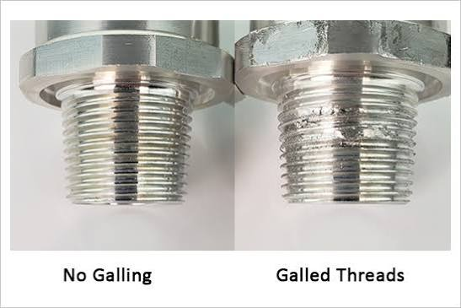
Galling in Threaded Joints
Steam School Notes | 16 Piping
Galling is severe adhesive wear causing metal surfaces to cold-weld together
• Galling occurs when two metal surfaces slide under pressure
• Microscopic welds form between threads, then tear apart
• Material transfers between threads in practical metal-to-metal seizure
• Pipe dope and PTFE tape are lubricants that reduce friction and prevent galling

Slide 18
Why Galling Occurs
Steam School Notes | 16 Piping
Galling promoted by high pressure, lack of lubrication, and soft materials
Galling promoted by:
• High contact pressure
• Lack of lubrication
• Repeated assembly and disassembly
• Similar metals rubbing together
• Soft, ductile materials
Particularly common with:
• Stainless-steel fasteners
• Stainless threaded pipe fittings
• Brass and bronze components
• High-torque threaded connections

Slide 19
What Galled Threads Look Like
Steam School Notes | 16 Piping
Galled threads appear rough, smeared, and may be impossible to turn
• Rough and torn appearance
• Smeared or scored surface
• Covered with metallic debris
• Difficult or impossible to turn
• In severe cases, threads effectively seize together

Slide 20
Why Pipefitters Care About Galling
Steam School Notes | 16 Piping
Friction without lubrication causes thread damage and assembly problems
Without a lubricant:
• More torque is required
• Threads can tear or deform
• Proper engagement may not be achieved
• Disassembly becomes difficult years later
Thread compounds are valuable because they reduce friction, prevent galling, and allow proper thread engagement.

Slide 21
Functions of Pipe Dope and PTFE Tape
Steam School Notes | 16 Piping
Thread sealants fill gaps, lubricate, and minimize damage during assembly
• Fill microscopic leak paths
• Lubricate the threads
• Reduce friction during assembly
• Minimize galling and thread damage
• Allow deeper thread engagement before excessive torque develops
A lubricated NPT joint typically tightens farther than a dry joint using the same wrench force, resulting in a better mechanical seal and less damage.

Slide 22
Threaded Connections Summary
Steam School Notes | 16 Piping
Proper thread sealing requires cutting, engagement, and avoiding overtightening
• Tapered male and female threads wedge together as tightened
• Threads provide mechanical strength and primary seal
• Thread sealant fills microscopic leak paths
• Proper thread cutting, adequate engagement, and avoiding overtightening are essential
A threaded connection seals because tapered threads wedge together, threads provide strength, and sealant fills microscopic leak paths.

