Slide 1
Chapter 24 Overview
Steam School Notes | Chapter 24: Valve Maintenance
Valve Maintenance Fundamentals
Globe valve design: body, bonnet, stem, disc (plug)
Disc selection based on pressure, temperature, service conditions
Stem packing materials and bonnet-stem interface maintenance
Valve seat reconditioning for persistent leakage

Slide 2
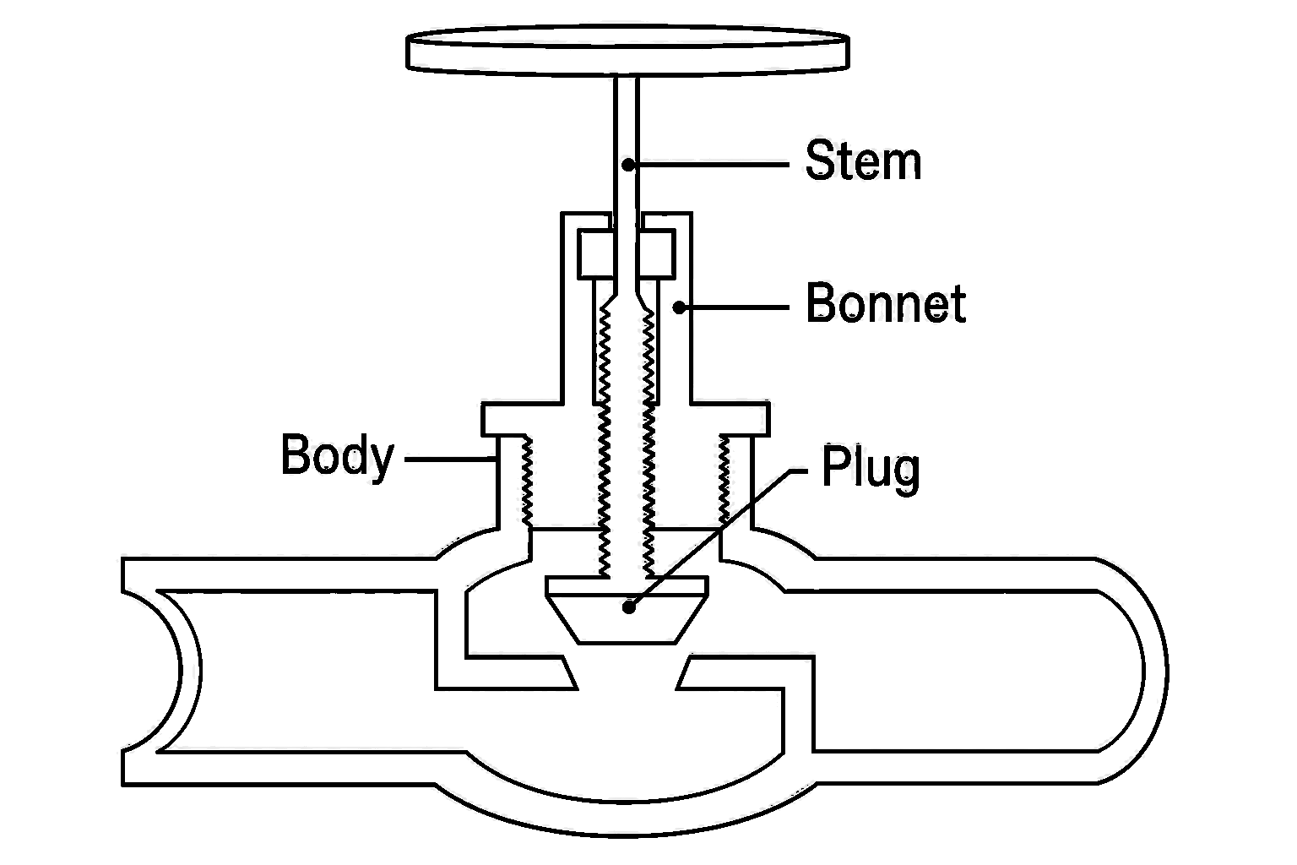
Globe Valve Components and Operation
Steam School Notes | Chapter 24: Valve Maintenance
Globe Valve Structure
Globe valve: linear-motion valve used to start, stop, and regulate fluid flow
Main components: body, bonnet, stem, plug (disc)
Operation: handwheel turns stem, causing disc to move toward or away from valve seat
Bonnet: contains stem threads and packing assembly
Packing: seals around stem to prevent leakage while allowing stem movement
Precise flow control and reliable shutoff
Common in steam, condensate, and process systems

Slide 3
Disc Materials for Low- and Medium-Pressure Steam
Steam School Notes | Chapter 24: Valve Maintenance
PTFE and Common Disc Materials
PTFE (Teflon) discs: most common for steam below 300 psi
Excellent shutoff performance, simple replacement, corrosion resistant
Bronze discs: water service and older low-pressure designs
Good corrosion resistance but less effective sealing than PTFE

Slide 4
Disc Materials for High-Temperature and High-Pressure Service
Steam School Notes | Chapter 24: Valve Maintenance
Stainless Steel and Specialized Disc Materials
Stainless Steel: used where PTFE temperature limits exceeded
Hardened Stainless Steel: frequent operation or abrasive service
Stellite-Faced: high-pressure and high-temperature steam service
Resists erosion, wire drawing, and seat damage
Disc Replacement Criteria
Replace when worn, scored, cracked, or distorted
Replace when valve leaks through seat while fully closed

Slide 5
Stem Packing Materials
Steam School Notes | Chapter 24: Valve Maintenance
Packing Selection by Service
Graphite Packing: most common for steam service, excellent high-temperature performance, low friction, long service life
PTFE (Teflon) Packing: excellent chemical resistance, common in water and chemical service, limited for high-temperature steam
Graphite/PTFE Combination: combines chemical resistance with improved temperature capability
Packing material must match operating temperature, pressure, and fluid

Slide 6
Adjusting Packing for Stem Leakage
Steam School Notes | Chapter 24: Valve Maintenance
Initial Response to Stem Leakage
Stem leakage may not require packing replacement
Normal wear can be compensated by tightening gland nut
Tighten the gland nut a small amount
Operate the valve several times
Check whether leakage has stopped
Repeat adjustment as necessary if leakage persists
If gland nut cannot be tightened further or leakage continues, inspect and replace packing

Slide 7
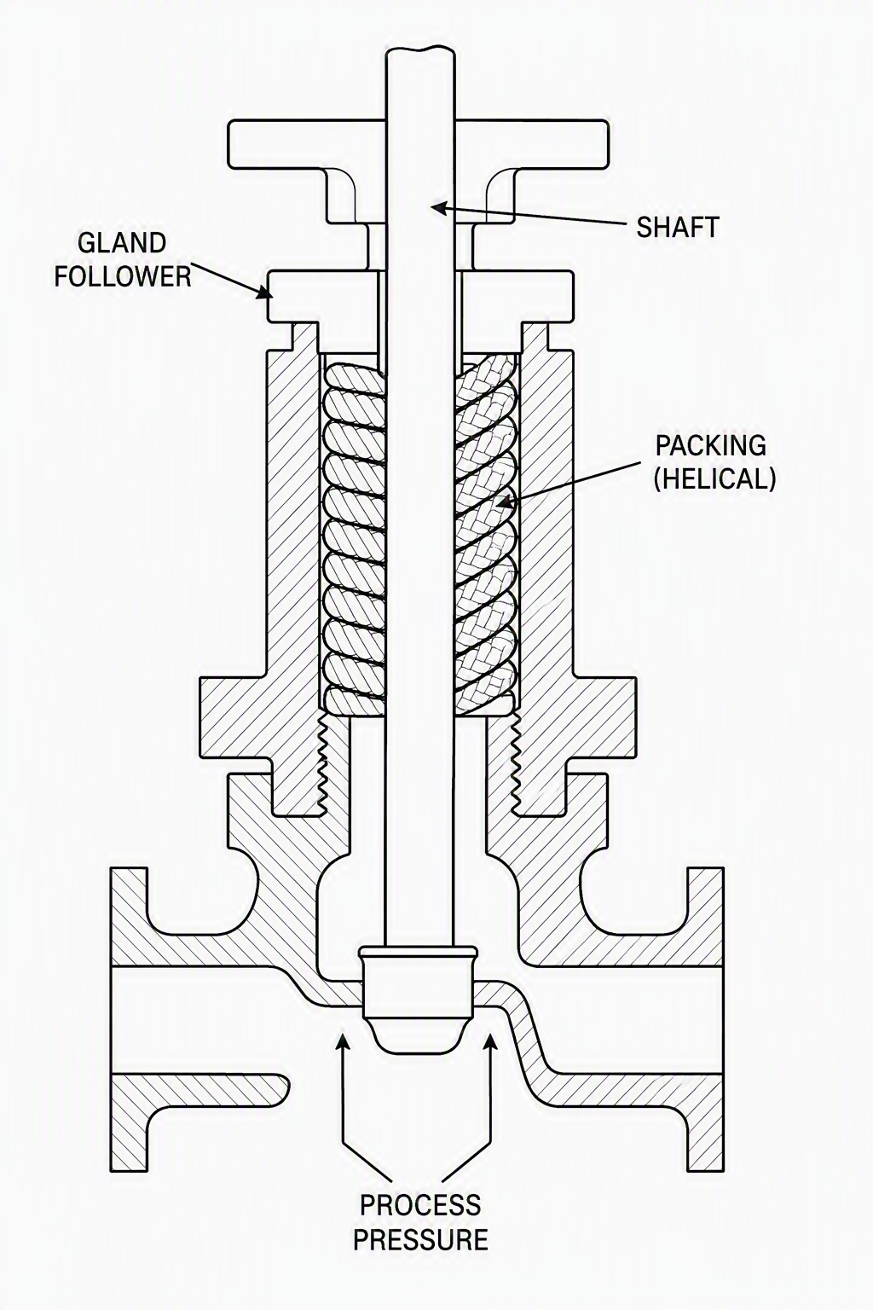
Bonnet-Stem Interface Components
Steam School Notes | Chapter 24: Valve Maintenance
Stuffing Box Assembly
Stuffing box: annular space between valve stem and bonnet, filled with packing material
Gland follower: compresses the packing
Gland nut(s): provide force to maintain tight seal around stem
Packing installed as preformed rings or continuous packing cord
Interface design varies by valve model

Slide 8
Repacking Procedure: Isolation and Disassembly
Steam School Notes | Chapter 24: Valve Maintenance
Steps 1-2: Preparation and Loosening Gland Assembly
Step 1: Isolate the Valve
Close and isolate the valve from the system
Apply lockout/tagout procedures
Depressurize and drain the valve
Verify that pressure has been removed before beginning work
Step 2: Loosen the Gland Assembly
Loosen the gland nut evenly
Lift off or withdraw the gland follower
Expose the stuffing box

Slide 9
Repacking Procedure: Packing Removal and Inspection
Steam School Notes | Chapter 24: Valve Maintenance
Steps 3-4: Old Packing Removal and Component Inspection
Step 3: Remove Old Packing
Use a packing puller to remove all old packing material
Remove packing completely from the stuffing box
Clean the stuffing box thoroughly
Step 4: Inspect Components
Stem: check for scoring or wear
Stuffing box: check for corrosion or damage
Gland follower: check for distortion
Replace damaged components before installing new packing

Slide 10
Repacking Procedure: Preparation of New Packing
Steam School Notes | Chapter 24: Valve Maintenance
Step 5: New Packing Selection and Preparation
General Preparation
Select the correct packing material for the service
Determine packing format: preformed rings or continuous rope packing
For Preformed Rings
Verify rings are correct size for valve stem and stuffing box
Inspect rings for damage before installation
For Rope Packing
Clean the stem thoroughly
Wind packing around stem in stuffing-box area
Apply enough turns to fill stuffing box when compressed
Ensure even wrapping without twists

Slide 11
Repacking Procedure: Packing Installation
Steam School Notes | Chapter 24: Valve Maintenance
Step 6: Installation of Preformed Rings and Rope Packing
Using Preformed Rings
Install one ring at a time
Seat each ring firmly in the stuffing box
Stagger ring joints approximately 90° to 120° apart
Continue until stuffing box is filled to original packing height
Using Rope Packing
Position the wound packing around the stem
Install the gland follower
Tighten the gland nut evenly
Gland follower compresses packing into stuffing box as it moves downward
Continue tightening until packing is firmly seated and stem moves freely

Slide 12
Repacking Procedure: Final Adjustment and Return to Service
Steam School Notes | Chapter 24: Valve Maintenance
Steps 7-8: Packing Adjustment and Valve Commissioning
Step 7: Adjust the Packing
Verify the gland follower is seated correctly
Tighten gland nut evenly
Apply only enough compression to seat the packing
Ensure the stem still operates smoothly
Step 8: Return the Valve to Service
Slowly restore system pressure
Cycle the valve several times
Check for stem leakage
Tighten the gland slightly if leakage occurs
Avoid overtightening: excessive packing pressure increases operating torque and accelerates stem wear

Slide 13
Diagnosing Valve Leakage
Steam School Notes | Chapter 24: Valve Maintenance
Key Point: Distinguishing Stem and Seat Leakage
Stem leakage does not necessarily indicate failed packing
First attempt: tighten gland nut slightly
If adjustment ineffective: inspect and replace packing
Seat leakage (fully closed valve) indicates disc and seat wear or damage
Leakage location determines maintenance action: stem leakage first responds to gland adjustment, while through-seat leakage requires disc and seat inspection.

Slide 14
Valve Seat Reconditioning: Assessment and Disassembly
Steam School Notes | Chapter 24: Valve Maintenance
Steps 1-2: Seat Inspection and Grinding Preparation
Continued leakage after disc replacement indicates seat damage
Minor damage can often be repaired by reconditioning
Step 1: Disassemble the Valve
Isolate and depressurize the valve
Remove the bonnet and disc assembly
Inspect the seat for wear, scoring, or pitting
Step 2: Dress the Seat
Mount suitable seat-grinding stone in power drill
Position stone square with valve seat throughout operation
Grind lightly using moderate speed and pressure
Remove only enough material to restore smooth, continuous seating surface
Periodically inspect to avoid excessive material removal

Slide 15
Valve Seat Reconditioning: Cleaning and Reassembly
Steam School Notes | Chapter 24: Valve Maintenance
Steps 3-4: Seat Inspection and Return to Service
Step 3: Clean and Inspect
Remove all grinding residue
Inspect the seating surface
Verify all scoring and surface defects have been removed
Step 4: Reassemble and Test
Reinstall the disc and bonnet assembly
Return the valve to service
Check for leakage when valve is fully closed
If satisfactory seat surface cannot be restored, replace seat or valve

