Slide 1
Chapter 20 Summary
Steam School Notes | Chapter 20: Material Test Reports (MTRs)
Material Test Reports and traceability
MTR is a document that provides evidence that a material meets a specified standard
Used for pipe, fittings, flanges, valves, pressure vessel components, and structural materials
Answers the question: How do we know this material is what the supplier claims it is?
Provides documented evidence of chemical composition, mechanical properties, manufacturing information, and traceability
Heat number links physical component to its documentation
Maintaining traceability is essential for quality control and code compliance

Slide 2
Why MTRs Matter
Steam School Notes | Chapter 20: Material Test Reports (MTRs)
Material identification and documentation needs
Many materials appear identical while possessing very different mechanical and chemical properties
Example materials that appear similar
ASTM A53 pipe
ASTM A106 pipe
Stainless steel pipe
Alloy steel pipe
MTR provides documented evidence of
Chemical composition
Mechanical properties
Manufacturing information
Traceability information

Slide 3
What Is a Heat
Steam School Notes | Chapter 20: Material Test Reports (MTRs)
Steel manufacturing batches and heat numbers
Steel is manufactured in batches known as heats
During production, molten steel is processed in a furnace and assigned a unique heat number
The heat number identifies the specific batch of material from which a component was produced

Slide 4
Heat Numbers and Material Traceability
Steam School Notes | Chapter 20: Material Test Reports (MTRs)
Heat number function and traceability process
A heat number provides the connection between a physical component and its documentation
Example pipe marking
ASTM A106 GR B
HEAT 12345
The heat number allows inspectors to locate the corresponding MTR and verify material properties
This process is called material traceability

Slide 5
Information on an MTR
Steam School Notes | Chapter 20: Material Test Reports (MTRs)
Typical MTR content and data elements
Manufacturer name
Material specification
Material grade
Heat number
Chemical composition
Mechanical test results
Applicable standards
Certification information

Slide 6
Chemical Composition
Steam School Notes | Chapter 20: Material Test Reports (MTRs)
Elements reported on MTR and specification comparison
Typical alloying elements listed
Carbon (C)
Manganese (Mn)
Silicon (Si)
Phosphorus (P)
Sulfur (S)
Additional alloying elements may also be listed
Reported values are compared against limits established by applicable specification

Slide 7
Mechanical Properties
Steam School Notes | Chapter 20: Material Test Reports (MTRs)
Material strength and ductility test results
Typical test results on MTR
Tensile strength
Yield strength
Elongation
These properties help demonstrate that material has required strength and ductility

Slide 8
Reading a Typical MTR
Steam School Notes | Chapter 20: Material Test Reports (MTRs)
MTR verification process for inspectors
Verify the material specification
Verify the material grade
Verify the heat number
Verify chemical composition
Verify mechanical properties
Heat number on MTR must match heat number marked on component
If numbers do not match, traceability has been lost

Slide 9
Maintaining Traceability
Steam School Notes | Chapter 20: Material Test Reports (MTRs)
Methods for preserving heat number identification
Traceability importance
Traceability is only useful if it is preserved
When pipe is cut into shorter sections, shops often transfer heat number to each piece
Common marking methods
Paint markers
Metal tags
Stamping
Traceability records
If heat number is lost, proving material compliance may become difficult or impossible

Slide 10
Missing Traceability
Steam School Notes | Chapter 20: Material Test Reports (MTRs)
Consequences of lost heat number identification
Component status when heat number is lost
Component does not necessarily become defective if heat number is lost
However, it may no longer be possible to prove compliance
Cannot be established without traceability
What specification it meets
Which heat it came from
Which MTR applies to it
In code work, lack of traceability can create significant problems during inspection

Slide 11
Why Pipefitters Should Care
Steam School Notes | Chapter 20: Material Test Reports (MTRs)
Importance of traceability to installation practices
Material traceability is not solely an engineering concern
When markings are removed, painted over, or discarded, the connection between component and documentation may be lost
Maintaining traceability helps ensure correct materials are installed and compliance can be demonstrated during inspections

Slide 12
Key Takeaway
Steam School Notes | Chapter 20: Material Test Reports (MTRs)
Essential understanding of MTRs and material traceability
A Material Test Report is the document that proves a material meets its specified requirements. The heat number provides the link between the physical component and the MTR. Maintaining that link is essential for material traceability, quality control, and code compliance.

Slide 13
Sample Documents Overview
Steam School Notes | Chapter 20: Material Test Reports (MTRs)
Material traceability documentation chain
No single document contains all information
Invoice, material certificates, and heat numbers work together to create chain of traceability
Chain links purchased component to manufacturer's test records

Slide 14
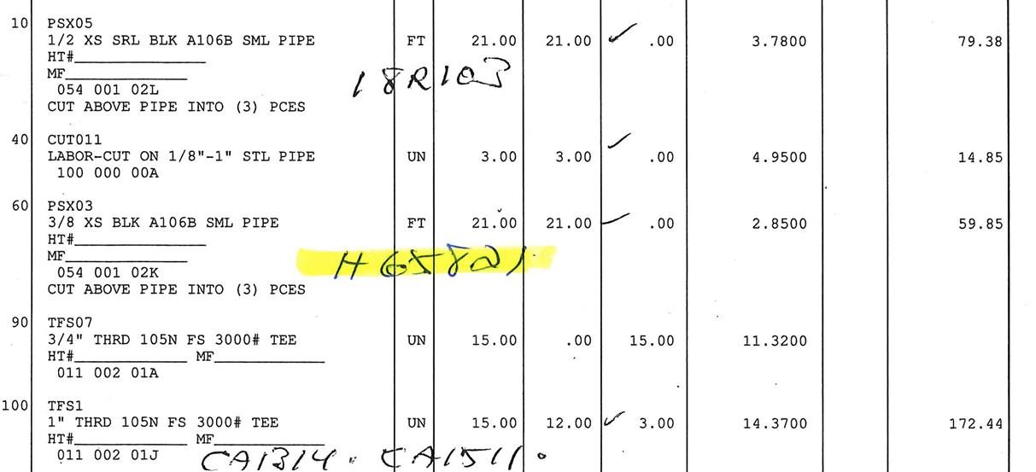
Invoice Document
Steam School Notes | Chapter 20: Material Test Reports (MTRs)
Role of invoice in establishing traceability
Invoice information
Part number
Material description
Size
Quantity
Manufacturer
Purchase information
Identifies the material that was purchased and received
Handwritten heat numbers create connection between items on invoice and supporting material certificates
Acts as first link in traceability chain

Slide 15
Mill Test Certificate
Steam School Notes | Chapter 20: Material Test Reports (MTRs)
Typical mill test certificate contains
Manufacturer information
Material specification
Material grade
Heat number
Size and dimensions
Chemical composition
Mechanical properties
Heat treatment information
Hydrostatic test results
Non-destructive examination results
Certification statement
Pipe material documentation and test results
Heat number and description on certificate connect document to invoice
Example: Heat 18R103 identifies 1/2" XH X WT 0.147" X 21 FEET pipe
Example certificate identifies pipe as
ASTM A106 Grade B
ASME SA106 Grade B
Heat Number 18R103
1/2" extra-heavy seamless pipe
Chemical analysis demonstrates material composition meets applicable specification
Mechanical test results demonstrate required strength properties have been achieved

Slide 16
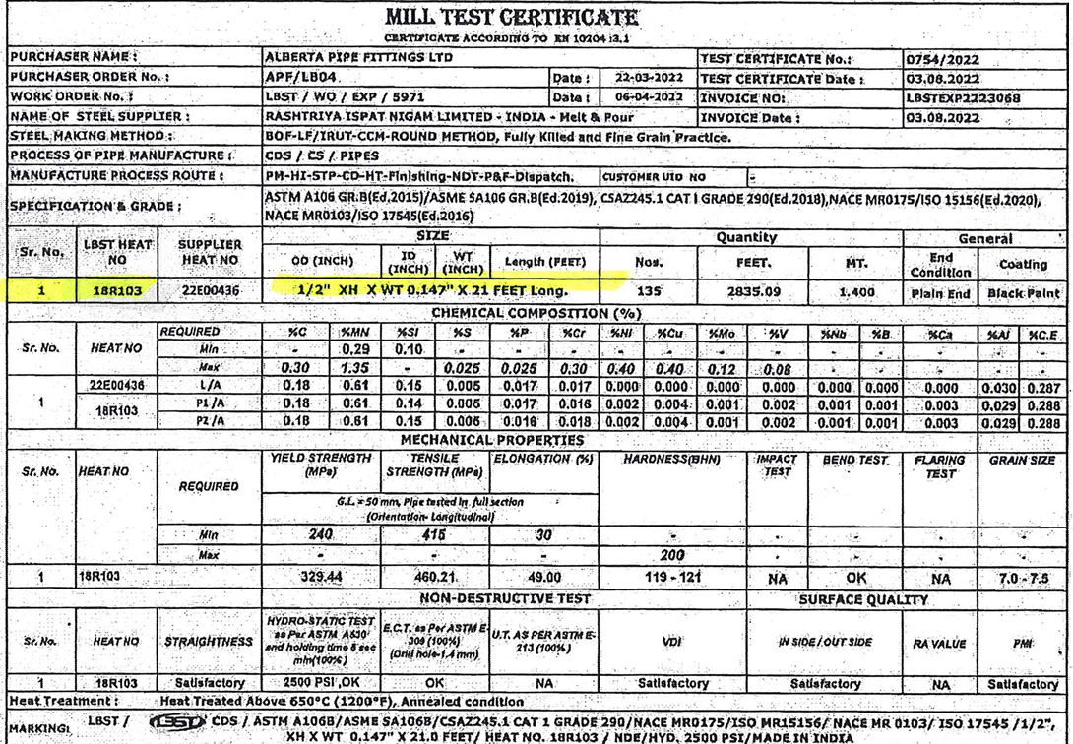

Slide 17
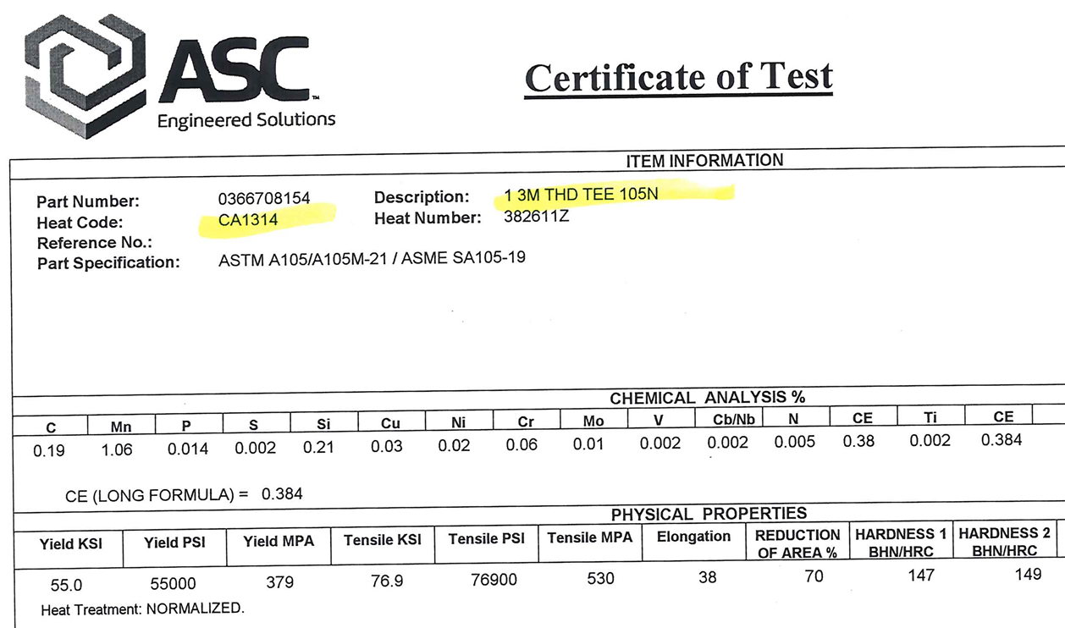
Certificate of Test
Steam School Notes | Chapter 20: Material Test Reports (MTRs)
Fitting material documentation and test results
Heat Code CA1314, Heat Number 382611Z, and description 1 3M THD TEE 105N connect document to invoice
Certificate of test for fitting documents the material of the fabricated component
Example certificate identifies fitting as
ASTM A105 / ASME SA105 forged carbon steel
1" threaded tee
Class 3000 fitting
Heat Code CA1314
Heat Number 382611Z
Document provides chemical analysis and mechanical properties of material from which fitting was manufactured

Slide 18
Following the Traceability Chain
Steam School Notes | Chapter 20: Material Test Reports (MTRs)
Connecting invoices to certificates through heat numbers
Traceability chain example
Invoice → Heat Number 18R103 → Pipe Mill Test Certificate
Invoice → Heat Code CA1314 → Certificate of Test for Tee
Inspector can verify
What material was purchased
Which heat the material came from
The chemical composition of the material
The mechanical properties of the material
Compliance with the specified standard
Ability to follow chain from component to certificate is foundation of material traceability

Slide 19
Material Identification vs. Certification
Steam School Notes | Chapter 20: Material Test Reports (MTRs)
Distinction between markings and documentation
A marking on a pipe, fitting, or valve identifies the component. An MTR provides the documentation that supports that identification.
A pipe marked ASTM A106 Grade B may appear suitable for service, but without corresponding MTR there may be no way to verify material chemistry, mechanical properties, or traceability
Markings and documentation work together. One does not replace the other.

Slide 20
Not Every Component Requires an MTR
Steam School Notes | Chapter 20: Material Test Reports (MTRs)
Scope of MTR documentation requirements
Material test reports are common for pressure-retaining components such as pipe, fittings, flanges, and valves used in code construction
Not every item in a plant will have associated MTR
Documentation requirements depend on governing code, quality program, purchaser requirements, and intended service

Slide 21
The Inspector's Question
Steam School Notes | Chapter 20: Material Test Reports (MTRs)
Purpose of material markings and documentation
Core inspection question
When reviewing pressure system, inspector asks: Can you prove that this component is what you say it is?
Purpose of markings, heat numbers, and material test reports is to provide that proof
If traceability chain can be followed from installed component back to supporting documentation, material can be verified
If that chain is broken, verification may no longer be possible

