Slide 1
Chapter 5 Summary
Steam School Notes | Chapter 5: Lubrication Points
Lubrication points and lubricator types
Six types of lubricators deliver different lubricants to specific engine points
  Oil cups (gravity) feed light machine oil to main bearings and valve-gear pivots
  Grease cups (screw-down) deliver hard grease to high-load, slow-moving bearings
  Mechanical lubricators provide measured oil strokes driven by engine motion
  Hydrostatic (sight-feed) lubricators use steam pressure for cylinder lubrication
  Wick lubricators meter oil slowly through felt or cotton reservoirs
  Alemite/Zerk fittings are modern retrofit grease nipples
Cold-engine lubrication requires manual priming and hand-oiling because automatic systems cannot function until engine reaches operating temperature

Slide 2
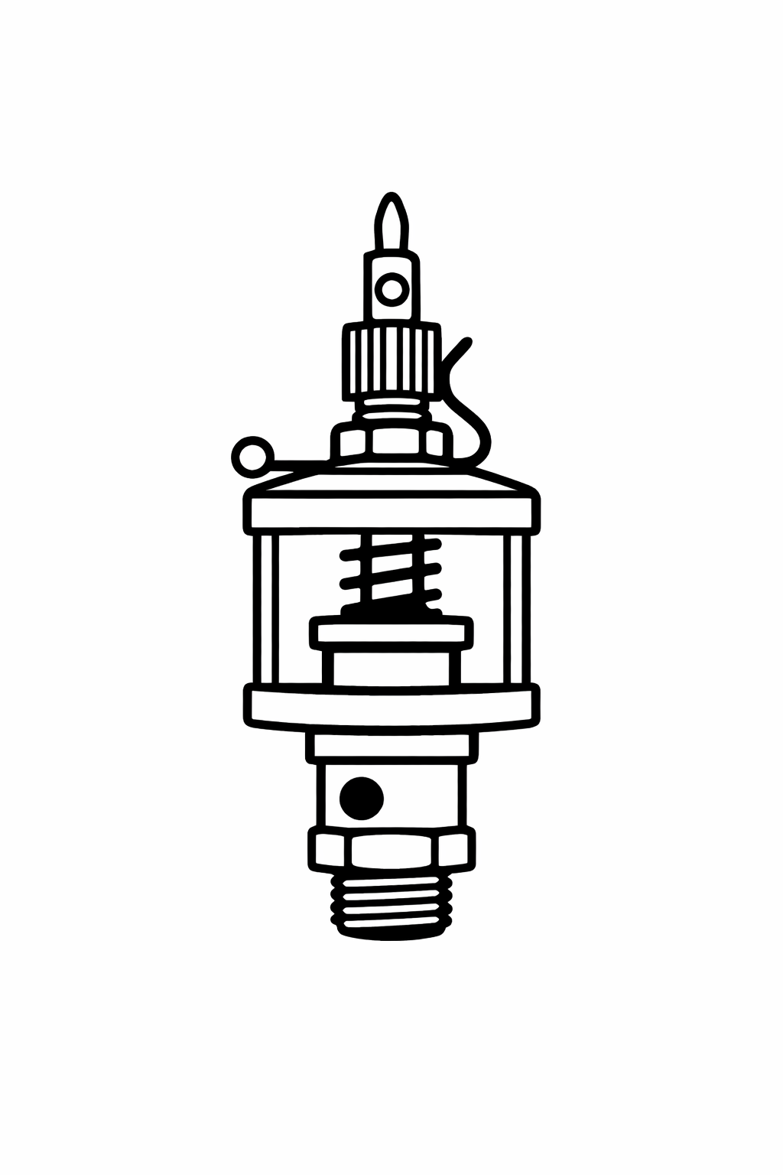
Oil Cups (Gravity Lubricators)
Steam School Notes | Chapter 5: Lubrication Points
Oil cup design and application
Small upright cups with cap or flip-lid, filled with light machine oil
Operation
Oil feeds by gravity through needle or drip hole
Knurled knob controls drip rate
Lever flips to turn off oil entirely
Found on
Main bearings
Crank pins
Valve-gear pivots
Governor bearings
Recognition: small brass cup, often with knurled cap or hinged lid

Slide 3
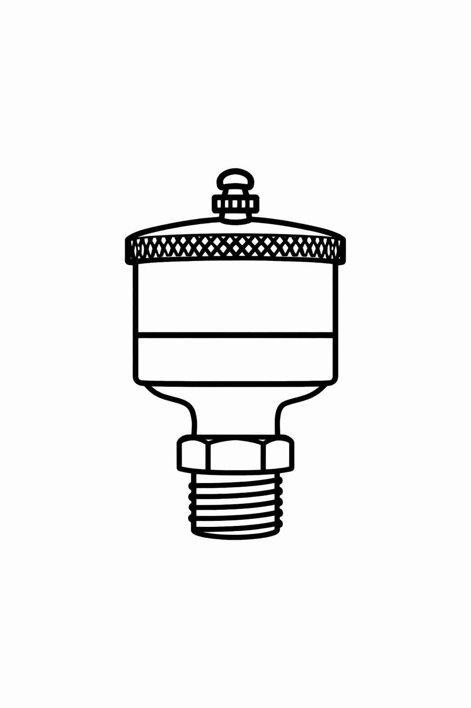
Screw-Down Grease Cups
Steam School Notes | Chapter 5: Lubrication Points
Grease cup design and application
Short, squat cup filled with hard grease; cap screws downward to force grease into bearing
Found on
Steering gear
Axle bearings
Some valve-gear joints
Application
Used for slow-moving, high-load points
Remove cup to fill with hard grease
Screw cap down one turn to deliver grease
Recognition: short, squat cup with threaded cap that screws downward

Slide 4
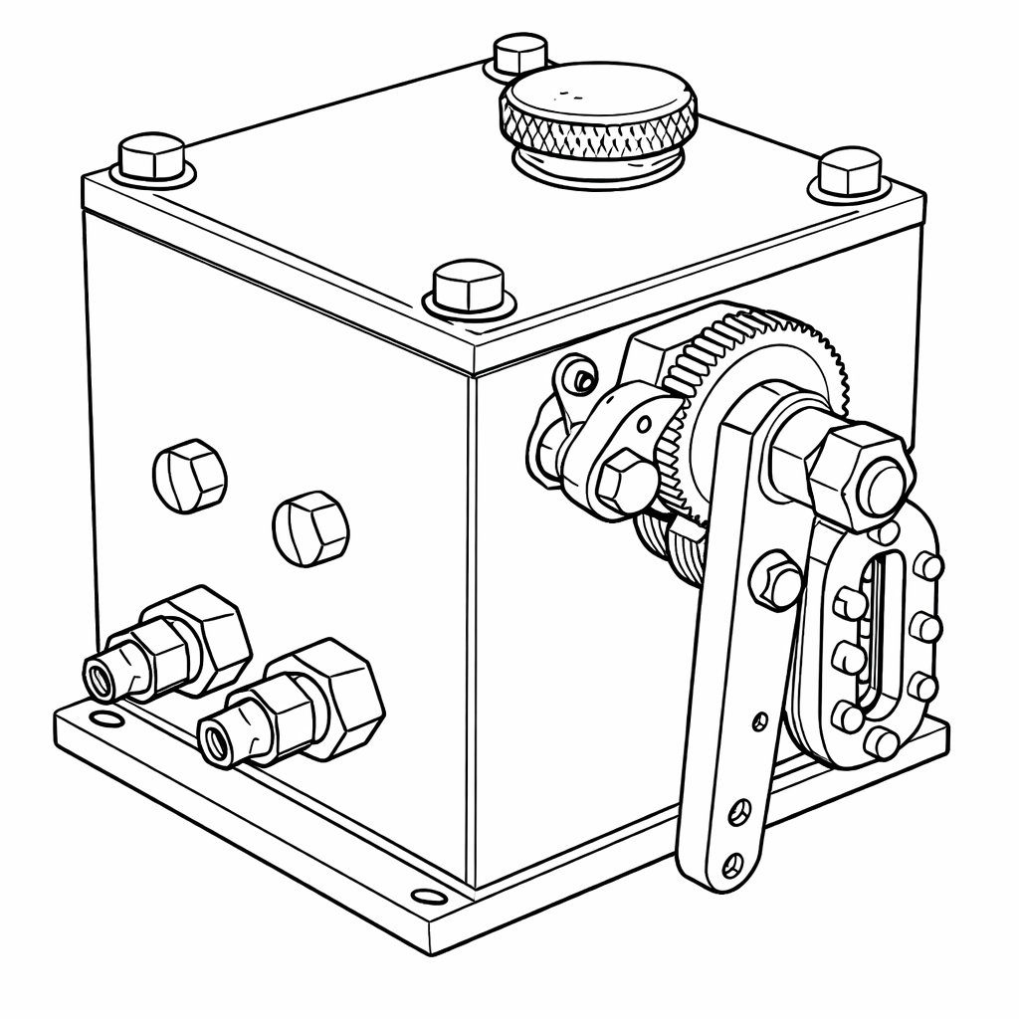
Mechanical Lubricators
Steam School Notes | Chapter 5: Lubrication Points
Mechanical (ratchet/displacement) lubricator design and application
Delivers oil in measured strokes driven by engine motion
Found on
Cylinder lubrication on some traction engines
Governor drive
High-load bearings
Recognition: small box with ratchet arm or linkage; oil lines leading away from it

Slide 5
Hydrostatic Lubricators
Steam School Notes | Chapter 5: Lubrication Points
Hydrostatic (sight-feed) lubricator design and application
Feeds cylinder oil using steam pressure and sight glass where drops are visible
Found on
Cylinder lubrication on many engines
Water pumps
Usually mounted on the turret
Recognition: glass column with needle valve and feed lines

Slide 6
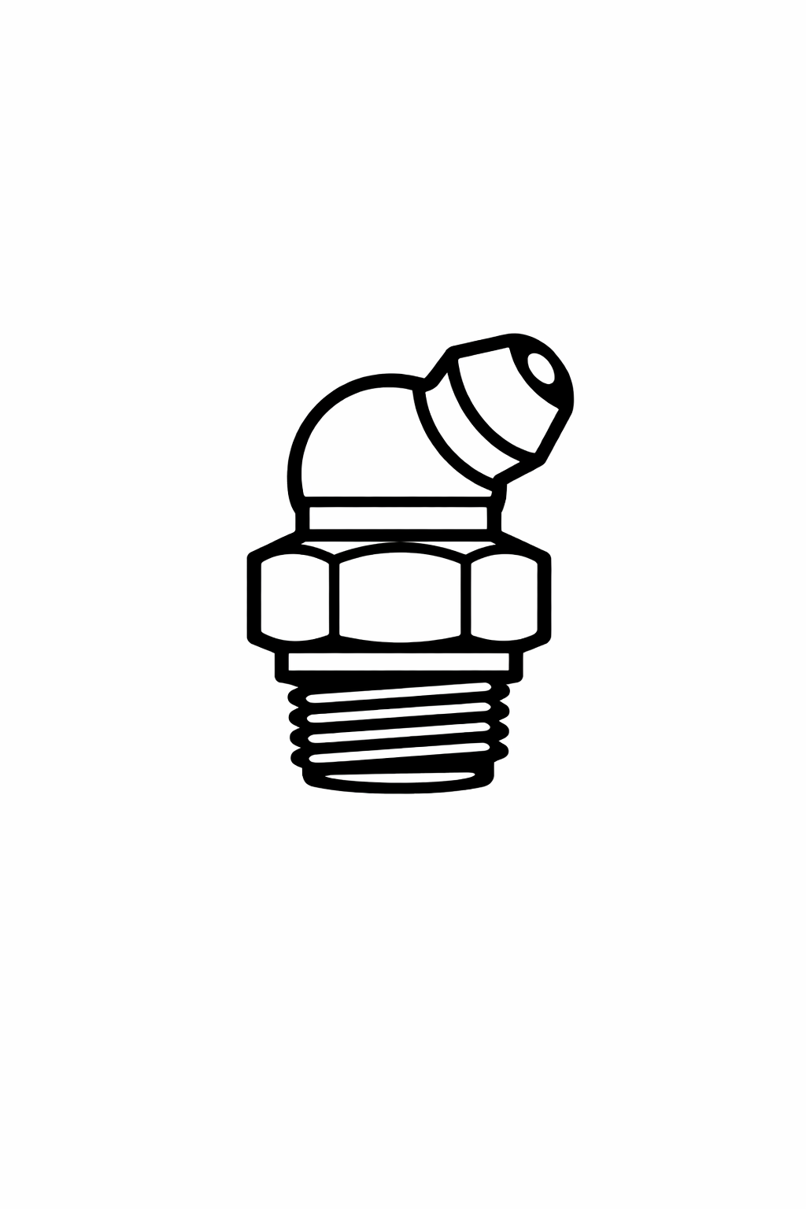
Alemite/Zerk Fittings
Steam School Notes | Chapter 5: Lubrication Points
Modern grease nipples
Alemite/Zerk Fittings
Modern retrofit grease nipples
Found anywhere previous owner wanted easier greasing
Recognition: small conical or ball-type grease nipples

Slide 7
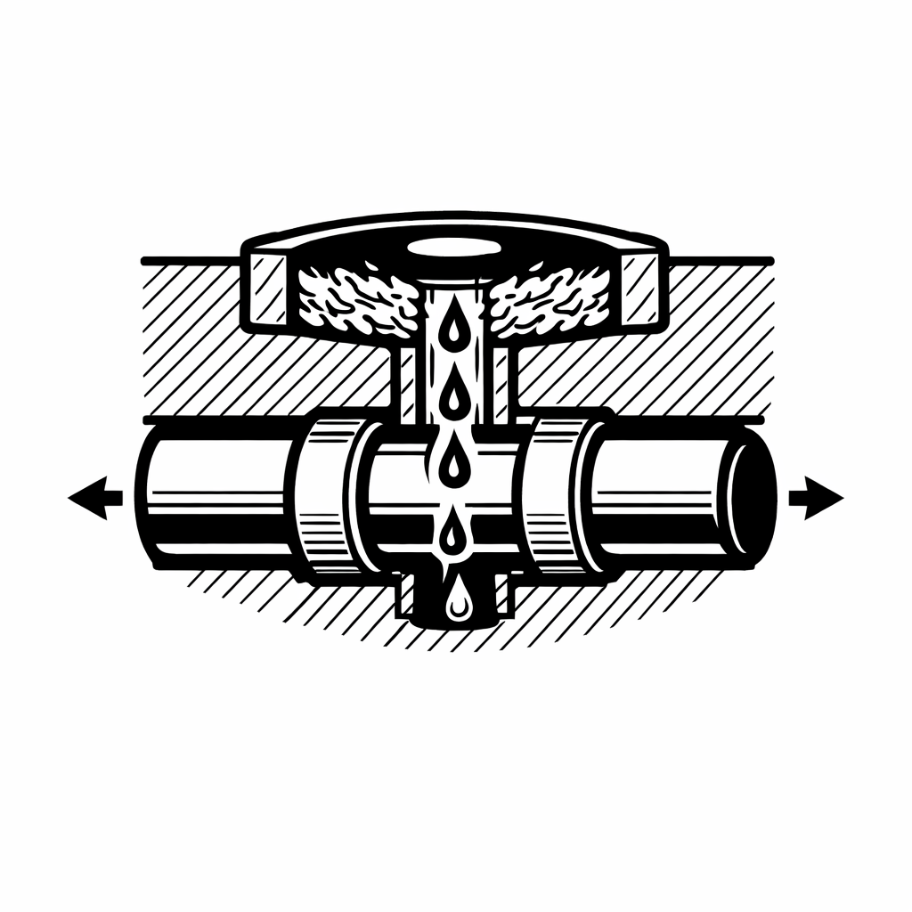
Wick Lubricators
Steam School Notes | Chapter 5: Lubrication Points
Old-school wick lubricator systems
Wick Lubricators
Use felt or cotton wick to meter oil slowly
Found on valve rocker arm, upper and lower cannon bearings
Recognition: reservoir in the casting filled with cotton waste

Slide 8
Lubricant Types and Matching
Steam School Notes | Chapter 5: Lubrication Points
Lubricant types and proper matching to lubricator systems
Cylinder Oil
Very heavy, high-temperature oil
Used only where steam enters (cylinders, valves)
Formulated to dissolve in water
Delivered by hydrostatic or mechanical lubricators
Engine Oil (Light Machine Oil)
Medium-weight
Used for bearings, pins, and moving joints
Delivered by oil cups, wicks, or mechanical lubricators
Grease
Used for slow, high-load bearings
Delivered by grease cups or Zerk fittings
Matching the wrong lubricant to the wrong lubricator is as bad as missing the point entirely

Slide 9
Cold-Engine Lubrication Requirements
Steam School Notes | Chapter 5: Lubrication Points
Why manual lubrication is necessary during engine warm-up
Cold Engine Constraints
Oil is thick
Grease is stiff
Wicks don't draw
Mechanical lubricators may not stroke
Hydrostatic lubricators won't feed until steam is up
Time is available to perform lubrication
Manual Lubrication Requires Knowledge Of
Where each point is located
What type of lubricator it uses
What lubricant belongs there
Whether it needs manual priming before engine moves
Experienced operators walk the engine with an oil can during warm-up knowing exactly what they are looking at

