Slide 1
Instructor Introductions
26-27 SAM Steam School

Slide 2
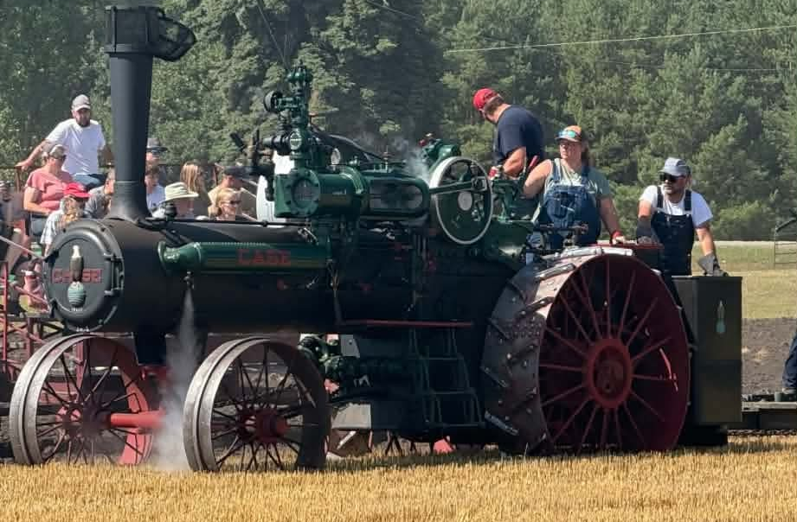
Taylor Storhoff, Goodrich ND USA
4 Years spent with steam
Flus on N&S Double Cylinder
Attended in 2024, Teaching in 2026
Doctor of Veterinary Medicine

Slide 3
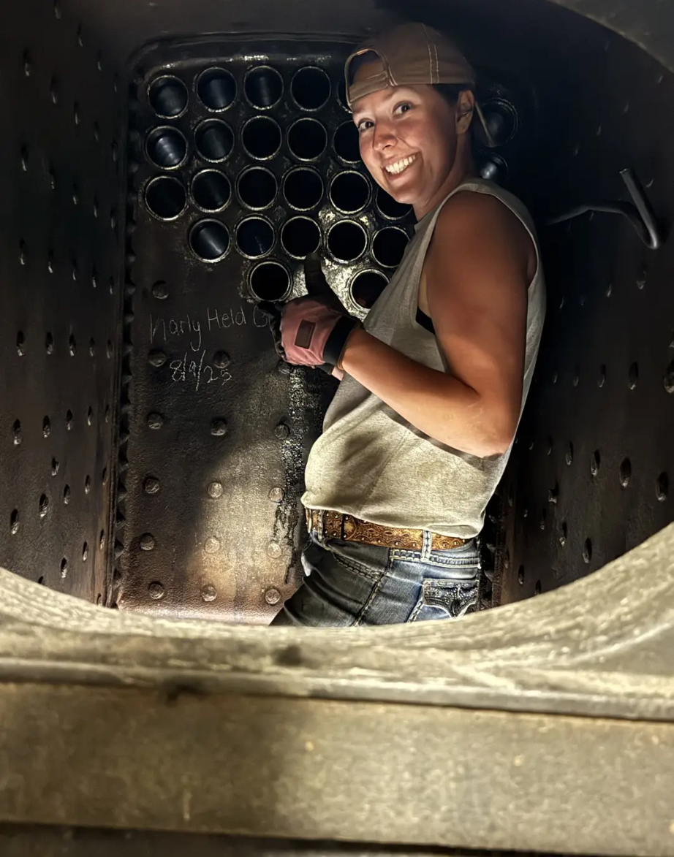
Karly Gefroh, Egeland ND USA
15 Years spent around steam
Helped install new boiler on N&S Single Cylinder, new flus on 80 N&S Double Cylinder
Attended Steam school in Aug 24, Teaching in 26
2nd Grade teacher
Dale and Martha Hawk Museum, Wolford ND
Mark Pederson’s 16 HP Undermount Avery-CNDSTR
Be patient while operating, give the engine time to respond to your commands. AND find fellow steam people and support each other

Slide 4
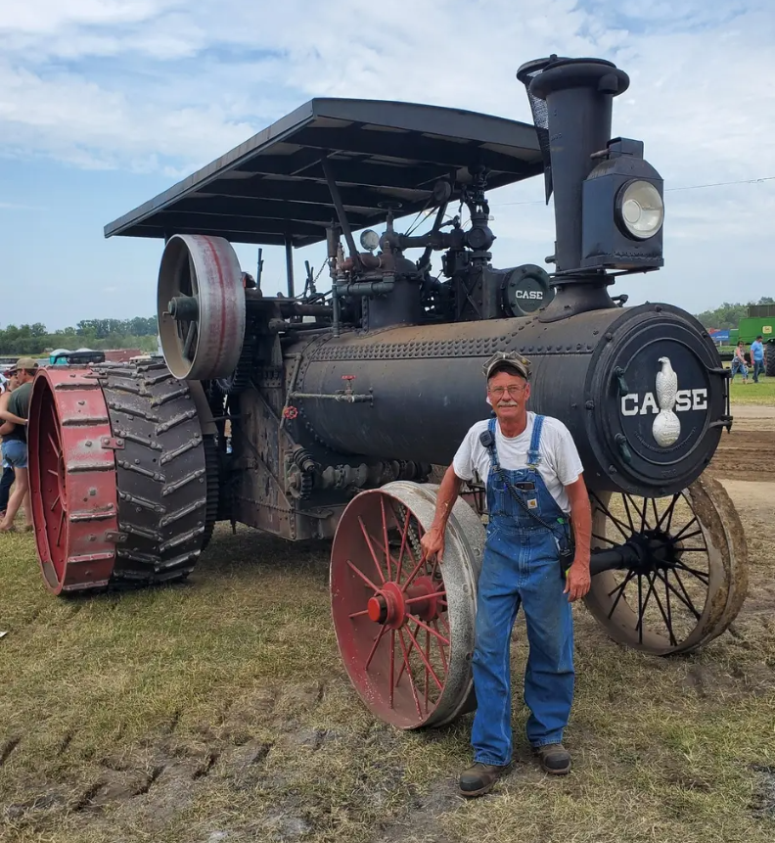
Darwin Fedorowich, Greybull WY, USA
40 Years spent running steam
Too many to name, my Case 75 took me a very long time to restore
Instructor at SAM for a very long time
Retired Oil field Generator repair
Austin MB, Wolford ND, Killarney MB
Favorite engine to run is my 75 Case purchased in Deering ND from the Grilley Family
Steam is great but you have to earn it and respect it

Slide 5
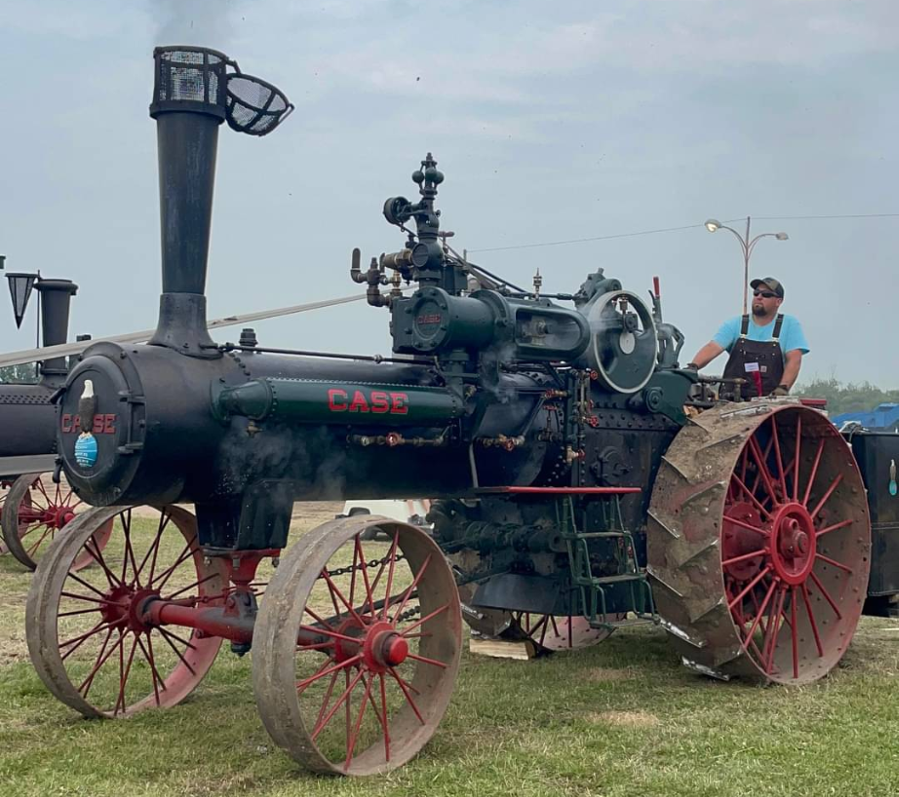
Garrett Bodie, Bagot MB CAN
36 years, Ticketed when 15
Restored MAM Case 50 in
Attended or helped out at 20ish steam schools
John Deere Mechanic & Shop Forman
Manitoba Threshermen's Reunion
Favorite Engine to run Case 75
Pulling the levers of an engine and making it move is easy. Each engine has its own quirks. To be a good engineer, you need to learn how to fire an engine and manage water safely and efficiently

Slide 6
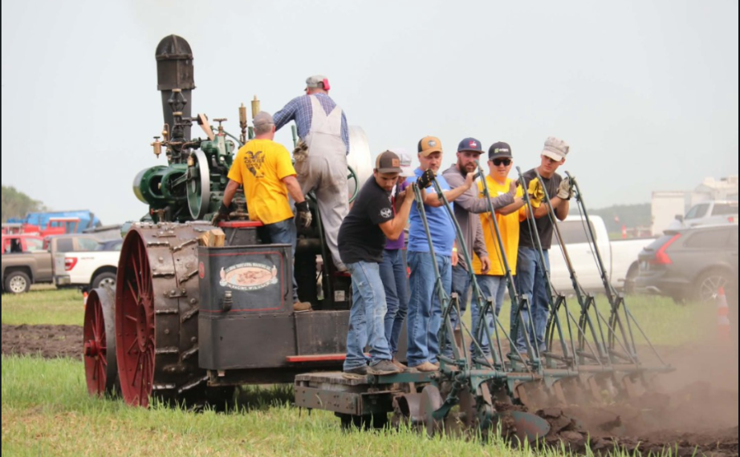
Ryan Down Swan River MB CAN
34 Years of experience with steam
Maintained and repaired the Downs 50 Case, rebuilt the MAM Sawyer Massey 27-82
Attended SAM Steam school and have been teaching for 6 classes
Work in health and safety as a journeyman mechanic
Austin thresherman's reunion
Never stop asking questions, don’t be afraid to get your hands dirty, never assume something is ok, have fun. It’s hard to work in the steam hobby but it’s rewarding

Slide 7
Gerald Dueck Brandon MB CAN
33 Years of experience with steam, MB ST class 00128
Restored MAM Case 65, ground-up reconstruction of Case 75
Attended SAM Steam school 1993; co-author of curriculum 2012
Worked as professor of mathematics and computer science 1981-2014
MAM board 2001-2010; president 2007-2010.
Past chair MAM steam committee

Slide 8
Jim Nowell, Winnipeg, MB CAN
Manitoba steam traction class license #00059
Minnesota traction engineers license #36518
American society ofpower engineers vintage engine engineer #R10503100R
National Institute for univorm licensing of power engineers certificate
50 years of experience
Past president, SAM

Slide 9
Robert Beamish Hamiota MB CAN
Licenses held
  Power engineer 4th class #3127
  Steam traction class #0017
Owns a 1914 Case 65
Operates MAM Case 75
Has operated Case, Advance Rumely, George White and portables.
President, SAM
Past president, MAM

Slide 10
Thomas Beamish Brandon MB CAN
Steam experience: 34 years
Manitoba steam traction license since 2000
Operates MAM Case 75
Qualified Refregeration Tech level 4
B.Sc., Brandon University
Past president, SAM

Slide 11
Jim Down Portage La Prairie MB CAN
Steam experience: 50 years
Manitoba steam traction license #00056
Operates Down Family Case 50
Past chair, MAM Steam Committee

Slide 12
Colin Farquhar, Chilliwack BC, CAN
Manitoba steam traction license
BC Antique Shoe Boiler (traction)
Power Engineer 2nd class
20 years experience with steam
Institute of Power Engineers
Vintage Locomotive Society

