Slide 1
Chapter Overview: Fittings
Steam School Notes | Chapter 19: Fittings
Purpose and scope of piping fittings
Fittings join pipe sections and direct fluid flow through piping systems
Five primary functions: change direction, create branches, change size, connect/disconnect equipment, close pipe ends
Proper fitting selection affects pressure capability, maintainability, and system reliability
Understanding fitting types, materials, and limitations is essential for installation and maintenance

Slide 2
What Fittings Do
Steam School Notes | Chapter 19: Fittings
Five primary fitting functions
Change direction: redirect flow at various angles
Create a branch: split flow into multiple paths
Change pipe size: transition between different pipe diameters
Connect or disconnect equipment: enable removable connections
Close the end of a pipe: terminate open ends
Fitting Selection Criteria
Operating pressure and temperature requirements
Material compatibility and service conditions
Connection type (threaded, welded, flanged)
Available space and installation constraints

Slide 3
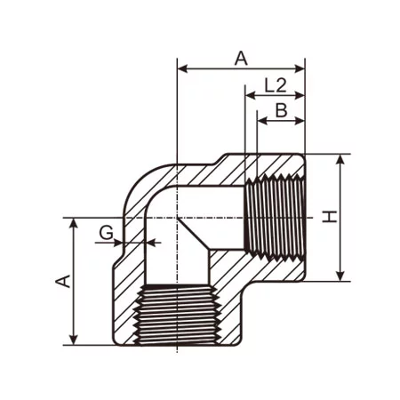
90° Elbow
Steam School Notes | Chapter 19: Fittings
Direction change fitting for perpendicular connections
Changes flow direction by ninety degrees
Commonly used where space is limited
Most common fitting type in any piping system

Slide 4
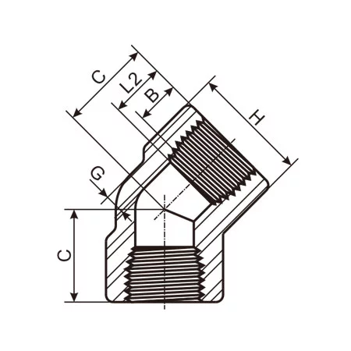
45° Elbow
Steam School Notes | Chapter 19: Fittings
Direction change fitting for gradual turns
Changes direction more gradually than 90° elbow
Generally produces less pressure loss than 90° elbow
Preferred where pressure drop must be minimized

Slide 5
Long-Radius and Short-Radius Elbows
Steam School Notes | Chapter 19: Fittings
Elbow design variations affecting flow characteristics
Long-radius (LR) elbows: centerline radius equals 1.5 times pipe diameter
Short-radius (SR) elbows: centerline radius equals pipe diameter
Performance Characteristics
Long-radius elbows produce less turbulence and lower pressure loss
Commonly used in steam and process piping systems
Short-radius elbows used where space constraints are severe

Slide 6
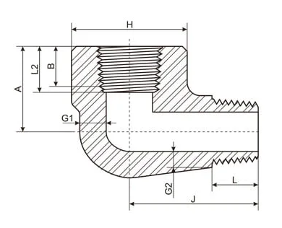
Street Elbows
Steam School Notes | Chapter 19: Fittings
Compact elbow with mixed connection types
Has male connection on one end and female connection on other
Connects directly to another fitting without intermediate pipe
Reduces overall assembly length and fitting count

Slide 7
Direction Changes and Flow Resistance
Steam School Notes | Chapter 19: Fittings
Impact of elbows on piping system performance
Flow Effects
Every direction change creates resistance to flow
Velocity distribution changes as fluid passes through elbow
Turbulence increases, causing pressure loss
Piping systems should minimize unnecessary direction changes

Slide 8
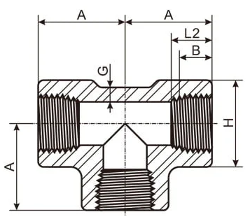
Tee Fitting
Steam School Notes | Chapter 19: Fittings
Standard branch fitting with three openings
Most common branch fitting in piping systems
Has three openings
Standard tee provides branch connection same size as run
Used where piping system must divide flow into two or more paths

Slide 9
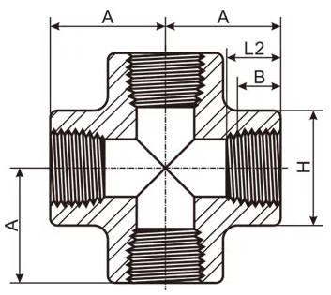
Cross Fitting
Steam School Notes | Chapter 19: Fittings
Branch fitting with four openings
Has four openings instead of three
Used when multiple branch connections required from single location
Less common than tee fitting

Slide 10
Reducing Tee
Steam School Notes | Chapter 19: Fittings
Tee with branch smaller than run
Provides branch connection smaller than main run
Allows flow distribution where branch flow is less than main flow
Example: 2" × 1" Reducing Tee
Run: 2 inch
Branch: 1 inch

Slide 11
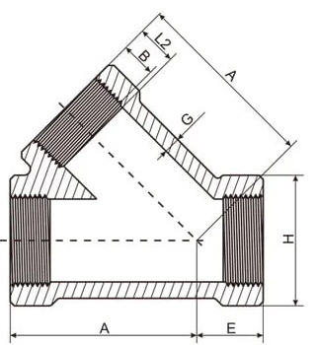
Lateral Tee
Steam School Notes | Chapter 19: Fittings
Branch fitting with angled outlet
Creates branch at an angle, typically 45 degrees
Smoother flow path than standard tee
May reduce pressure losses compared to standard tee

Slide 12
Branch Connection Stresses
Steam School Notes | Chapter 19: Fittings
Mechanical loads on branch connections
Sources of Stress
Internal pressure from system operation
Thermal expansion from temperature changes
Vibration from fluid flow and equipment
External loads from pipe weight and support brackets
Design Implications
As pipe size and pressure increase, branch reinforcement becomes critical
Reinforcement requirements must be considered during design
Proper support and bracing reduces fatigue failures

Slide 13
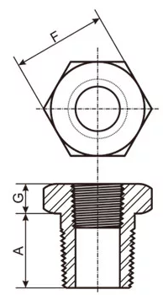
Bushings
Steam School Notes | Chapter 19: Fittings
Compact size-reduction fitting for threaded connections
Threads into larger fitting to provide smaller threaded opening
Example: 1 inch × 3/4 inch bushing allows 3/4 inch pipe on 1 inch fitting
Reduction occurs within fitting itself, requires very little space
Advantages
Compact installation with minimal space requirements
Lower cost compared to other size-change options
Fewer fittings required for assembly
Disadvantages
Creates abrupt change in flow area
Concentrates stress in small area
Can be difficult to remove after years of service

Slide 14
Bushing Applications
Steam School Notes | Chapter 19: Fittings
Common uses for bushing fittings
Instrument connections
Drain line connections
Vent connections
Small auxiliary piping systems

Slide 15
Reducing Couplings
Steam School Notes | Chapter 19: Fittings
Size-change fitting for straight runs
Joins two different pipe sizes in a straight run
Occupies additional length compared to bushing
Provides stronger, more conventional connection than bushing
Example Sizes
1 inch × 3/4 inch
1-1/4 inch × 1 inch
2 inch × 1-1/2 inch
Advantages
Better mechanical support than bushing
Easier maintenance and serviceability
Commonly accepted piping practice

Slide 16
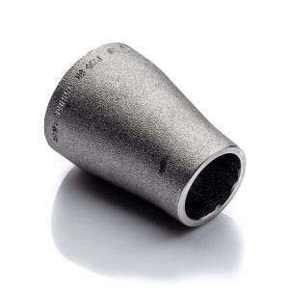
Reducers for Welded Piping
Steam School Notes | Chapter 19: Fittings
Size-change fittings in welded systems
In welded piping systems, size changes usually accomplished using reducers
Available in two styles: concentric and eccentric
Common Reducer Sizes
2 inch × 1-1/2 inch
4 inch × 3 inch
6 inch × 4 inch

Slide 17
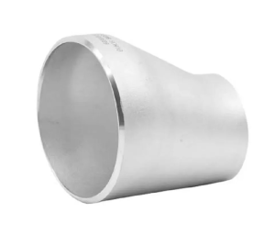
Eccentric Reducers
Steam School Notes | Chapter 19: Fittings
Offset reducer for steam service applications
Eccentric reducer offsets smaller pipe to one side
Used to maintain sloped piping in steam systems
Prevents condensate pockets and air traps

Slide 18
Reducer Selection Impact
Steam School Notes | Chapter 19: Fittings
Consequences of improper reducer selection
Problems from Poor Selection
Condensate pockets: areas where liquid collects in steam lines
Air traps: pockets where air becomes trapped
Increased turbulence: creating pressure drop and noise
Water hammer conditions: damaging pressure surges
Steam Service Considerations
Proper reducer orientation is especially important in steam service
Eccentric reducers preferred over concentric when slope must be maintained

Slide 19
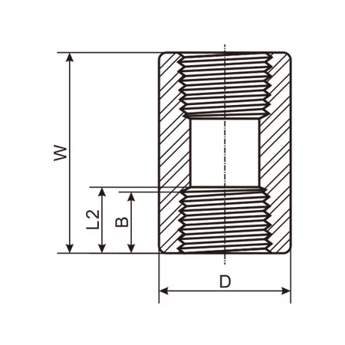
Couplings
Steam School Notes | Chapter 19: Fittings
Fitting that joins two pipe sections in straight line
Joins two pieces of pipe in straight line
Threaded couplings common in smaller piping systems
Similar connection for equal-sized pipe

Slide 20
Half Couplings
Steam School Notes | Chapter 19: Fittings
Branch connection fitting
Essentially half of a coupling
Commonly welded to vessel or larger pipe
Creates branch connection at weld point

Slide 21
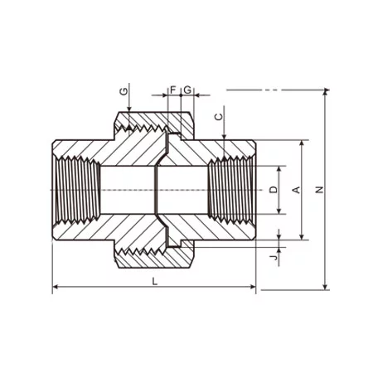
Unions
Steam School Notes | Chapter 19: Fittings
Disconnectable fitting for removable equipment
Provides means of disconnecting piping without rotating pipe
Allows rapid equipment removal and replacement
Simplifies maintenance and component servicing
Typical Union Applications
Valve connections
Steam trap installations
Pump connections
Instrument connections

Slide 22
Why Use Unions
Steam School Notes | Chapter 19: Fittings
Advantages of union fittings
Without union, disassembly may require removing large section of piping
Union allows components to be removed quickly for servicing
Reduces downtime for maintenance and replacement

Slide 23
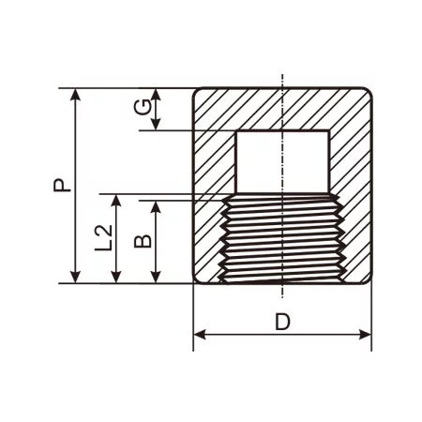
Caps
Steam School Notes | Chapter 19: Fittings
Fitting that closes end of pipe
Fits over the end of pipe and closes it
Cap goes over the outside of pipe
Used for temporary or permanent pipe closures

Slide 24
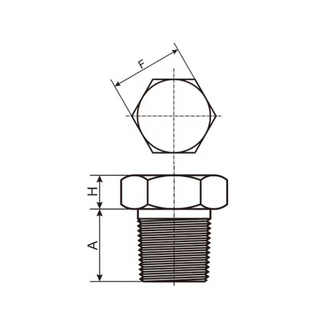
Plugs
Steam School Notes | Chapter 19: Fittings
Fitting that closes internal opening
Screws into threaded fitting and closes opening
Plug fits into fitting rather than over pipe
Used for temporary or permanent closure of internal ports

Slide 25
Remembering Caps vs. Plugs
Steam School Notes | Chapter 19: Fittings
Memory aid for cap and plug distinction
Cap goes over a pipe
Plug goes into a fitting

Slide 26
Threaded End Connections
Steam School Notes | Chapter 19: Fittings
Threads as fitting connection method
Used primarily on smaller pipe sizes
Most common connection method for small piping systems
Advantages
Easy to assemble
No welding required
Disadvantages
Potential leak paths at threaded connections
Limited pressure and temperature capability

Slide 27
Socket-Weld End Connections
Steam School Notes | Chapter 19: Fittings
Welded connection within socket
Pipe inserted into socket and welded around outside
Creates strong permanent connection
Suitable for higher-pressure service
Advantages
Strong connection suitable for high pressure
Improved reliability compared to threaded
Disadvantages
Requires welding expertise
More difficult to inspect internally

Slide 28
Butt-Weld End Connections
Steam School Notes | Chapter 19: Fittings
Direct end-to-end welded connection
Pipe and fitting welded directly end-to-end
Highest strength of all connection methods
Provides smooth internal bore without restrictions
Advantages
Highest strength connection
Smooth internal bore without ledges
Preferred for larger steam systems
Disadvantages
Requires qualified welding procedures and inspection

Slide 29
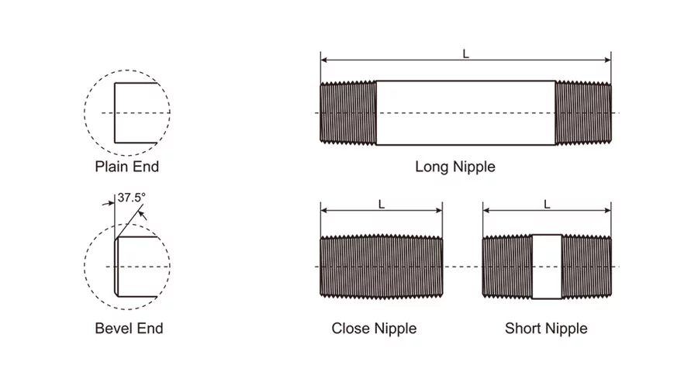
Nipples
Steam School Notes | Chapter 19: Fittings
Short length of pipe with external threads on both ends
Short length of pipe with external threads on both ends
Connects two threaded fittings or components
Unlike most fittings, nipple is short piece of pipe prepared for threaded service
Common Nipple Uses
Connecting valves to fittings
Extending a branch line
Installing pressure gauges
Connecting steam traps
Creating spacing between components

Slide 30
Common Nipple Lengths
Steam School Notes | Chapter 19: Fittings
Standard nipple length categories
Close: threads over entire length
Shoulder: short unthreaded section between ends
Short: standard medium length
Long: extended length for spacing
Custom-cut: fabricated to specific length
Exact dimensions vary by manufacturer and pipe size

Slide 31
Close Nipples
Steam School Notes | Chapter 19: Fittings
Nipple with threads along entire length
Has threads over entire length
Very little of nipple remains visible between fittings when assembled
Useful where space is limited
Maintenance Consideration
Can be difficult to remove because no unthreaded section available for pipe wrench

Slide 32
Shoulder Nipples
Steam School Notes | Chapter 19: Fittings
Nipple with limited unthreaded section
Also called a short nipple
Contains short unthreaded section between threaded ends
Unthreaded shoulder visible after assembly
May provide limited wrench grip for removal

Slide 33
Long Nipples
Steam School Notes | Chapter 19: Fittings
Extended nipple for component spacing
Simply longer sections of threaded pipe
Used to create space between components
Bridges short distances in piping system
Applications
Create space between components
Bridge short distances
Position instruments or valves for easier access

Slide 34
Barrel and Running Nipples
Steam School Notes | Chapter 19: Fittings
Specialized nipple configurations
Barrel nipple: threads only near ends with unthreaded section in middle; used when greater length required while minimizing threading
Running nipple: threaded continuously from end to end; useful when fitting must be rotated onto nipple during assembly

Slide 35
Why Pipefitters Care About Nipples
Steam School Notes | Chapter 19: Fittings
Importance of nipple selection in piping systems
Nipples may appear simple but often determine whether system can be assembled efficiently
Correct nipple length critical for system functionality
Correct Nipple Selection Benefits
Provides wrench clearance for assembly and disassembly
Allows valve handles to move freely
Improves system accessibility
Simplifies future maintenance
Poor Selection Consequences
Can leave components difficult or impossible to service

Slide 36
Nipples in Steam Service
Steam School Notes | Chapter 19: Fittings
Common steam system applications for nipples
Between steam trap and isolation valve
Between pressure gauge and gauge valve
Between tee and drain valve
Between boiler nozzle and valve assembly
In instrument and control piping

Slide 37
Flanges
Steam School Notes | Chapter 19: Fittings
Mechanical disconnectable joint connection method
Mechanical method of connecting pipe, valves, vessels, and equipment
Can be disassembled relatively easily
Ideal for equipment requiring periodic inspection, maintenance, or replacement
Flanged Joint Components
Two mating flanges
A gasket
Bolts and nuts
Sealing Mechanism
As bolts are tightened, flanges compress gasket and create pressure-tight seal

Slide 38
When to Use Flanges
Steam School Notes | Chapter 19: Fittings
Applications requiring removable connections
Flanges used where equipment must be removable
Without flanges, removing large equipment often requires cutting and rewelding piping
Typical Flange Applications
Valves
Steam traps
Pumps
Heat exchangers
Pressure vessels
Boilers

Slide 39
Weld Neck Flange
Steam School Notes | Chapter 19: Fittings
Preferred flange design for pressure piping
Considered preferred flange for many pressure piping applications
Tapered hub provides smooth transition between pipe and flange
Reduces stress concentrations at pipe junction
Advantages
Excellent strength
Good fatigue resistance
Suitable for high pressure and temperature service
Common Applications
Steam systems
Process piping
High-pressure service

Slide 40
Slip-On Flange
Steam School Notes | Chapter 19: Fittings
Economical flange design with welded connection
Slides over outside of pipe and is welded in place
Easier alignment than weld neck flange
Lower cost alternative
Advantages
Easy alignment
Lower cost
Simplified fit-up during assembly
Disadvantages
Lower strength than weld neck flanges
More susceptible to fatigue failure

Slide 41
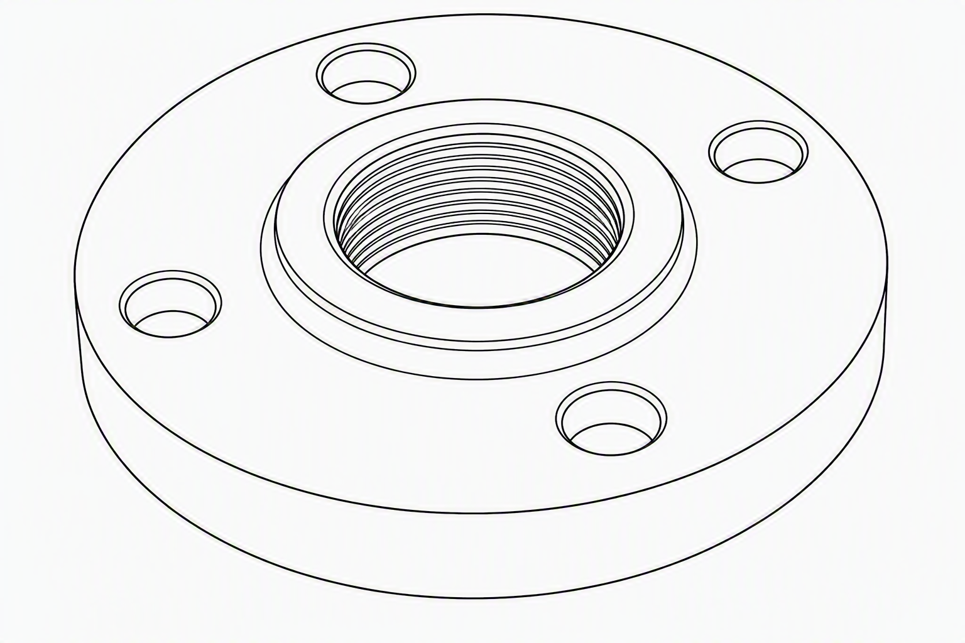
Threaded Flange
Steam School Notes | Chapter 19: Fittings
Non-welded flange with internal pipe threads
Contains internal pipe threads
Does not require welding
Convenient for small piping systems
Advantages
No welding required
Convenient for small piping systems
Disadvantages
Limited pressure and temperature capability
Potential leak paths through threads

Slide 42
Socket Weld and Blind Flanges
Steam School Notes | Chapter 19: Fittings
Specialized flange types
Socket weld flange: contains recessed socket into which pipe is inserted before welding; commonly used on smaller high-pressure piping systems
Blind flange: solid plate used to close end of flanged connection; used for future expansion points, equipment isolation, and pressure testing

Slide 43
Gaskets in Flanged Joints
Steam School Notes | Chapter 19: Fittings
Sealing component selection
Flange alone does not normally provide seal
Seal created by gasket compressed between flange faces
Gasket material must be suitable for system temperature, pressure, and fluid
Common Gasket Materials
Compressed fiber
Graphite
PTFE (polytetrafluoroethylene)
Spiral wound metal gaskets

Slide 44
Why Gaskets Matter
Steam School Notes | Chapter 19: Fittings
Consequences of improper gasket selection
Potential Problems
Improperly selected gasket can result in steam leaks
Gasket blowouts and loss of pressure
Equipment damage from leakage
Steam Service Criticality
In steam service, gasket selection often as important as flange selection

Slide 45
Flange Face Designs
Steam School Notes | Chapter 19: Fittings
Sealing surface configurations
Flat face (FF): completely flat sealing surface; commonly used with cast-iron equipment
Raised face (RF): small raised sealing surface around bore; most common type in industrial piping systems; concentrates gasket loading and improves sealing performance
Ring-type joint (RTJ): machined metal ring seated in precision grooves; reserved for very high-pressure and high-temperature service

Slide 46
Bolting and Tightening Flanged Joints
Steam School Notes | Chapter 19: Fittings
Proper assembly technique for flange connections
Bolts in flanged joint do not directly seal pipe
Purpose of bolts is to compress gasket with sufficient force to maintain seal
Tightening Criticality
Uneven tightening can damage gasket
Excessive tightening can crush gasket
Insufficient tightening can cause leaks
Best Practice
Bolts normally tightened in crisscross or star pattern to ensure even gasket compression
This pattern distributes load evenly around flange

Slide 47
Flange Pressure-Temperature Ratings
Steam School Notes | Chapter 19: Fittings
Flange classes and pressure capability
Flanges manufactured with pressure-temperature ratings known as classes
Higher class generally indicates flange capable of higher pressure service
Common Flange Classes
Class 150
Class 300
Class 600
Class 900
Class 1500
Class 2500
Common Misconception
Class 150 flange is not limited to 150 psi
Flange ratings vary with both material and temperature
Actual allowable pressure must be determined from applicable standard

Slide 48
Importance of Proper Flange Assembly
Steam School Notes | Chapter 19: Fittings
Critical factors in flanged joint reliability
Flanges among most common connection methods in industrial piping
Proper alignment, gasket selection, bolting techniques, and pressure-class selection all affect system safety and reliability
Many steam leaks occur not because flange was defective, but because joint was assembled incorrectly

Slide 49
Fitting Markings and Identification
Steam School Notes | Chapter 19: Fittings
Information provided on fitting identification
Fittings marked with information identifying size, material, pressure class, and manufacturer
Understanding markings helps ensure correct fitting is selected for intended service
Fitting may look identical to another fitting while having different pressure rating or intended service
Before Installation, Check Markings For
Size
Material
Pressure class
Manufacturing standard
Traceability requirements

Slide 50
Pressure Class Markings
Steam School Notes | Chapter 19: Fittings
Understanding forged fitting pressure classifications
Most forged steel threaded and socket-weld fittings marked with pressure class
Common examples: 3000, 6000, 9000
Often referred to as thousand pound fittings
Common Misconception
Pressure class is not the maximum allowable working pressure in psi
Class 3000 fitting is not necessarily limited to 3000 psi nor automatically suitable for 3000 psi service
Actual Rating Depends On
Material
Temperature
Applicable standards
Service conditions

Slide 51
Material Markings
Steam School Notes | Chapter 19: Fittings
Identifying fitting material specifications
Fittings commonly marked with material specification
Material markings help ensure compatibility with piping system and service environment
Marking | Material Description
A105 | Forged carbon steel; commonly used in steam and process piping
A182 F304 | Forged 304 stainless steel
A182 F316 | Forged 316 stainless steel

Slide 52
Manufacturing Standards
Steam School Notes | Chapter 19: Fittings
Standards specifying fitting design and construction
Many fittings marked with standard to which they were manufactured
Knowing standard helps verify fitting is suitable for intended piping system
ASME B16.11: applies to forged threaded fittings and socket-weld fittings such as couplings, unions, tees, elbows, bushings
ASME B16.9: applies to factory-made wrought butt-weld fittings such as welded elbows, reducers, tees, caps

Slide 53
Size and Reducer Markings
Steam School Notes | Chapter 19: Fittings
Identifying fitting dimensions
Most fittings marked with nominal size
Reducing fittings show both sizes
Size Marking Examples
Standard size: 1, 1-1/2, 2 inch
Reducing sizes: 2 × 1, 1-1/2 × 3/4 inch
Markings indicate pipe sizes for which fitting is intended

Slide 54
Manufacturer Identification and Traceability
Steam School Notes | Chapter 19: Fittings
Traceability markings on fittings
Most fittings contain manufacturer's trademark, logo, or identification code
Information Provided By Markings
Product identification
Traceability for quality control
Verification of source
Higher-Grade Piping Systems
Fittings may carry heat number that links fitting to chemical analysis records, mechanical test records, and material certifications
Canadian Systems
Many pressure-retaining components in Canada carry Canadian Registration Number (CRN) indicating design acceptance by regulatory authority

Slide 55
Reading Fitting Markings Example
Steam School Notes | Chapter 19: Fittings
Interpreting typical fitting markings
Example fitting markings: ABC, 3000, A105, 1, B16.11
Interpretation
Manufacturer: ABC
Pressure class: 3000
Material: ASTM A105 forged carbon steel
Size: 1 inch
Standard: ASME B16.11
From few simple markings, pipefitter can determine great deal about fitting

Slide 56
Cast vs. Forged Fittings
Steam School Notes | Chapter 19: Fittings
Manufacturing methods affecting fitting properties
Although fittings may appear similar, they are not manufactured the same way
Manufacturing method affects strength, pressure capability, toughness, reliability, and suitable service applications

Slide 57
Cast Fitting Manufacturing
Steam School Notes | Chapter 19: Fittings
Casting process for fitting production
Cast fittings manufactured by pouring molten metal into mold and allowing it to solidify
Can be produced in complex shapes with relatively little machining
Common Cast Fitting Materials
Cast iron
Malleable iron
Cast steel
Bronze

Slide 58
Advantages and Disadvantages of Cast Fittings
Steam School Notes | Chapter 19: Fittings
Cast fitting performance characteristics
Advantages
Lower manufacturing cost
Complex shapes are easy to produce
Suitable for many low-pressure applications
Disadvantages
Generally lower toughness than forged
More susceptible to casting defects
Less resistant to shock loading
Lower pressure ratings than forged equivalents

Slide 59
Forged Fitting Manufacturing
Steam School Notes | Chapter 19: Fittings
Forging process for fitting production
Forged fittings manufactured by mechanically forming heated metal under high pressure
Metal is compressed into shape rather than poured into mold
Forging process improves grain structure of steel and produces stronger component

Slide 60
Advantages and Disadvantages of Forged Fittings
Steam School Notes | Chapter 19: Fittings
Forged fitting performance characteristics
Advantages
Higher strength
Better toughness
Improved fatigue resistance
Higher pressure capability
Greater reliability in severe service
Disadvantages
Higher cost
More machining may be required

Slide 61
Visual Differences Between Cast and Forged
Steam School Notes | Chapter 19: Fittings
Identifying fitting type by appearance
Forged Fitting Characteristics
Smooth machined surfaces
Clearly stamped markings
Class ratings such as 3000, 6000, or 9000
Cast Fitting Characteristics
Rougher surface finish
Cast-in markings
Pressure ratings such as 125 lb or 150 lb
While appearance can provide clues, markings should always be used for positive identification

Slide 62
Fitting Types in Steam Service
Steam School Notes | Chapter 19: Fittings
Preferred fitting materials for steam systems
For most industrial steam systems, forged steel fittings are preferred
These fittings designed to withstand temperatures and pressures commonly encountered in steam service
Common Steam Service Fitting Types
ASTM A105 forged carbon steel fittings
ASME B16.11 threaded fittings
ASME B16.11 socket-weld fittings
ASME B16.9 butt-weld fittings

Slide 63
Malleable Iron Fittings
Steam School Notes | Chapter 19: Fittings
Characteristics and applications of malleable iron
Malleable iron threaded fittings are common in compressed-air systems, water systems, and low-pressure utility piping
Historically used in some low-pressure steam systems
Many industrial facilities now prefer forged steel fittings because of superior strength and durability

Slide 64
Cast Iron Fittings
Steam School Notes | Chapter 19: Fittings
Cautions regarding cast iron in steam service
Cast iron fittings should generally be viewed with caution in steam service
Cast iron is strong in compression but relatively brittle
Less tolerant of thermal stress and mechanical shock
Fitting that performs satisfactorily in water service may not be suitable for higher-temperature steam

Slide 65
Typical Cast vs. Forged Comparison
Steam School Notes | Chapter 19: Fittings
Example comparison of fitting types
110 lb Malleable Iron Elbow | Characteristic | 3000 lb A105 Forged Elbow
Cast construction | Manufacturing | Forged construction
Lower pressure rating | Pressure capability | Higher pressure capability
Utility service | Application | Industrial steam service
Although both fittings may be same nominal size, they are intended for very different operating conditions

Slide 66
Fitting Selection for Safety
Steam School Notes | Chapter 19: Fittings
Critical verification steps before fitting installation
Two fittings may have identical dimensions and threads yet possess vastly different pressure and temperature capabilities
Never assume fitting is acceptable simply because it fits
Before Installing a Fitting, Verify
Material
Pressure class
Manufacturing standard
Service suitability

Slide 67
Key Takeaway: Fittings Overview
Steam School Notes | Chapter 19: Fittings
Essential concepts for piping fitting application
Fittings make a piping system practical by enabling direction changes, branch creation, size transitions, equipment connection, and line termination. Proper fitting selection directly affects system pressure capability, maintainability, and long-term reliability. Selection criteria include operating conditions, material compatibility, connection type, and space availability.

Slide 68
Key Takeaway: Nipples
Steam School Notes | Chapter 19: Fittings
Essential concepts for nipple application
A nipple is a short piece of threaded pipe used to connect fittings and components. Although simple in appearance, proper nipple selection is important for accessibility, assembly, maintenance, and overall piping layout. Correct nipple length provides wrench clearance, allows free valve movement, and improves system accessibility.

Slide 69
Key Takeaway: Flanges
Steam School Notes | Chapter 19: Fittings
Essential concepts for flange application
Flanges provide a removable method of connecting piping and equipment. A flanged joint consists of two flanges, a gasket, and bolting. Understanding flange types, gasket selection, flange ratings, and proper assembly practices is essential for anyone working with steam systems. Many leaks occur not because the flange was defective, but because the joint was assembled incorrectly.

Slide 70
Key Takeaway: Fitting Markings
Steam School Notes | Chapter 19: Fittings
Essential concepts for fitting identification
Fitting markings are the component's identification card. They provide information about size, material, pressure class, manufacturing standard, and traceability. Learning to read these markings is an important skill for pipefitters, inspectors, and maintenance personnel because many fittings appear similar even though their pressure ratings and intended applications may be very different.

Slide 71
Key Takeaway: Cast vs. Forged Fittings
Steam School Notes | Chapter 19: Fittings
Essential concepts about fitting manufacturing
Cast and forged fittings may look similar, but their performance can be very different. Forged steel fittings are the preferred choice for most industrial steam systems because they provide greater strength, toughness, and pressure capability. Cast and malleable iron fittings are commonly used in lower-pressure utility services but may not be suitable for demanding steam applications.

