Slide 1
Chapter Overview: Engine Types
Steam School Notes | Chapter 22: Engine Types
Historical development and operation of steam engines from reciprocating to compound designs
Steam engines converted heat energy into continuous mechanical power on large scale
Operation based on fundamental principle: steam pressure on piston converts to rotary motion
Expansive working: steam continues pushing piston after admission valve closes
Steam indicator: instrument recording cylinder pressure throughout piston cycle
Compound engines divide expansion among multiple cylinders for greater efficiency

Slide 2
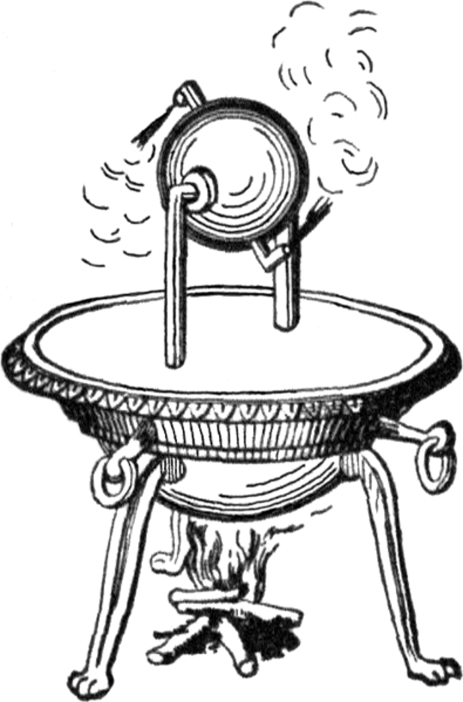
The Aeolipile: Early Steam Technology
Steam School Notes | Chapter 22: Engine Types
Historical significance of the Aeolipile as first known steam-powered device
Described by Hero (Heron) of Alexandria during first century AD
Consisted of hollow sphere mounted to rotate freely
Steam from boiler escaped through bent nozzles, causing sphere to spin
Demonstrated that steam could produce motion nearly 2000 years before Industrial Revolution
Not practical engine: could not perform useful work beyond own rotation
Not connected to machinery
Led to development of practical reciprocating steam engine using piston within cylinder

Slide 3
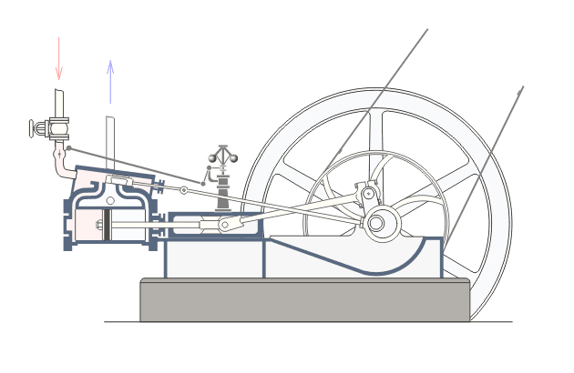
Double-Acting Simple Steam Engine: Components and Operation
Steam School Notes | Chapter 22: Engine Types
Structure and operation of the fundamental reciprocating steam engine design
Basic form of reciprocating steam engine from which many designs developed
Steam acts alternately on both sides of piston, producing power during outward and return strokes
Principal components: cylinder, piston, piston rod, connecting rod, crankshaft, flywheel, steam valve
Steam from boiler enters cylinder through ports controlled by valve mechanism
Steam pressure acts on one side of piston, moving it through cylinder and turning crankshaft
Spent steam on opposite side released through exhaust port
Near end of stroke, valve mechanism changes position
Steam admitted to opposite piston side while first side opens to exhaust
Piston reverses direction and process repeats

Slide 4
Power Stroke Frequency: Steam vs Internal-Combustion Engines
Steam School Notes | Chapter 22: Engine Types
Comparison of power delivery frequency between engine types
Four-stroke internal-combustion engine
  One power stroke per two revolutions of crankshaft
  Remaining strokes used for intake, compression, and exhaust
Two-stroke internal-combustion engine
  One power stroke per revolution of crankshaft
Double-acting steam engine
  One power stroke per 1/2 revolution of crankshaft
  Each piston stroke corresponds to one-half revolution of crankshaft
Frequent application of power explains smooth operation of steam engines
Reduces size of flywheel needed to carry engine through non-power-producing portions

Slide 5
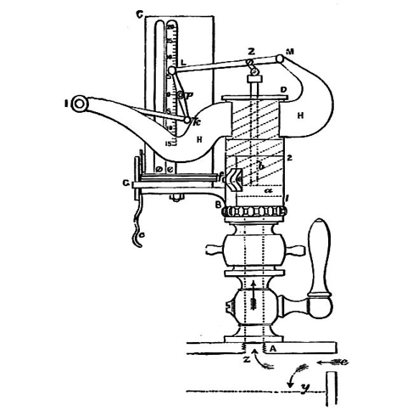
The Steam Indicator: Measuring Cylinder Pressure
Steam School Notes | Chapter 22: Engine Types
Instrument for recording and analyzing cylinder pressure throughout piston cycle
Instruments date back to James Watt in late 18th century
Charles Richards developed improved design about hundred years later
Transforms engine operation from guesswork into measurable engineering process
Connected to engine cylinder by small pipe
Spring-loaded piston moves in response to cylinder pressure changes
Mechanism driven from engine crosshead moves pencil horizontally proportional to piston position
Resulting diagram records cylinder pressure against piston travel

Slide 6
Indicator Diagram: Visualization of Engine Operation
Steam School Notes | Chapter 22: Engine Types
Graphical representation of cylinder pressure changes during piston cycle
Graphical record called indicator diagram or indicator card
Sheet of paper wraps around oscillating drum moving with piston
Pencil rests against paper, moves up and down with steam pressure
Combined motions trace closed loop as piston travels through stroke
Horizontal direction: piston position within cylinder
Vertical direction: steam pressure
Shape of loop reveals events occurring during piston cycle
Provides valuable information about engine operation
Used to evaluate performance, adjust valve settings, diagnose problems
Compares efficiency of different engine designs
For steam engineers, one of most important tools for understanding cylinder operation

Slide 7
Principal Events of the Steam Engine Cycle
Steam School Notes | Chapter 22: Engine Types
Five key events recorded by indicator diagram
Steam admission
Steam cut-off
Expansion
Exhaust release
Compression
These events explain how steam engine obtains useful work from expanding steam
Form foundation for understanding compound and multiple-expansion engines
Cut-off and expansion particularly important for efficient operation

Slide 8
Steam Admission: Beginning the Power Stroke
Steam School Notes | Chapter 22: Engine Types
First event of piston cycle when steam enters cylinder
At beginning of stroke, admission valve opens and high-pressure steam enters cylinder
Pressure rises rapidly and acts on piston
Produces force required to move piston and turn crankshaft
On indicator diagram, appears as near-vertical rise at left side of loop

Slide 9
Steam Cut-Off and Expansive Working
Steam School Notes | Chapter 22: Engine Types
Process of trapping steam to continue performing work after admission stops
After piston travels portion of stroke, admission valve closes
No additional steam enters cylinder
Trapped steam continues pushing piston: process called cut-off
Marks beginning of expansive working
Cut-off position one of most important adjustments affecting engine performance and economy
Typical cut-off occurs between one-quarter and one-third of piston stroke
Allows engine to obtain more useful work from same quantity of steam

Slide 10
Expansion: Continued Work from Expanding Steam
Steam School Notes | Chapter 22: Engine Types
Period when trapped steam continues pushing piston as pressure decreases
Following cut-off, steam expands as piston continues toward end of cylinder
Pressure and temperature decrease during expansion
Steam continues exerting force and producing useful work despite lower pressure
Curved upper portion of indicator diagram represents steam expansion
Ability of expanding steam to continue performing work after admission stopped is key to engine efficiency
Allows engine to extract more work from same quantity of steam
Reduces fuel and water consumption

Slide 11
Exhaust Release: Depressurizing the Cylinder
Steam School Notes | Chapter 22: Engine Types
Event when remaining steam is released near end of piston stroke
Near end of stroke, exhaust valve opens and remaining steam released
Sudden drop in pressure occurs
Event called release
Opening slightly before piston reaches end of stroke reduces back pressure
Reduces pressure opposing return movement of piston
On indicator diagram, appears as steep drop on right side of loop

Slide 12
Compression: Preparing for Next Cycle
Steam School Notes | Chapter 22: Engine Types
Final event of piston cycle when trapped steam is compressed
As piston begins return stroke, exhaust valve closes before piston reaches end
Small quantity of steam remains trapped within cylinder
Trapped steam compressed during final portion of return stroke
Cylinder pressure rises again before fresh steam admitted
Compression cushions piston motion and reduces mechanical shock
Prepares cylinder for next admission of steam
Lower portion of indicator diagram represents compression process

Slide 13
Complete Piston Cycle: Integration of Five Events
Steam School Notes | Chapter 22: Engine Types
How five cycle events combine to convert steam energy to mechanical work
Steam admission, cut-off, expansion, release, and compression form complete piston cycle
Indicator diagram provides convenient visualization of these events
Shows how engine converts energy in steam into useful mechanical work
Cut-off and expansion particularly important
Allow engine to continue producing work after steam admission stopped
Reduce steam consumption and improve operating economy

Slide 14
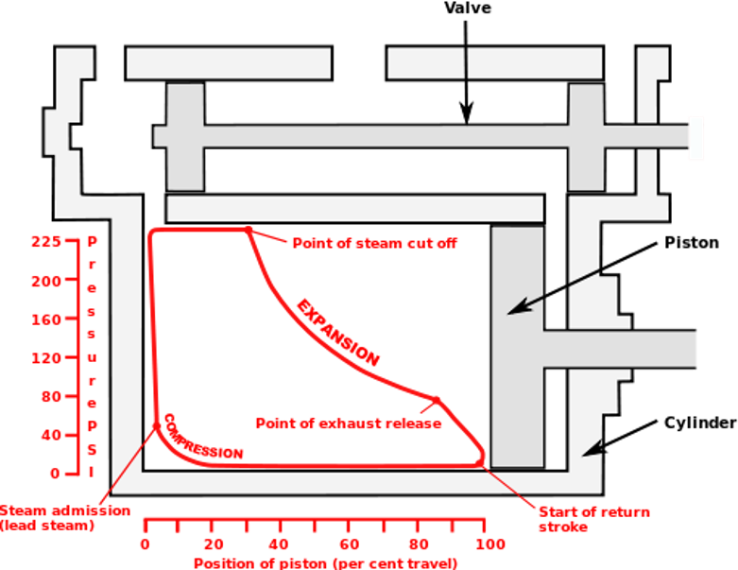
Schematic Indicator Diagram: Events in Position
Steam School Notes | Chapter 22: Engine Types
Visualization of indicator diagram events mapped to piston position
Places indicator diagram directly on engine cylinder
Allows association of diagram events with physical piston position
Shows operation of valves relative to piston location
Aids understanding of cycle events

Slide 15
Expansive Working: The Core Principle of Efficiency
Steam School Notes | Chapter 22: Engine Types
Fundamental principle enabling steam engines to extract maximum work per pound of steam
Expansive working: ability of expanding steam to continue performing work after admission stopped
Simple solution would admit steam throughout entire stroke
Would produce large force but consume large steam quantity
More economical approach: cut-off after 25% to 33% of stroke
Trapped steam expands and continues pushing piston to end of stroke
Although pressure falls during expansion, steam continues exerting force and performing work
Engine extracts additional work from steam already admitted
Reduces fuel and water consumption per unit of power produced
Expansive working allows steam engines to obtain more useful work from each pound of steam by allowing pressure-reduced steam to continue pushing the piston after admission has ceased.

Slide 16
Temperature Changes During Steam Expansion
Steam School Notes | Chapter 22: Engine Types
Thermodynamic behavior of steam as it expands in cylinder
As steam expands, pressure decreases
Temperature also decreases as energy transferred to piston as mechanical work
Very little heat exchanged between steam and surroundings during expansion period
Engineers describe as adiabatic expansion
Adiabatic expansion: process where steam performs work while losing little or no heat to outside environment
Steam enters cylinder at relatively high temperature
Leaves at lower temperature after expansion

Slide 17
Cylinder Temperature Cycling: A Major Inefficiency
Steam School Notes | Chapter 22: Engine Types
Source of energy waste from repeated heating and cooling of cylinder walls
During admission, hot incoming steam heats cylinder walls
During expansion and exhaust, cooler steam allows walls to cool
Continual cycle of heating and cooling occurs with every stroke
Energy repeatedly transferred into and out of metal cylinder
Energy converted to heat rather than useful work
Heating and cooling of cylinder one of principal sources of inefficiency in simple engine
The repeated heating and cooling of cylinder walls during each piston stroke represents a significant waste of energy in simple steam engines, as heat energy is dissipated rather than converted to mechanical work.

Slide 18
Economy versus Smoothness Trade-Off in Engine Design
Steam School Notes | Chapter 22: Engine Types
Design compromise between steam economy and uniform turning effort
Early cut-off improves economy: more work obtained from each pound of steam
Trade-off: steam pressure falls during expansion, force decreases throughout stroke
Turning moment (torque) on crankshaft becomes less uniform
To smooth variations, steam engines rely on flywheel
Flywheel stores energy during stronger portions of cycle
Releases energy during weaker portions
Engines with very early cut-off require larger flywheels to maintain steady speed
Steam engineers faced compromise: early cut-off reduced consumption but increased turning effort variation
Much of steam engine development history: attempt to achieve both good economy and smooth operation

Slide 19
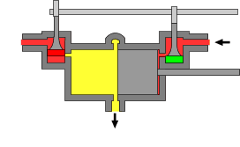
Uniflow Engine: Reducing Cylinder Temperature Variations
Steam School Notes | Chapter 22: Engine Types
Engine design that minimizes temperature cycling within cylinder
Uniflow engine: design where steam enters at cylinder ends, exhausts through central ports, traveling in one direction rather than alternating
Addresses inefficiency of conventional engines where hot incoming steam and cooler exhaust pass through same regions
Conceptually: two half-cylinders sharing common exhaust region at center
Steam enters through inlet valves near cylinder ends
Exhausts through ports near center of cylinder
Unlike double-acting engine with alternating admission and exhaust at both ends
In uniflow, steam always travels same direction: from hot ends toward cooler central exhaust ports
Ends remain relatively hot while central exhaust region remains relatively cool
Temperature variations within cylinder reduced

Slide 20
Compound Engine: Dividing Expansion Among Multiple Cylinders
Steam School Notes | Chapter 22: Engine Types
Development of compound engines to improve steam economy
Compound engine: engine that passes steam through multiple cylinders, expanding progressively as pressure decreases
Double-acting simple engine uses single cylinder for admission, expansion, and exhaust
As steam expands, pressure and temperature decrease
Large temperature range between admission and exhaust causes repeated heating and cooling
Solution: divide expansion process into stages
High-pressure steam enters small high-pressure (HP) cylinder
After doing work, steam passes to larger low-pressure (LP) cylinder
Additional expansion occurs before exhaust to atmosphere or condenser
Purpose not simply to add cylinders
Purpose to obtain more useful work from steam
Reduce cylinder temperature variations
Improve overall economy of engine

Slide 21
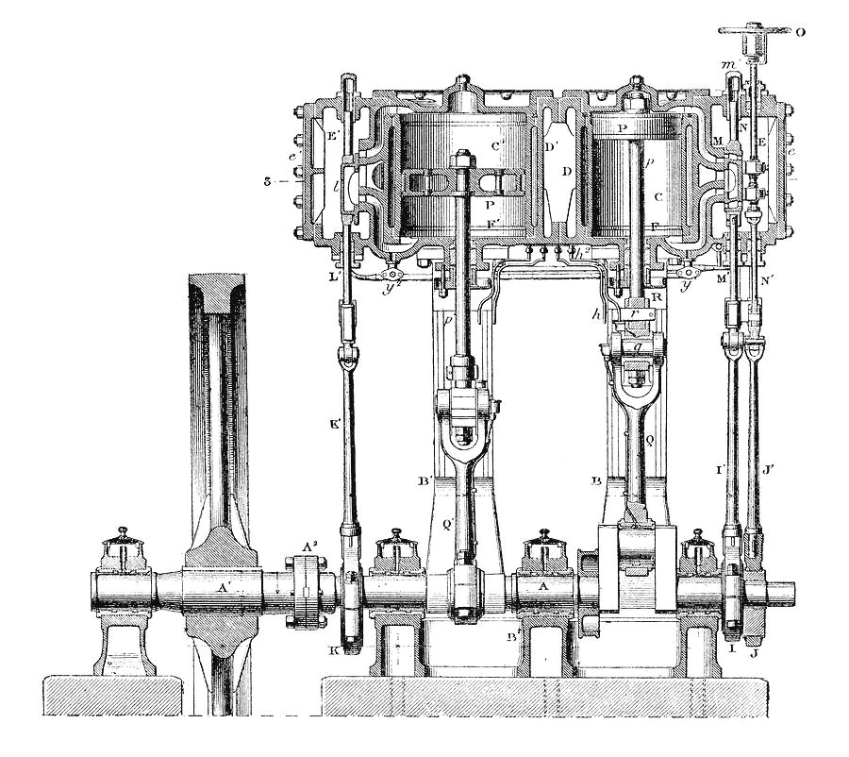
Cross-Compound Engine: Side-by-Side Configuration
Steam School Notes | Chapter 22: Engine Types
Compound engine arrangement with separate crank throws
High-pressure and low-pressure cylinders mounted side by side
Drive separate crank throws on common crankshaft
Steam enters small high-pressure cylinder, partially expands
Passes to larger low-pressure cylinder where expansion continues before exhaust
Low-pressure cylinder larger than high-pressure cylinder
Steam occupies greater volume after expansion
Can be recognized by two separate cylinders and connecting rods on different crank throws
Distributes turning effort more evenly around crankshaft
Provides smoother operation than single-cylinder engine
Popular arrangement for stationary and marine service
Combined improved economy with straightforward mechanical construction

Slide 22
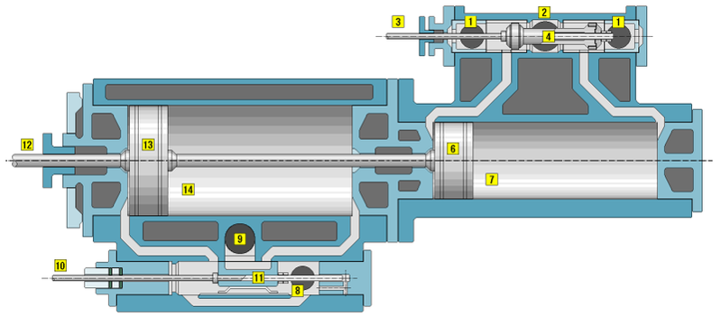
Tandem Compound Engine: Inline Configuration
Steam School Notes | Chapter 22: Engine Types
Compound engine with cylinders on common centerline
High-pressure (HP) and low-pressure (LP) cylinders arranged in line
Share common piston rod
Both pistons drive same connecting rod and crankshaft
High-pressure steam enters smaller HP cylinder, does work
Partially expanded steam passes directly to larger LP cylinder
Expansion continues before exhaust
Steam path: Boiler → HP Cylinder → LP Cylinder → Exhaust
Unlike cross-compound, uses single connecting rod and crank throw
Results in more compact engine with fewer moving parts
Forces from HP and LP pistons combine before reaching crankshaft

Slide 23
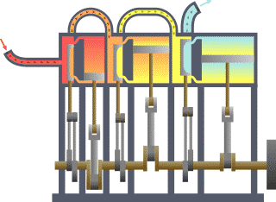
Triple-Expansion Engine: Three-Stage Expansion
Steam School Notes | Chapter 22: Engine Types
Engine dividing expansion among three progressively larger cylinders
As boiler pressures increased, greater economy achieved by expanding steam in three stages
Result: triple-expansion engine, one of most successful steam-engine designs ever built
Steam passes through three cylinders of progressively increasing size
High-Pressure (HP) Cylinder
Intermediate-Pressure (IP) Cylinder
Low-Pressure (LP) Cylinder
High-pressure steam from boiler enters HP cylinder, performs work
Partially expanded steam passes to IP cylinder, further expansion occurs
Steam enters LP cylinder where last stage of expansion takes place
Exhausted to condenser or, in some cases, directly to atmosphere
Steam path: Boiler → HP Cylinder → IP Cylinder → LP Cylinder → Exhaust

Slide 24
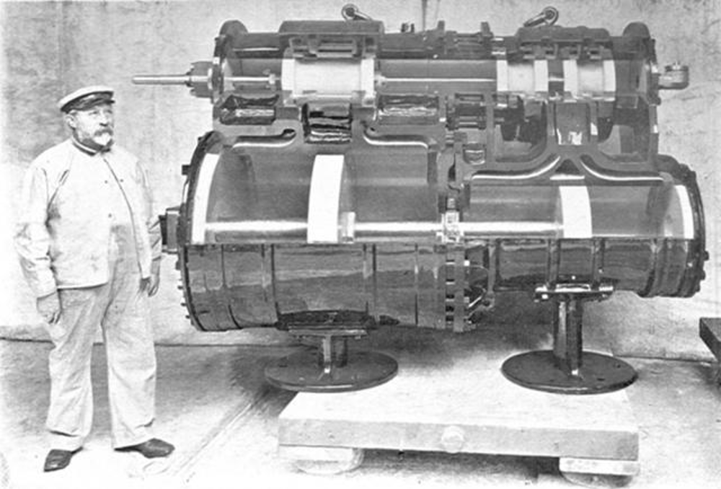
Vauclain Compound: Compact Locomotive Compounding
Steam School Notes | Chapter 22: Engine Types
Specialized compound arrangement for railway locomotive service
Developed by Baldwin Locomotive Works as compact method of compound expansion for locomotives
Differs from conventional cross-compound engine
High-pressure (HP) and low-pressure (LP) cylinders stacked above one another on each side of locomotive
Two pistons share common crosshead and drive single connecting rod
High-pressure steam enters smaller HP cylinder
After partial expansion, steam directed to larger LP cylinder
Additional expansion before exhaust
Steam path: Boiler → HP Cylinder → LP Cylinder → Exhaust
Combines advantages of tandem and cross-compound engines
Cylinders closely grouped, producing compact installation
Suitable for locomotive service where space between frame rails limited
Widely used during late nineteenth century by railways seeking improved fuel economy

Slide 25
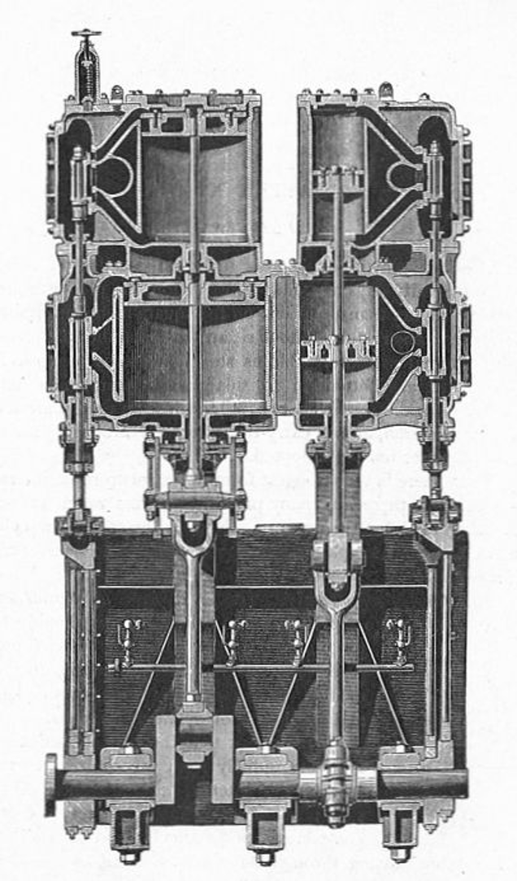
Quadruple-Expansion Engine: Four-Stage Expansion
Steam School Notes | Chapter 22: Engine Types
Most highly developed form of reciprocating compound steam engine
As steam pressures increased, engineers sought even greater economy by four-stage expansion
Quadruple-expansion engine: most highly developed reciprocating compound steam engine form
Steam passes through four cylinders of progressively increasing size
High-Pressure (HP)
First Intermediate-Pressure (IP)
Second Intermediate-Pressure (IP)
Low-Pressure (LP)
Steam path: Boiler → HP → IP → IP → LP → Exhaust
Each cylinder larger than previous because steam occupies increasingly greater volume
Example engine by Fleming & Ferguson of Paisley:

Slide 26
Historical Context: Steam-Engine Catechisms as Technical Instruction
Steam School Notes | Chapter 22: Engine Types
Pedagogical method for technical education in nineteenth-century engineering
Many nineteenth and early twentieth-century engineering manuals written as catechism
Format: series of questions and answers intended for memorization and discussion
Reflected apprenticeship system through which many engineers learned trade
Goal: not merely provide information but establish shared technical vocabulary
Apprentices reviewed questions and answers repeatedly
Learned both terminology and principles needed to operate and maintain steam machinery
Nehemiah Hawkins' Steam Engine Catechism and Steam Indicator Catechism among best-known examples
Represented effective method for practical technical instruction

Slide 27
Summary: Evolution of Steam-Engine Efficiency
Steam School Notes | Chapter 22: Engine Types
Overview of progression from early to advanced steam-engine designs
From Aeolipile of Hero to refined uniflow engine, history of steam engine largely history of improving steam expansion use
Engineers progressively learned to obtain more work from each pound of steam
Reduced fuel consumption and mechanical losses
Steam engines appeared in many configurations
Underlying objective remained constant: convert as much heat energy as possible into mechanical work
Before steam was exhausted
Key developments: early cut-off, expansive working, compound expansion, uniflow principle
All important steps toward goal of extracting more work from each pound of steam
The history of steam-engine development represents a continuous effort to extract more useful work from each pound of steam through understanding and refinement of expansion processes, achieving both improved economy and smoother operation.

