Slide 1
Chapter 21 Summary
Steam School Notes | Canadian Registration Numbers (CRNs)
Canadian Registration Numbers (CRNs)
A Material Test Report (MTR) proves material acceptability
A Canadian Registration Number (CRN) proves design acceptability
A CRN demonstrates that the design of a pressure-retaining component has been reviewed and accepted by the applicable Canadian regulatory authority
Both MTR and CRN may be required before a component can be installed in a pressure system
Common CRN applications
Valves
Fittings
Pressure vessels
Boilers
Heat exchangers
Pressure piping components
A CRN is evidence that a pressure-retaining component design has been reviewed and accepted by the applicable Canadian regulatory authority

Slide 2
What Is a CRN and Why CRNs Exist
Steam School Notes | Canadian Registration Numbers (CRNs)
Purpose and definition of Canadian Registration Numbers
CRN definition
Issued after a pressure-retaining design has been reviewed and accepted by the appropriate regulatory authority
A component that requires registration may not be legally installable until an appropriate CRN has been obtained
Why CRNs exist
Pressure equipment can store a tremendous amount of energy
If a component fails, consequences may include serious injury, property damage, loss of production, and environmental damage
CRNs provide a mechanism for verifying that pressure-containing designs meet requirements of applicable codes and standards before placement into service

Slide 3
CRNs versus MTRs
Steam School Notes | Canadian Registration Numbers (CRNs)
Distinction between MTRs and CRNs
Question | Document
Is the material acceptable? | MTR
Is the design acceptable? | CRN
Documentation requirements
MTR and CRN are often confused because both involve documentation
However, they answer different questions
A valve may have a valid MTR for its material and a valid CRN for its design
Both forms of documentation may be required

Slide 4
CRN Format and Location
Steam School Notes | Canadian Registration Numbers (CRNs)
CRN format, identification, and physical location
Typical CRN format examples
0C12345.5C
0F56789.2
CRN format components
A registration number
One or more jurisdiction identifiers
Where CRNs appear
A nameplate
A casting
A stamping
A manufacturer's data report
Product documentation

Slide 5
CRN Format and Location
Steam School Notes | Canadian Registration Numbers (CRNs)
CRN format, identification, and physical location
Physical markings on components
Pressure vessels
Safety valves
Fittings
Strainers
Heat exchangers
Inspection guidance
When inspecting a component, both the physical marking and the supporting documentation should be reviewed

Slide 6
Components with CRNs
Steam School Notes | Canadian Registration Numbers (CRNs)
Types of pressure-retaining components commonly registered with CRNs
Valves
Safety valves
Pressure reducing valves
Control valves
Fittings
Forged steel fittings
Specialized branch fittings
Strainers
Pressure vessels
Air receivers
Steam separators
Heat exchangers
Boiler components

Slide 7
CRN Function and Limitations
Steam School Notes | Canadian Registration Numbers (CRNs)
What CRNs do and do not represent
CRN function
The CRN acts as a reference that links the component design to the registration records maintained by the regulatory authority
A CRN is not intended to provide material properties or operating pressures
What CRN does not replace
MTRs
Pressure ratings
Nameplate information
Code markings
A CRN proves design acceptability only; the condition of the individual component must be verified by inspection, testing, and proper maintenance

Slide 8
CRN Function and Limitations
Steam School Notes | Canadian Registration Numbers (CRNs)
What CRNs do and do not represent
Common misconception
Many assume a CRN proves a component is safe to use
In reality, a CRN only demonstrates that the design has been reviewed and accepted
The condition of the component must still be verified by inspection, testing, and proper maintenance
A CRN demonstrates acceptance of the design, not the condition of the individual component
Component condition factors
A valve may have a valid CRN but still be worn, damaged, improperly installed, or unsuitable for the intended service

Slide 9
Why Pipefitters Should Care About CRNs
Steam School Notes | Canadian Registration Numbers (CRNs)
Relevance and application of CRN knowledge for inspectors and operators
Responsibility
Pipefitters, inspectors, and owners are often responsible for verifying that the correct components have been installed
Inspection questions
Does this component require a CRN?
Is a CRN present?
Does the documentation match the component?
Key benefit
Understanding where to find a CRN and what it represents can help avoid delays during inspection and certification

Slide 10
Example CRN Registration
Steam School Notes | Canadian Registration Numbers (CRNs)
Interpretation of a real CRN registration document
Key concept
A CRN is usually issued for a family of pressure-retaining designs rather than for a specific serial-numbered valve
Registration identifies
The manufacturer
The applicable design standard
The types of valves covered
Materials of construction
Pressure ratings
Size ranges
Manufacturer model numbers
Example application
Registration applies to a variety of bronze gate, globe, and check valves manufactured in accordance with MSS SP-80

Slide 11
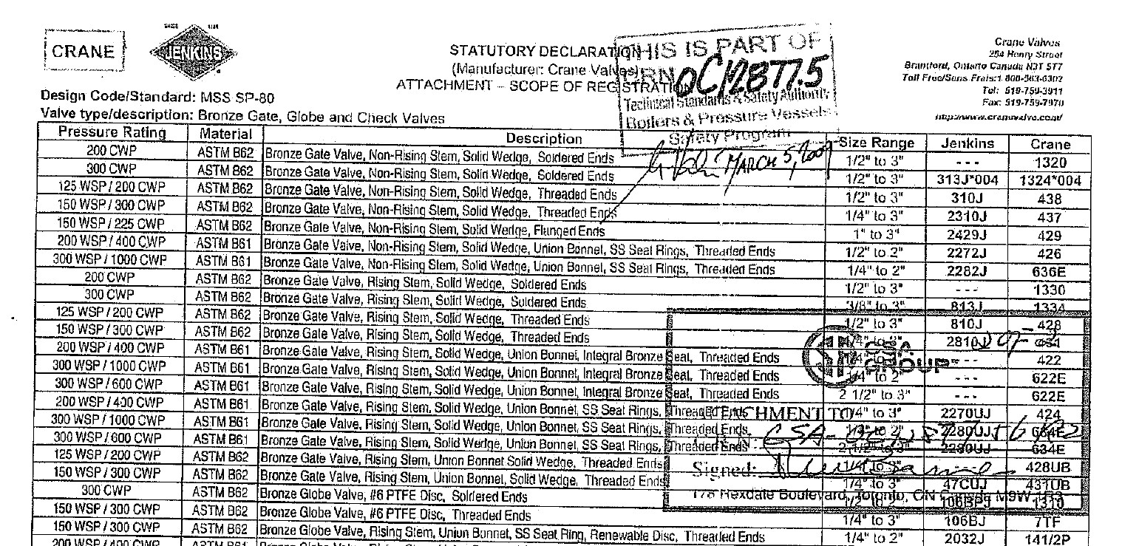
CRN Registration Example
Steam School Notes | 21 Canadian Registration Numbers (CRNs)
CRN issued for family of designs

Slide 12
CRN Coverage and Limitations
Steam School Notes | Canadian Registration Numbers (CRNs)
Scope of what CRN registrations cover and do not cover
What CRN covers
A CRN certifies the design of a valve family
A particular model may be available in several sizes, multiple pressure ratings, and different end connections
All configurations may be covered by the same registration provided they fall within the approved scope
What CRN does not cover
Prove the material composition
Replace the MTR
Verify the condition of a valve
Guarantee proper installation
Material and verification
Material certification, inspection, testing, and maintenance address these matters

Slide 13
Province and Territory CRN Suffixes
Steam School Notes | Canadian Registration Numbers (CRNs)
Decoding CRN jurisdiction identifiers
Suffix meaning
Digits and letters after the decimal point identify jurisdictions where the design has been accepted
The first digit or letter after the decimal point indicates the province or territory where the design was first registered
Code | Province or Territory
1 | British Columbia
2 | Alberta
3 | Saskatchewan
4 | Manitoba
5 | Ontario
6 | Quebec
7 | New Brunswick
Code | Province or Territory
8 | Nova Scotia
9 | Prince Edward Island
0 | Newfoundland and Labrador
N | Nunavut
T | Northwest Territories
Y | Yukon

Slide 14
Reading CRN Suffixes: Examples
Steam School Notes | Canadian Registration Numbers (CRNs)
Interpretation of CRN suffix examples
Example: 4321.5
Indicates a design first registered in Ontario
Example: 4321.52
Indicates a design first registered in Ontario and subsequently accepted in Alberta
Example: 4321.15
Indicates a design first registered in British Columbia and later accepted in Ontario
Order significance
The order of the suffixes is important because the first jurisdiction shown is the jurisdiction that originally issued the registration
A design registered in Ontario and later accepted in Alberta is not the same registration history as a design first registered in Alberta and later accepted in Ontario

Slide 15
The Letter C in CRN Suffixes
Steam School Notes | Canadian Registration Numbers (CRNs)
Meaning of C designation in CRN
C designation
Many modern CRNs end with the letter C, for example: 0C12877.5C
The letter C indicates that the design has been accepted in all Canadian jurisdictions
Example interpretation: 0C12877.5C
The design was first registered in Ontario (5)
The design was subsequently accepted throughout Canada (C)
Purpose
This abbreviation is commonly used because listing every individual province and territory would make the CRN unnecessarily long
Crane registration example
Crane valve registration carries the CRN: 0C12877.5
The .5 indicates that Ontario was the first jurisdiction to register the design
If registration subsequently receives acceptance across Canada, the CRN may be shown as: 0C12877.5C

Slide 16
Why Jurisdiction Suffixes Matter
Steam School Notes | Canadian Registration Numbers (CRNs)
Significance of CRN suffix codes for equipment selection
Importance
When reviewing a valve, fitting, or pressure vessel, the presence of a CRN demonstrates that the design has been reviewed and accepted by the relevant regulatory authority
Information suffix provides
Where the design was first registered
Whether the design has been accepted in multiple jurisdictions
Whether the design has Canada-wide acceptance
Practical application
Becomes particularly important when purchasing pressure equipment that may be installed in different provinces or territories

Slide 17
Historical Boilers and CRNs
Steam School Notes | Canadian Registration Numbers (CRNs)
CRN registration considerations for heritage boilers
Modern versus historical equipment
Most modern valves, fittings, and pressure vessels are manufactured from standardized designs covered by a CRN that applies to an entire family of products
Historical boilers are often very different
Historical boiler characteristics
Many heritage boilers were built as individual machines
Modified over their operating lives
Repaired using a variety of methods
Constructed before modern design standards were established
Registration approach
Each historical boiler may require its own unique registration and evaluation
In Manitoba, heritage boilers are typically assigned an individual CRN because each boiler has a unique construction history, repair and alteration history, and inspection history

Slide 18
Historical Boilers: CRN and MAWP Relationship
Steam School Notes | Canadian Registration Numbers (CRNs)
CRN and MAWP relationship
The CRN for a historical boiler is closely tied to the boiler's Maximum Allowable Working Pressure (MAWP)
MAWP determination
Established through a combination of inspection, non-destructive examination (NDE), thickness measurements, engineering calculations, and applicable code requirements
Changes over time
As the boiler ages, periodic inspections may reveal changes in condition, including corrosion, wastage, repairs, or other factors that affect strength
Under the National Board Inspection Code (NBIC), historical boilers are periodically re-evaluated
If results of inspection or NDE lead to a change in calculated MAWP, the boiler's registration records must be updated
MAWP reduction implications
A reduction in MAWP normally requires a corresponding change to the boiler's registered maximum allowable operating pressure
May require revisions to safety-valve settings, inspection records, and registration documentation

Slide 19
Historical Boilers: Ongoing CRN Evolution
Steam School Notes | Canadian Registration Numbers (CRNs)
Dynamic nature of CRN registration for heritage boilers
Modern versus historical CRN roles
For modern catalogued valves and fittings, the CRN is primarily a design-registration document
For historical boilers, the CRN becomes part of an ongoing process of inspection, engineering evaluation, and regulatory oversight
CRN evolution
A historical boiler's CRN may evolve over time as new inspection information becomes available and the boiler's allowable operating pressure is reassessed
Documentation consistency
Pressure ratings, safety-valve settings, inspection certificates, and CRN records must all remain consistent with the boiler's current MAWP
This is one reason why these documents must be kept in alignment
Pressure ratings, safety-valve settings, inspection certificates, and CRN records must remain consistent with the boiler's current MAWP

