Slide 1
Chapter Overview
Steam School Notes | Chapter 11 Strength of the Boiler Shell
Introduction to boiler shell strength
Pressure acts perpendicular to surfaces in all directions
Pressure-retaining parts experience enormous forces
Curved surfaces carry pressure more efficiently than flat surfaces
Cylindrical shells form the main body of most boilers
Understanding force distribution through structure is key to boiler strength

Slide 2
Curved Surfaces vs. Flat Surfaces
Steam School Notes | Chapter 11 Strength of the Boiler Shell
How different shapes respond to internal pressure
Curved (cylindrical) surfaces: Expand slightly under pressure; load carried efficiently as tension around the shell
Flat surfaces: Bend and bulge outward under pressure; bending stresses increase rapidly with plate size; require stays or reinforcement
Cylindrical shells carry pressure most efficiently
Shell, barrel, steam dome, and other pressure-retaining parts use curved shapes
Curved shapes form the main body of most boilers

Slide 3
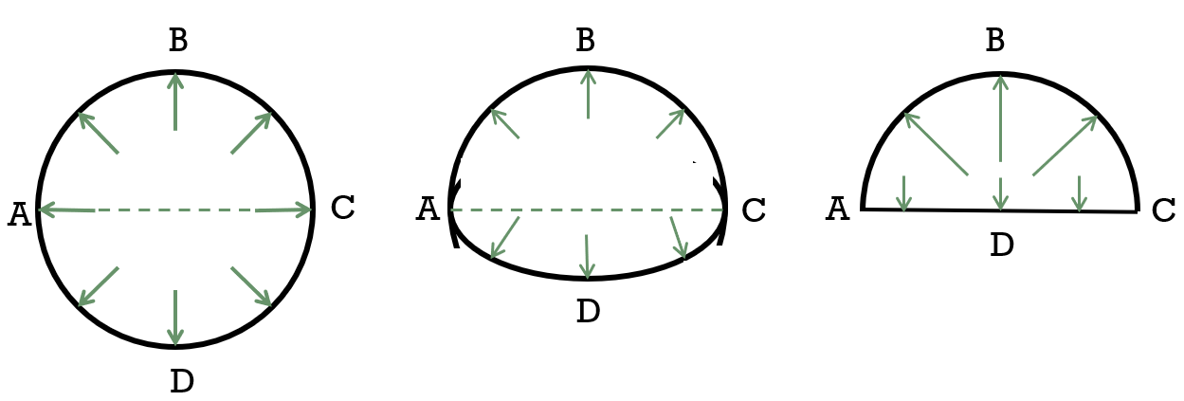
Shell Failure Analysis: The Longitudinal Plane Method
Steam School Notes | Chapter 11 Strength of the Boiler Shell
Understanding how cylindrical shells resist pressure through force balance
Cylindrical shell divided by longitudinal plane into two halves
Internal pressure pushes upward on one half, downward on the other
Total separating force equals pressure multiplied by projected area
Upper and lower forces must be equal to prevent differential rise
At the dividing line, material experiences two equal opposing forces
Force Balance Principle
If lower force was less than upper force, boiler would rise (new form of air travel)
Therefore, forces must match: force on flat lower surface equals force on curved upper surface
This force balance is the key to understanding shell strength

Slide 4
Shell Failure Analysis: Tensile Forces at the Seam
Steam School Notes | Chapter 11 Strength of the Boiler Shell
How material resists separating forces through tensile strength
Resisting Area and Tensile Force
Material along dividing line experiences two equal forces in opposite directions
Resisting area equals shell thickness multiplied by cylinder length at each side
Total resisting area: 2LT
Force required to tear metal determined by tensile strength of material
Shell bursts when force on seam equals tensile strength
Bursting Pressure Relationship
Bursting pressure depends on thickness and diameter only
Cylinder length cancels out in bursting pressure equation
Length of cylinder does not affect bursting pressure
Bursting pressure formula: P_{b} = (2T × σ_{t}) / D

Slide 5
Worked Example: Bursting Pressure Calculation
Steam School Notes | Chapter 11 Strength of the Boiler Shell
Calculating burst pressure for a specific cylindrical boiler
Given Parameters
Diameter: D = 30 in
Length: L = 96 in
Internal pressure: P_{B} = 100 lb/in²
Shell thickness: T = 0.250 in
Tensile strength: σ_{t} = 60,000 lb/in²
Separating Force Calculation
P_{D} = D × L × P_{B} = 30 in × 96 in × 100 lb/in² = 288,000 lb
Resisting Area Calculation
A_{s} = 2 × L × T = 2 × 96 in × 0.250 in = 48 in²
Bursting pressure depends on tensile strength
σ_{t} =P_{D}/A_{s}
= D × L × P_{B} / (2 × L × T )
P_{B} = (2 × L × T × σ_{t}) / (D × L)
= (2 × T × σ_{t}) / D
Bursting Pressure Result
P_{B} = (2 × T × σ_{t}) / D = (2 × 0.250 × 60,000) / 30 = 1,000 psi
Cylinder 30 inches diameter, 96 inches long, 0.250 inch thick will burst at 1,000 psi

Slide 6
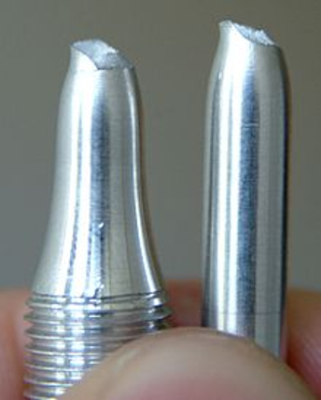
Material Behavior Under Tensile Stress
Steam School Notes | Chapter 11 Strength of the Boiler Shell
How metals deform and fail when pulled in tension
Stages of Material Deformation
Elastic stretching: Bolt lengthens slightly; would return to original shape if load removed
Yield strength reached: Material begins permanent deformation; neck forms in bolt
Neck growth: Remaining metal carries entire load across progressively smaller area; stress increases rapidly
Fracture: Material reaches ultimate tensile strength and breaks
Ductile material: Shows visible warning through significant deformation before breaking; characteristic necked shape on failed specimen
Brittle material: Shows little or no necking before fracture

Slide 7
Stress, Strain, and Material Elasticity
Steam School Notes | Chapter 11 Strength of the Boiler Shell
Fundamental definitions and behavior of materials under load
Stress: Force acting on a material
Strain: Deformation produced by stress
Elastic behavior: At low stresses, deformation is completely recoverable when load is removed
Yield strength: Stress level beyond which permanent deformation occurs
Ultimate tensile strength: Stress level at which material finally fractures
Stress-Strain Curve Regions
Elastic region: Deformation recoverable, metal returns to original shape
Yield point: Transition to permanent deformation
Plastic deformation leading to fracture: Progressive permanent deformation until failure
Key Material Relationships
For most boiler materials: Yield strength ≈ 1/2 × Tensile strength
Safe operation should remain well within elastic region

Slide 8
Safety Factor and Maximum Allowable Working Pressure
Steam School Notes | Chapter 11 Strength of the Boiler Shell
How safety factors protect boiler operation
Factor of safety: Margin between working stress and failure stress
Maximum Allowable Working Pressure (MAWP): P_MAWP = P_B / F, where F is the factor of safety
Design Rationale
Boilers are never operated near tensile strength limit
Factor of safety provides essential margin
MAWP equation: P_MAWP = (2 × T × σ_t) / (F × D)
Safety Considerations
Cylndrical boiler shell theoretically bursts at high pressure
Safe maximum operating pressure is significantly lower
Factor of safety ensures long-term safe operation

Slide 9
Example: Factor of Safety of Four
Steam School Notes | Chapter 11 Strength of the Boiler Shell
Application of safety factor to boiler design
Example Boiler Parameters
Bursting pressure: P_{B} = 1,000 psi
Factor of safety: F = 4
Maximum Allowable Working Pressure: P_MAWP = 1,000 / 4 = 250 psi
Result
Boiler that theoretically bursts at 1,000 psi is limited to working pressure of 250 psi
This ensures safe operation with adequate safety margin

Slide 10
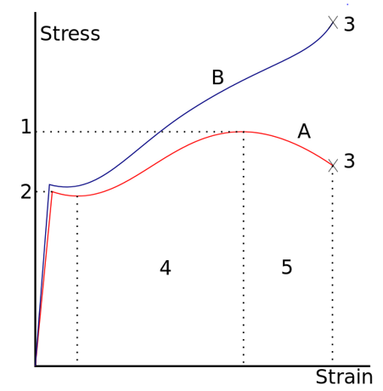
Safety Factor and Yield Strength Relationship
Steam School Notes | Chapter 11 Strength of the Boiler Shell
Why a factor of safety of four keeps operation in the elastic range
Yield Strength Relationship
For typical boiler steels: σ_y = σ_t / 2
Factor of safety of 4 limits working stress to σ_t / 4
This places working stress at approximately σ_y / 2
Operational Advantages
Working stress lies in lower half of elastic range
Well below onset of permanent deformation
Metal will return to original shape when load removed
Safety Margins Provided
Pressure fluctuations
Material variations
Corrosion and wear
Manufacturing tolerances
Minor stress concentrations
Uncertainties in operation

Slide 11
Engineering Stress vs. True Stress
Steam School Notes | Chapter 11 Strength of the Boiler Shell
Distinction between measured and actual stress in materials
Engineering stress: s = F / A₀, calculated using original cross-sectional area
True stress: σ = s × (1 + e), accounts for area reduction during stretching
Key Differences
As specimen stretches, width and thickness decrease
Actual stress in material greater than engineering stress
Engineering strain: e (engineering measurement)
True strain: ε = ln(1 + e) (actual state of material)
Engineering vs. True Stress for Boiler Design
Engineering stress convenient because requires only original specimen dimensions
True stress better represents actual state of material during deformation
For boiler design, allowable working stress intentionally kept far below ultimate tensile strength and fracture
Factor of safety of 4 places operation safely within elastic region

Slide 12
Design Implications of MAWP Formula
Steam School Notes | Chapter 11 Strength of the Boiler Shell
Practical design choices when increasing boiler size
MAWP Formula
P_MAWP = (2 × T × σ_{t}) / (F × D)
Options When Diameter Increases
Increase shell thickness
Use stronger material
Accept lower working pressure
Reduce factor of safety (if approved by code)
Key Design Relationship
Increasing shell thickness increases safe working pressure in direct proportion
This simple relationship is fundamental principle of boiler and pressure-vessel design

