Slide 1
Chapter Overview
Steam School Notes | Chapter 2: Boiler Construction
Boiler construction fundamentals
Boiler construction studies how pressure-retaining parts are shaped, supported, joined, and protected against failure
A boiler is a pressure vessel made from curved shells, flat sheets, openings, seams, tubes, stays, fittings, and reinforcement
Some parts are naturally strong due to shape; others require stays or support
Analysis determines which surfaces are self-supporting and which require stays
Chapter topics
Main historical boiler types
Important parts of a firetube boiler
Construction analysis for shells, riveted joints, and stayed surfaces

Slide 2
Boiler Types Overview
Steam School Notes | Chapter 2: Boiler Construction
Historic steam boiler arrangements
Historic steam equipment used several boiler arrangements
Each type places fire, water, steam space, tubes, flues, and pressure-retaining surfaces in different relationships
Differences are not merely visual but functional

Slide 3
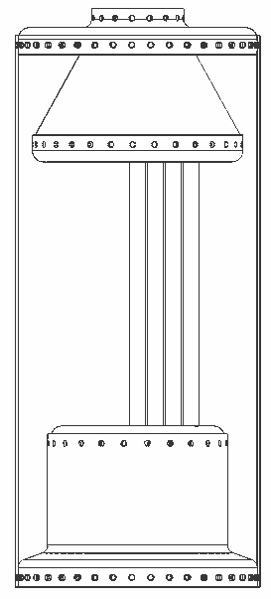
Vertical Boiler
Steam School Notes | Chapter 2: Boiler Construction
Vertical boiler design and characteristics
Design features
Shell placed upright
Compact and useful where floor space is limited
Suitable for moderate steam output
Structural characteristics
Cylindrical pressure vessel
Round shape provides relative strength under internal pressure
Firebox and heating surface arranged in several ways depending on design
May use tubes, cross tubes, or other internal heating surfaces
Simple and compact design
Steam space, water level, and heating surface must fit within short vertical vessel
Water-level management especially important

Slide 4
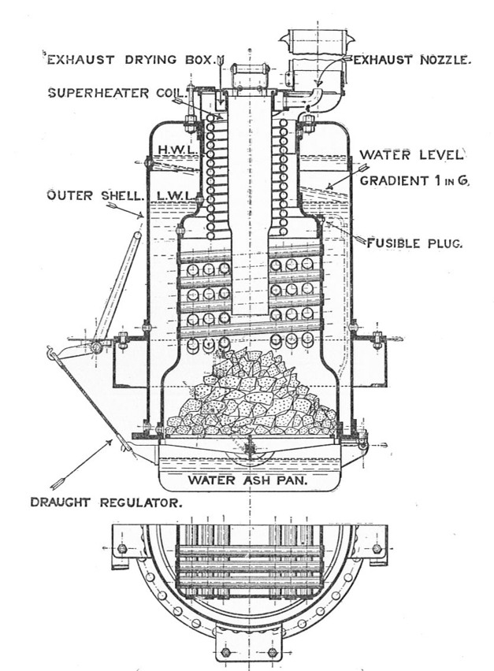
Water-tube Boiler
Steam School Notes | Chapter 2: Boiler Construction
Water-tube boiler design and advantages
Operating principle
Water flows inside tubes
Hot gases pass around outside of tubes
Reverse of firetube boiler arrangement
Construction advantages
Pressure-retaining tubes are small in diameter
Small-diameter pressure parts easier to make strong than large-diameter shell at same pressure
Well-suited to higher pressures
Can provide large heating surface in compact arrangement
More complex than simple firetube boilers
Involve more individual pressure parts

Slide 5
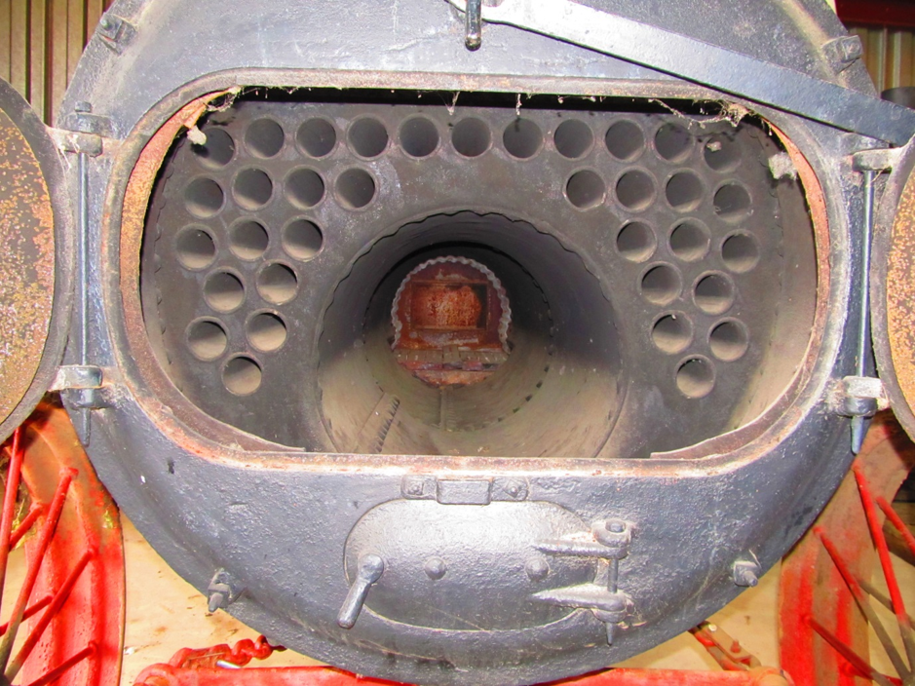
Return Flue Boiler
Steam School Notes | Chapter 2: Boiler Construction
Return flue boiler design and construction
Design characteristics
Gas path returns through boiler before discharge
Increases effective heating path within relatively compact shell
Firetube-family design: hot gases pass through flues surrounded by water
Construction features
Cylindrical shell largely self-supporting
Flat ends require construction details for adequate strength
Tube sheets require construction details for adequate strength
Openings require construction details for adequate strength

Slide 6
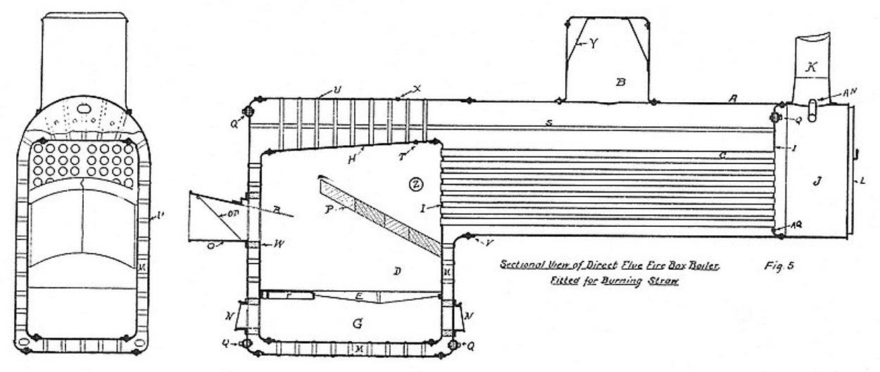
Locomotive-style Firetube Boiler
Steam School Notes | Chapter 2: Boiler Construction
Locomotive-style firetube boiler arrangement and components
General arrangement
Firebox located at rear
Hot gases pass from firebox through tubes or flues toward front smokebox
Water surrounds firebox and tubes
Steam collects above water line

Slide 7
Locomotive-style Firetube Boiler
Steam School Notes | Chapter 2: Boiler Construction
Locomotive-style firetube boiler arrangement and components
Construction components
Cylindrical shell or barrel
Flat front and rear tube sheets
Firebox sheets exposed to intense heat
Water legs around firebox
Crown sheet over fire
Staybolts and through stays supporting flat areas
Smokebox and front flue sheet
Steam collection through dome and dry pipe
Barrel is round and comparatively efficient as pressure vessel
Firebox, tube sheets, and backhead contain flat or partly flat areas that must be stayed
Combines multiple construction problems in one vessel

Slide 8
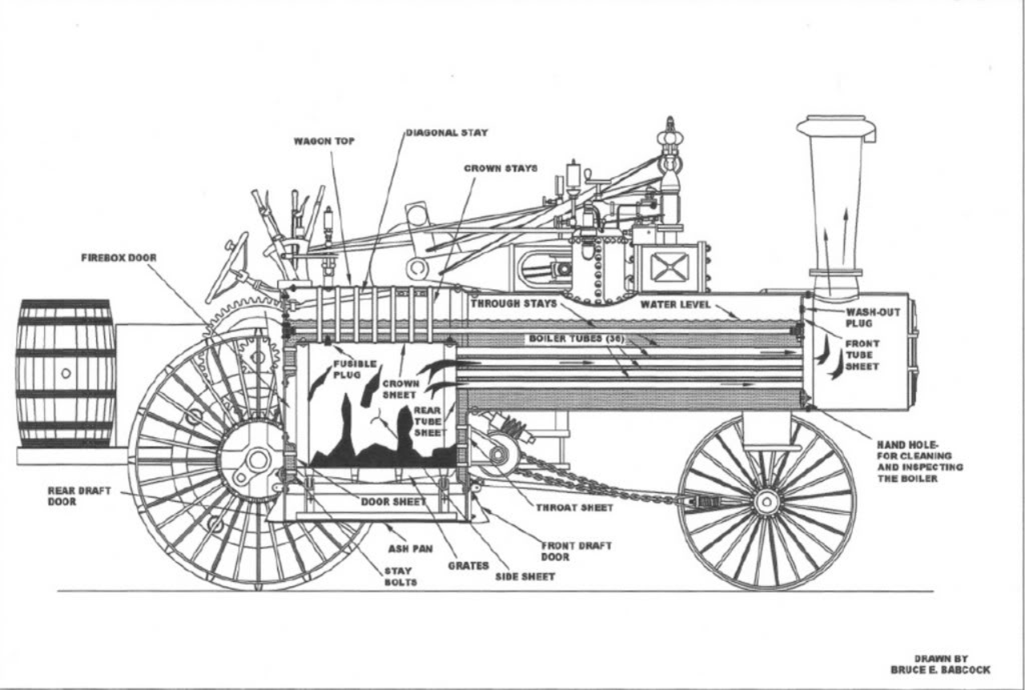
Boiler Parts: Definition and Terminology
Steam School Notes | Chapter 2: Boiler Construction
Principal parts of a locomotive-style firetube boiler
Names of boiler parts matter for inspection, repair, and strength calculations
Precise terminology is essential for identifying specific parts

Slide 9
Boiler Parts: Definition and Terminology
Steam School Notes | Chapter 2: Boiler Construction
Part | Definition
Mud ring | Lower ring or frame around firebox water legs; closes bottom of water space; ties together lower firebox structure
Manholes and handholes | Openings used for inspection, cleaning, and maintenance
Boiler jacket | Outer covering over insulation; reduces heat loss and improves appearance
Ash pit | Space below grate where ash collects and combustion air enters
Grate surface | Area supporting the fire
Heating surface | Wetted metal surface exposed to fire or hot gases; includes firebox sheets, tube surfaces, other heat-transfer surfaces
Steam space | Space above water line where steam collects
Water space | Space occupied by water around firebox, tubes, shell, and other internal parts
Staybolts | Short stays used to support flat firebox sheets
Through stays | Longer stays extending through boiler to support larger flat areas
Diagonal stays | Stays installed at angle; used where direct staying not practical
Double plating | Reinforcing plate at regions requiring extra strength; around openings or fittings
Principal parts of a locomotive-style firetube boiler
Part | Definition
Shell or barrel | Main cylindrical pressure shell containing water and steam; largest pressure-retaining part
Boiler heads | End plates of boiler shell; may be flat, dished, stayed, or connected to structural parts
Tube sheets or flue sheets | Plates into which tubes or flues are expanded; carry tube ends; withstand pressure loads and tube installation forces
Firebox | Combustion chamber where fuel burns; surrounded by water on sides and top
Water leg | Water-filled space around sides of firebox
Crown sheet | Top sheet of firebox; exposed to fire below and water above; flat surface under pressure and heat; one of most critical boiler parts
Smokebox | Chamber at front of boiler where hot gases collect after passing through tubes or flues
Steam dome | Raised chamber on top of shell used to collect drier steam from above water line
Dry pipe | Internal steam pipe usually running from dome toward throttle or steam outlet; collects steam from higher, drier part of steam space

Slide 10
Rear Flue Sheet
Steam School Notes | Chapter 2: Boiler Construction
Rear flue sheet structure and strength factors
Location and function
Located at firebox end of tube bank
Receives intense heat from firebox
Supports rear ends of tubes or flues
Strength factors
Pierced by many tube holes; not plain solid plate
Depends on plate thickness
Depends on tube spacing
Depends on ligament width between holes
Depends on staying
Depends on condition of tube-to-sheet joints

Slide 11
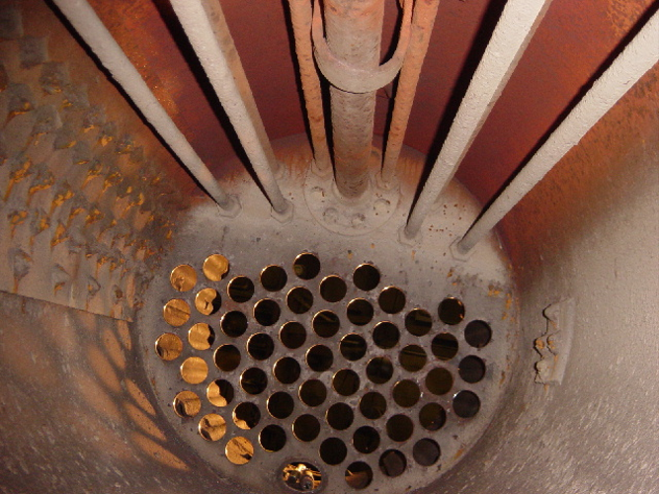
Front Flue Sheet
Steam School Notes | Chapter 2: Boiler Construction
Front flue sheet structure and internal features
Key features visible on front flue sheet
Internal butt cover
Double plating around water inlet
Dry pipe emerging from beneath steam dome
Dry-pipe hanger
Water inlet
Feedwater entering boiler may be colder than surrounding boiler water
Reinforcement or double plating found where fittings enter pressure shell

Slide 12
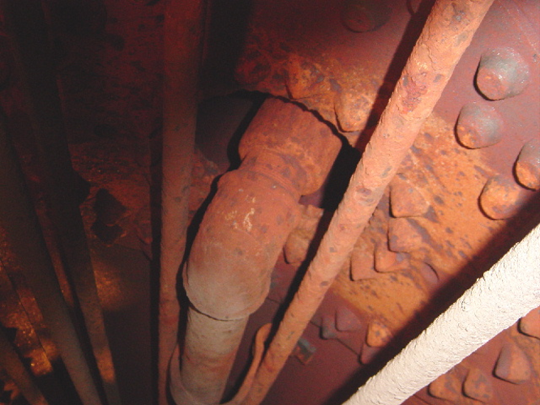
Front Flue Sheet
Steam School Notes | Chapter 2: Boiler Construction
Front flue sheet structure and internal features
Dry pipe importance
Part of steam collection path
Normally located within steam space
Position, support, and connection affect how steam is taken from boiler
Key features visible
Dry pipe emerging from beneath steam dome
Dry-pipe hanger

Slide 13
Boiler Construction Analysis: Regional Approach
Steam School Notes | Chapter 2: Boiler Construction
Construction analysis by pressure vessel region
Construction analysis begins by separating boiler into regions that behave differently under pressure
Each region has its own controlling factors
Not every shape resists pressure in the same way
Main boiler regions
Barrel and dome
Curved shell surfaces
Longitudinal shell seams
Firebox sheets
Flat stayed surfaces
Semi-curved stayed surfaces
Crown sheet and wagon-top areas
Backhead
Front flue sheet
Rear flue sheet
Stayed firebox surfaces
Example: shell barrel vs. flat firebox sheet
Shell barrel: curved surface; strength depends on diameter, thickness, material strength, joint efficiency, safety factor
Flat firebox sheet: not self-supporting; depends on plate thickness, staybolt size, staybolt pitch, stay attachment method

Slide 14
Stayed Surface Construction Factors
Steam School Notes | Chapter 2: Boiler Construction
Key factors controlling stayed surface strength
Construction factors for stayed surfaces
Plate thickness
Staybolt diameter
Staybolt pitch
Stay engagement
Stay attachment type
Construction factor
Condition of plate and stays
Pressure acts everywhere in the boiler
Not every shape resists pressure in the same way
Understanding regional differences is fundamental to construction analysis

Slide 15
Chapter Summary and Next Steps
Steam School Notes | Chapter 2: Boiler Construction
Boiler as complete system and path forward
A boiler is more than a pressure vessel
It is a complete operating system with fittings, valves, safety devices, lubrication points, water-management equipment, and other components
Understanding boiler parts
Names of parts are essential
Locations of parts are essential
Functions of parts are essential
Understanding enables safe operation and boiler inspection
Future topics
Next chapters examine safety features and attached components on steam boilers and traction engines
Later chapters examine pressure-retaining structure itself
Shell strength analysis
Riveted joint analysis
Stayed surface analysis
Allowable working pressure analysis

