Slide 1
Boiler Law and Regulations
Presented by
Robert Bryce
June 23, 2018

Slide 2
Introduction
If you are asked to operate a boiler that is new to you, what is the first thing you do?
Why?
Notes:
How presentation will benefit audience: Adult learners are more interested in a subject if they know how or why it is important to them.
Presenter’s level of expertise in the subject: Briefly state your credentials in this area, or explain why participants should listen to you.

Slide 3
Legislation Governing Pressure Equipment
THE STEAM AND PRESSURE PLANTS ACT
THE POWER ENGINEERS ACT
STEAM AND PRESSURE PLANTS REGULATION
POWER ENGINEERS REGULATION
ASME B31.1 – Power Piping Systems
CSA B51
Ministerial Orders
ASME Section V - NDE
Issued requirements documents
ASME Section I – Power Boilers
ANSI / NB23 - NBIC
Canadian Interprovincial Stds (1910-1937)
Notes:
Lesson descriptions should be brief.

Slide 4
Manitoba STEAM AND PRESSURE PLANTS Act
http://web2.gov.mb.ca/laws/statutes/ccsm/s210e.php
Act is passed by legislature and defines boundaries and rules for regulations. Defines:
powers and duties of minister
powers and duties of inspectors
duties of owners
  statement of ownership
requirements for operation of boilers
  regular inspections
  repairs, condemnation of boiler
offences and penalties
appeals process
Notes:
Example objectives
At the end of this lesson, you will be able to:
Save files to the team Web server.
Move files to different locations on the team Web server.
Share files on the team Web server.

Slide 5
Manitoba STEAM AND PRESSURE PLANTS Regulations
http://web2.gov.mb.ca/laws/regs/current/_pdf-regs.php?reg=108/87%20R
Regulations are maintained by the minister and can be modified by order in council.
Regulations define specifics such as:
  adopted and referenced codes standards
  fees
  classifications of boilers
  duties of power engineer
  specifics for historical boilers
Notes:
Example objectives
At the end of this lesson, you will be able to:
Save files to the team Web server.
Move files to different locations on the team Web server.
Share files on the team Web server.

Slide 6
Manitoba POWER ENGINEERS Act
http://web2.gov.mb.ca/laws/regs/current/_pdf-regs.php?reg=108/87%20R
Act is passed by legislature and defines boundaries and rules for regulations. Defines:
powers and duties of minister
issuance of engineer examinations
Issuance of engineer certificates
offences and penalties
Notes:
Example objectives
At the end of this lesson, you will be able to:
Save files to the team Web server.
Move files to different locations on the team Web server.
Share files on the team Web server.

Slide 7
Manitoba POWER ENGINEERS Regulations
http://web2.gov.mb.ca/laws/regs/current/_pdf-regs.php?reg=40/92
Regulations are maintained by the minister and can be modified by order in council.
Regulations define specifics such as:
  classes of certificates
    definition and scope of each certificate
    Requirements for operator certificates
  boiler supervision requirements
  process to transfer certificate from another Canadian jurisdiction
  fees
Notes:
Example objectives
At the end of this lesson, you will be able to:
Save files to the team Web server.
Move files to different locations on the team Web server.
Share files on the team Web server.

Slide 8
Office of the Fire Commissioner
Inspection and Technical Services Manitoba
Interprets and enforces the Acts and Regulations
Director
Chief Inspector
Design Review
Field Inspectors

Slide 9
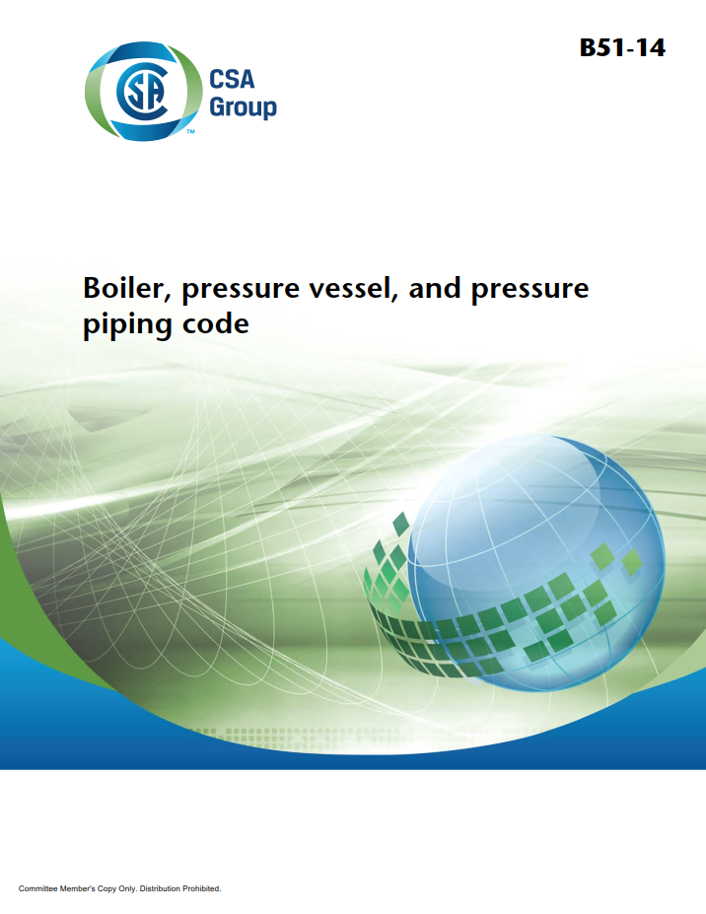
CSA B51
Canadian standard that all Cdn jurisdictions adhere to. Defines:
CRN and requirements
Requirements and scope of repairs and alterations
  Quality control system and written manual is required for any organization repairing or modifying a boiler
Additional construction and installation requirements above that of ASME Section I
Nameplates, stamping
Requirements for pressure relieve devices
Historical boilers
Recommended schedules (e.g. PSV renewal)
Recommended forms

Slide 10
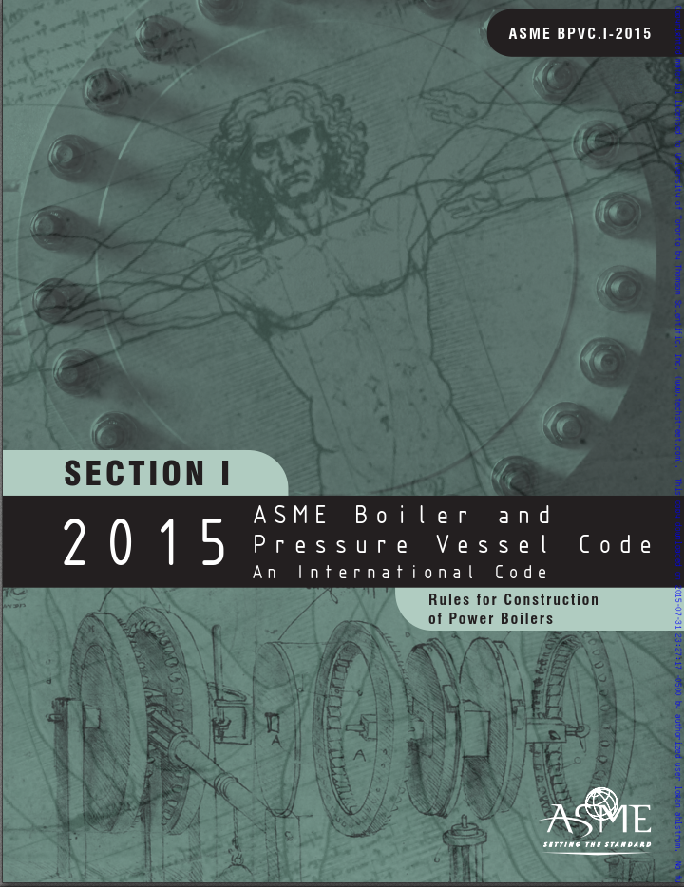
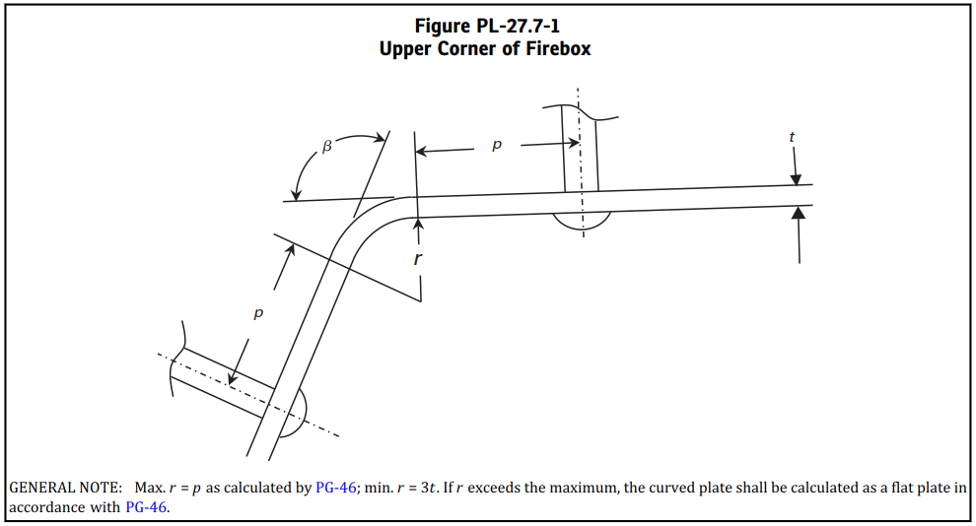
ASME Section I
North American Construction Standard for New Boilers
Covers:
all types of boilers, including traction & locomotive
riveting
minimum engineering requirements that boilers have to meet
  CSA B51 extends this
  standard
  “design by rule”
First drafted in 1914
major revision in 1972

Slide 11
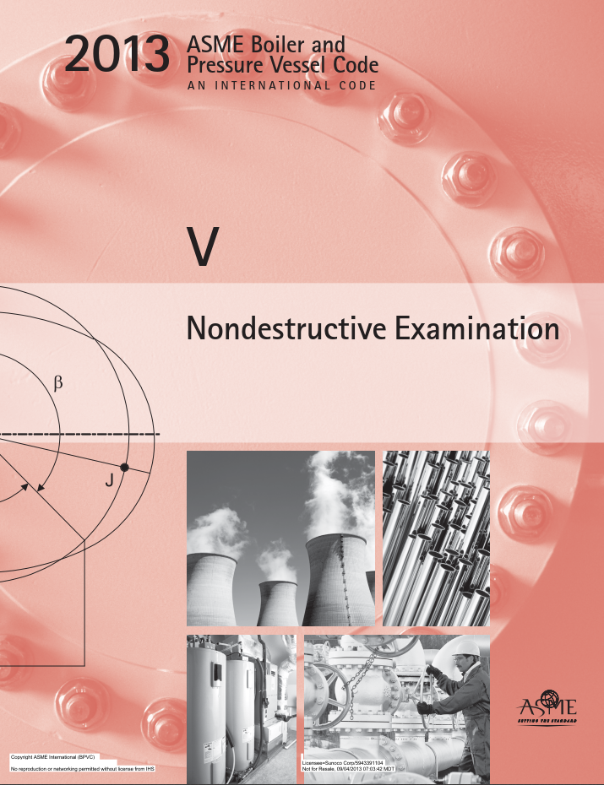
ASME Section V
Nondestructive Examination:
minimum requirements and processes for NDE
guidelines for interpretation

Slide 12
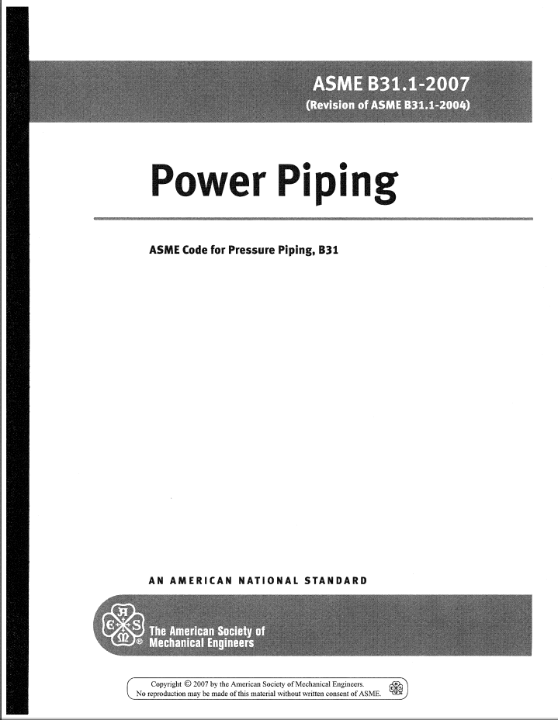
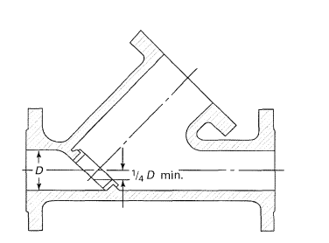
ASME B31.1
Now includes clauses that used to be part of ASME Section I
Power Piping:
Valve design criteria
Piping design criteria
Materials requirements for fittings, piping components

Slide 13
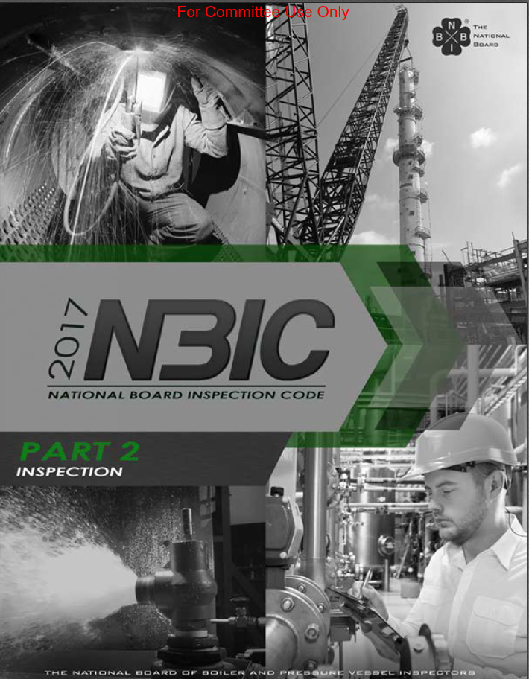
NB23 : NBIC
Where-as ASME defines new construction, NBIC defines in-service standards:
Pre-inspection requirements
Inspection requirements
NDE requirements
Material requirements
Piping requirements
Math / engineering for MAWP of historical boilers
Repair procedures
Recommended / sample forms
Recommended storage / lay-up procedures
Does not cover operation or engineer certification

Slide 14
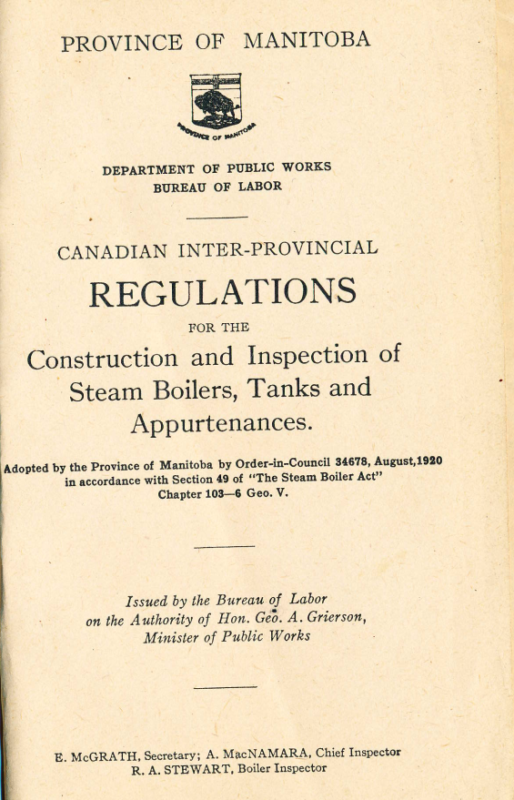
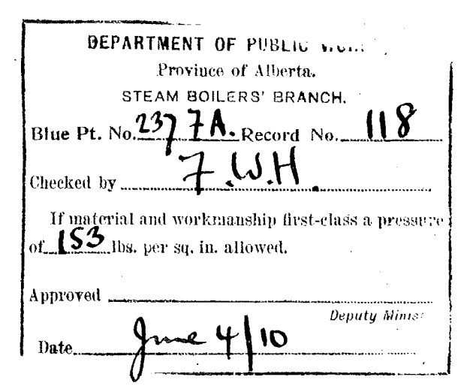
Canadian Interprovincial Standard (1910-1937)
Referenced from CSA B51, being the original code of construction for most historical traction boilers.
  Provides us with history and original safety factors, needed for MAWP
Predated ASME by 5 years
Defined modern-day CRN process of design approval and registration
Alberta archives has been a
wealth of information
  Original blueprints, affidavits
  of manufacture
  Correspondence with
  manufactures

Slide 15
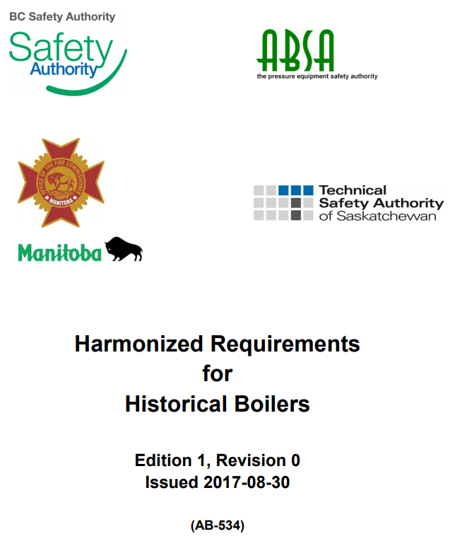
AB-534: Harmonized Requirements
Group effort by jurisdictions and associations
Details common requirements imposed on historical boilers and engineers to aid in consistency and interpretation of:
  Acts
  Regulations
  Applicable Codes and Standards
Each province has its own section to detail specific requirements per that province’s acts and regulations
Under revision for clarification and to remain in abidance to revised regulations

Slide 16
Owner / Operator Requirements
prepare boiler for inspection
assist inspector during inspection
  Includes reporting any known defects he believes to exist
  Supply water, operate pump, perform any work as needed during the inspection
maintain a log book including:
  records and proof of all affidavits, repairs and alterations to boiler and piping
  results of all inspections and reports (NDE), calculations
  operating and maintenance history, including any abnormal condition
  orders given by inspectors
responsible to verify certifications of NDE technicians
display and/or have available inspection and operation certificates
report details of any explosion, accident, incident, or occurrence
This is the difference between an engineer and a fireman!

Slide 17

Inspector Responsibilities
conduct inspections thoroughly and impartially
conduct inspections in a manner that won’t deface, mark, or otherwise scar the boiler
verify that the certification on the test gauge is valid and current
verify that pressure-retaining items comply with laws and regulations
  may be by inspection
  may be by review of paperwork in log book and Q/C manual
authorize legal operation of the boiler
  AND/OR
provide orders for any work to be performed

Slide 18
Types of Inspections
Visual
Hydrostatic
In-service
NDE
  Volumetric – plate thickness
  Staybolt – ultrasound or hammer test
  Rivets
  Magnetic Particle Inspection (MPI)

Slide 19
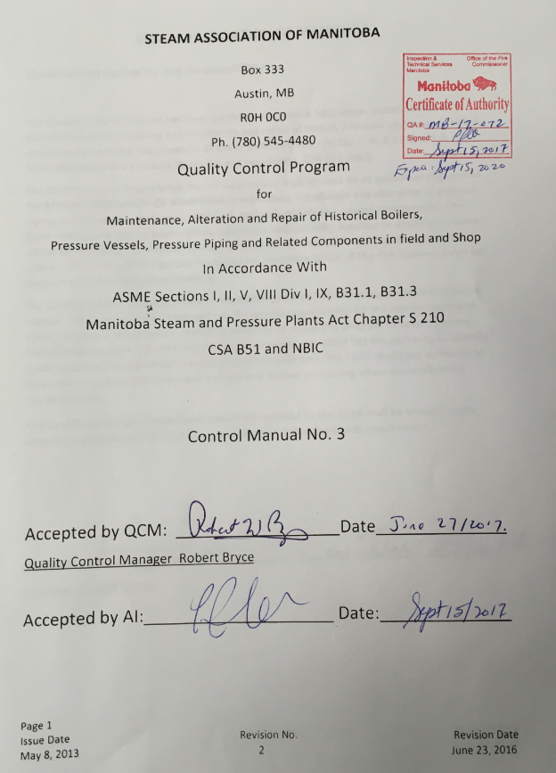
CSA B51 requires a Q/A Program
SAM Q/A program covers:
Certification to perform maintenance, repair, and alterations of historical boilers
  Material control for repairs
  Repair procedures (rivet, welding, brazing)
  Forms (travellers) for repairs
  Record retention of work performed
Test procedures (pneumatic, hydrostatic)
Inspection forms
  Initial Boiler Certification
  Visual inspection
  Hydrostatic inspection
  In-service inspection
  Steam gauge verification
Copies of referenced codes and standards
Managed by Quality Control Manager (QCM)

Slide 20
Example Repair Plan and Steps
Identification of problem to rectify
Interaction with owner / operator and QCM
Interaction with jurisdiction
Draft repair plan
Approval
Work
  Certified repair shops
  Approved welding procedures
  Registered, certified, and tested welders
Review, sign-off
Record
Return to operation

Slide 21
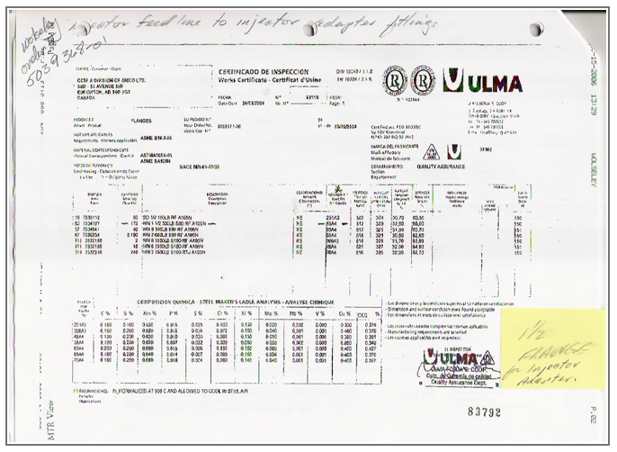
Documentation
Valve CRN’s
PSV certifications
Pipe MTR’s (Mill Test Report)
Certificates of compliance
Piping diagrams
Engineering drawings
Photographic evidence
Historical records and log books

Slide 22
Conclusion
Inspector, owner/operator, QCM roles are changing (currently).
New Act has recently been passed, regulations are being drafted.
Updates to AB-534 are being considered by all jurisdictions.
But
Safety is and always will be the primary goal
Attained in part by abiding the acts, regulations, codes, and standards
Canadian approach is and always will be distinct from USA w/o to inspection, operation, and engineering requirements

Slide 23
Legislation Governing Pressure Equipment
THE STEAM AND PRESSURE PLANTS ACT
inspection, operation
THE POWER ENGINEERS ACT
engineering, operation
STEAM AND PRESSURE PLANTS REGULATION
POWER ENGINEERS REGULATION
classifications of boilers
classifications of engineers
ASME B31.1 – Power Piping Systems
CSA B51
piping
Ministerial Orders
construction, inspection, design, repairs & alterations
variances, quick action
ASME Section V - NDE
Issued requirements documents
NDE
ASME Section I – Power Boilers
ANSI / NB23 - NBIC
Canadian Interprovincial Stds (1910-1937)
inspection, repair
new construction
interpretation,
implementation
history
Notes:
Lesson descriptions should be brief.

