Slide 1
Pressure Behavior in Boiler Shells
Steam School Notes | 13 Stayed Surfaces
Curved and flat surfaces respond differently to internal pressure
• Cylindrical shell: curved shape carries load as tension, resists pressure
• Flat plate: pressure causes bulging outward, creates excessive bending stress

Slide 2
Stay Function in Flat Surfaces
Steam School Notes | 13 Stayed Surfaces
Stays transfer pressure load into tension and prevent plate deflection
• Stays are support members that prevent flat plates from deforming excessively under internal pressure by converting bending stress into tension

Slide 3
Three Required Calculations for Stayed Surfaces
Steam School Notes | 13 Stayed Surfaces
Stayed surface analysis requires evaluating three separate load paths
• Load applied to plate by pressure
• Strength of connection between stay and plate
• Strength of stay itself
Allowable load is governed by the weakest of these three conditions

Slide 4
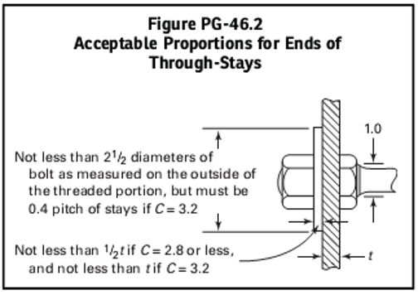
Through-Stay Attachment Details
Steam School Notes | 13 Stayed Surfaces
Stay attachment construction significantly affects strength
• ASME Code assigns different construction factors to different stay arrangements
• Connection details often govern strength more than material properties
• Stay quality is limited by attachment method, not material alone

Slide 5
Through-Stay Pressure Formula
Steam School Notes | 13 Stayed Surfaces
Allowable pressure for through stays depends on plate thickness, material strength, and stay spacing
• P_{through} = (t² · S · C) / p²
• t = plate thickness
• p = stay pitch (spacing)
• S = allowable stress
• C = construction factor
• Thicker plates resist pressure better than thinner plates
• Stays placed closer together support plate better than widely spaced stays

Slide 6
Through-Stay Worked Example
Steam School Notes | 13 Stayed Surfaces
Calculation of allowable pressure using through-stay formula
• Configuration: double-plated heads with nuts and washers, widely spaced through stays

Slide 7
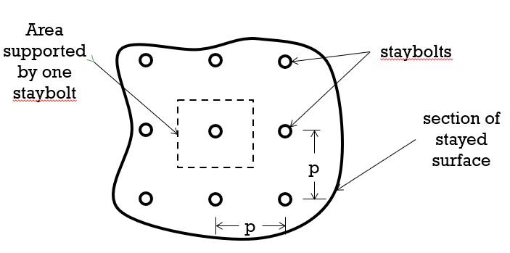
Regular Staybolt Patterns and Tributary Area
Steam School Notes | 13 Stayed Surfaces
Each staybolt supports the pressure on its tributary area, approximately the square of the pitch
• Staybolts arranged in regular square pattern on flat surfaces
• Tributary area ≈ (stay pitch)²
• Each stay carries load from surrounding plate area

Slide 8
Regular Staybolt Pressure Formula
Steam School Notes | 13 Stayed Surfaces
ASME formula for regularly spaced staybolts uses same form as through-stay equation
• P_regular = (t² · S · C) / p²
• Applies to plate < 1/2 inch thick, threaded and riveted staybolts
• Stay spacing appears squared in denominator
• Increased spacing requires each stay to support larger area
• Allowable pressure decreases rapidly with wider spacing

Slide 9
Regular Staybolt Worked Example
Steam School Notes | 13 Stayed Surfaces
Calculation of allowable pressure for regular staybolt pattern
• t = 0.300 inches
• S = 55000 / 4 = 13,750 psi
• C = 3.200
• p = 4.500 inches
• P_{regular} = (0.300² × 13,750 × 3.200) / 4.500² = 195.6 psi

Slide 10
Plate Thickness Effect on Pressure Capacity
Steam School Notes | 13 Stayed Surfaces
Plate thickness squared in equation means small material loss reduces allowable pressure significantly
• As boiler corrodes, stay spacing and construction factor remain unchanged
• Principal change is reduction in plate thickness
• Pressure falls approximately with square of remaining thickness
Plate thinned to 90% of original thickness has only about 81% of original pressure-carrying capacity

Slide 11
Staybolt Strength Evaluation
Steam School Notes | 13 Stayed Surfaces
Stayed surface strength requires separate evaluation of staybolt load capacity
• Stayed surface fails if plate too weak for stay spacing, or staybolts too weak for imposed load
• Each staybolt supports pressure on tributary area
• Staybolt strength must be evaluated separately from plate strength

Slide 12
Staybolt Load Formula
Steam School Notes | 13 Stayed Surfaces
Allowable pressure depends on staybolt diameter, material strength, and spacing
• P_{load} = (π(d/2)² · S) / (1.100 · p²)
• d = staybolt diameter
• p = staybolt pitch (spacing)
• S = allowable stress
• P = allowable pressure
• Staybolt strength varies with square of diameter
• Small diameter increase produces significant load-carrying increase
• Staybolt spacing squared in denominator reduces allowable pressure with wider spacing

Slide 13
Governing Constraint for Stayed Surface
Steam School Notes | 13 Stayed Surfaces
Allowable working pressure is determined by the weakest element in the load path
• Plate between stays must resist bending
• Stay attachment must transfer load to stay
• Stay itself must carry imposed tension
• Both plate-strength and staybolt-strength equations must be evaluated
Allowable pressure is smallest value produced by applicable calculations

