Slide 1
Five Required Safety Features
Steam School Notes | Chapter 3: Safety Features
Every boiler requires five safety features
• Safety valve: Prevents overpressure by releasing steam automatically
• Pressure gauge: Indicates internal pressure for safe operation
• Fusible plug: Melts if crown sheet is uncovered, warning of low water
• Try cocks: Independent water-level check at different heights
• Water gauge glass: Shows actual water level in boiler

Slide 2
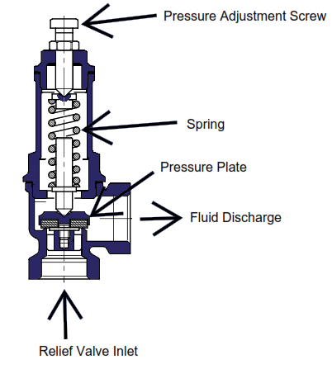
Safety Valve Function
Steam School Notes | Chapter 3: Safety Features
Safety valve prevents overpressure by releasing steam automatically
• Spring-loaded device fitted to boiler shell
• Steam pressure acts on valve disc held shut by adjustable spring
• When boiler pressure reaches set pressure, steam force overcomes spring tension
• Valve lifts and releases steam rapidly to atmosphere
• Prevents further pressure rise
• Spring reseats valve when pressure drops below set point

Slide 3
Safety Valve Key Characteristics
Steam School Notes | Chapter 3: Safety Features
Safety valves must be spring-loaded, sealed, quick-opening, and sized correctly
• Spring-loaded design used on modern traction and portable boilers
• Set pressure is sealed so operator cannot adjust it
• Opens fully and quickly to prevent dangerous pressure rise
• Reseats automatically when pressure falls to safe level
• Must be sized to discharge steam faster than boiler can generate it

Slide 4
Safety Valve Pop Mechanism
Steam School Notes | Chapter 3: Safety Features
Valve design creates two effective areas that produce rapid self-reinforcing lift
• Primary seat area: small circular area of valve disc under steam pressure
• Secondary (huddling) chamber area: larger annular area exposed after valve cracks open
• At set pressure: F = P × A₁ (seat area only)
• After lift begins: F = P × (A₁ + A₂) (seat plus huddling chamber)
• Sudden increase in effective area produces rapid, positive, self-reinforcing lift
• Spring cannot resist larger force, valve snaps fully open at high discharge rate
• This pop behavior is intentional and required by code

Slide 5
Safety Valve Sizing Rule
Steam School Notes | Chapter 3: Safety Features
MAWP and heating-surface area determine required relieving capacity and orifice size
• Set pressure determined by MAWP (maximum allowable working pressure)
• Relieving capacity determined by heating-surface area
• Rule of thumb: 7–11 lb/h per square foot of heating surface
• Applies conservatively to historic, hand-fired boilers
• Actual sizing must use applicable boiler code and manufacturer capacity charts
• Heating surface includes all wetted surfaces exposed to fire or hot gases

Slide 6
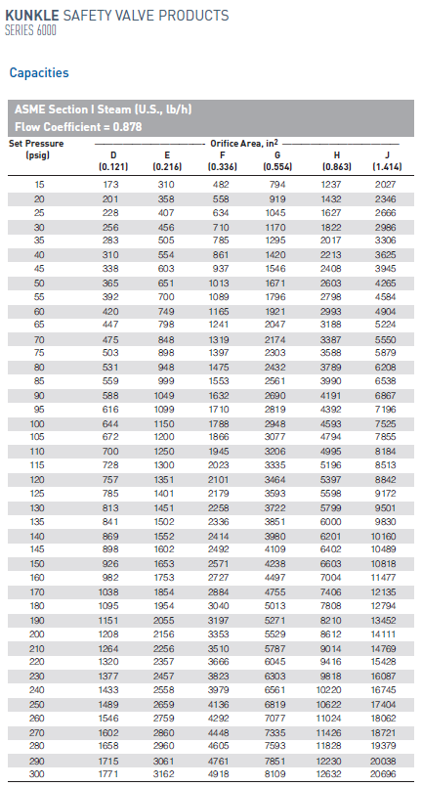
Safety Valve Sizing Lookup
Steam School Notes | Chapter 3: Safety Features
Use capacity and set pressure table to obtain required orifice size
• Select the row corresponding to the set point
• Select the column corresponding to the capacity
• Obtain the orifice from the column heading
• Construct model number using orifice and inlet sizes

Slide 7
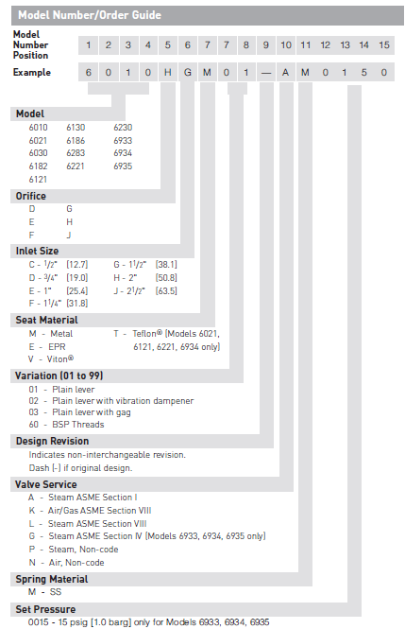
Safety Valve Sizing Lookup
Steam School Notes | Chapter 3: Safety Features
Use capacity and set pressure table to obtain required orifice size
• Select the row corresponding to the set point
• Select the column corresponding to the capacity
• Obtain the orifice from the column heading
• Construct model number using orifice and inlet sizes

Slide 8
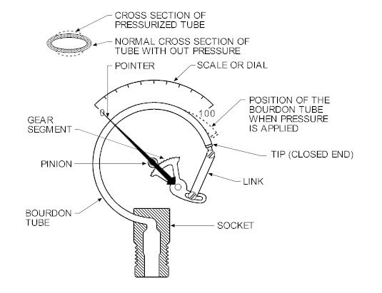
Pressure Gauge Function
Steam School Notes | Chapter 3: Safety Features
Bourdon tube converts steam pressure to needle motion for direct pressure reading
• Steam pressure enters curved Bourdon tube causing straightening motion
• Tiny motion transmitted through linkage and gears to rotate needle
• Siphon or pigtail forms water seal between boiler and gauge
• Water absorbs steam heat, protecting Bourdon tube from live-steam temperature
• Protection greatly extends gauge life
• Gauge siphon mounted above isolation valve (typically quarter-turn style)

Slide 9
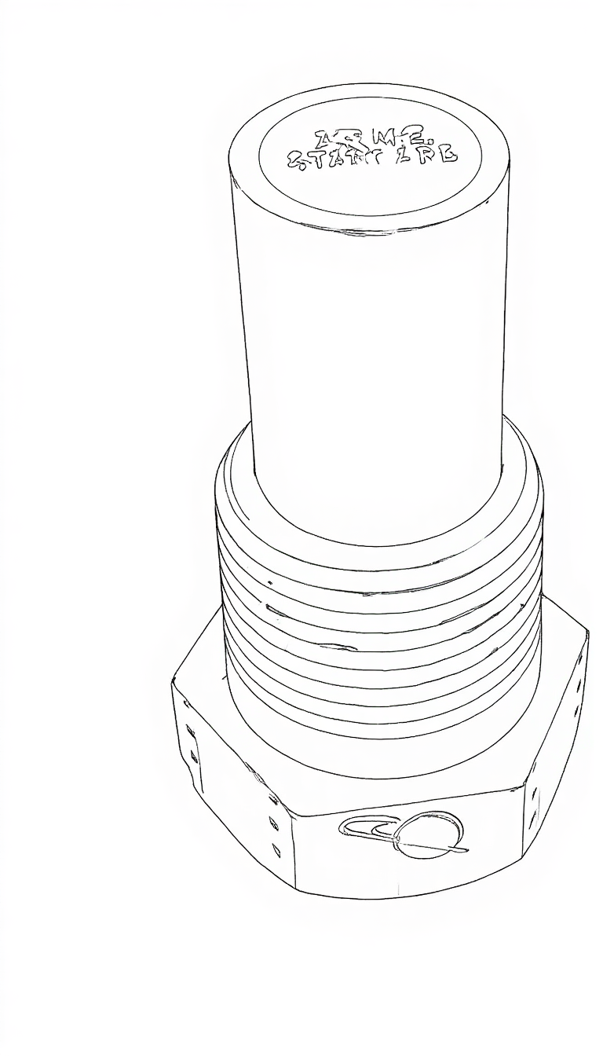
Fusible Plug Reality vs. Myth
Steam School Notes | Chapter 3: Safety Features
Fusible plug produces a warning, not a fire extinguisher effect
• Myth: Melts and dumps water onto fire, extinguishing it
• Reality: Discharge is mostly steam, far too small to quench fire
• Reality: Firebox draft blows discharge away
• Actual function: Produces violent roar and white-steam blast

Slide 10
Fusible Plug Function
Steam School Notes | Chapter 3: Safety Features
Fusible plug is a temperature-triggered warning device that prevents crown-sheet failure
• Contains low-melting-point alloy on water side of crown sheet
• Alloy melts if water level drops and crown sheet overheats
• Melting creates opening that vents steam and water into firebox
• Produces violent roar and blast of white steam
• Discharge does not quench fire (too small, draft overwhelms it)
• Provides immediate, unmistakable warning of dangerously low water
• Forces operator to react before crown-sheet reaches critical temperature
Fusible plug melting indicates dangerous low-water condition requiring immediate operator action

Slide 11
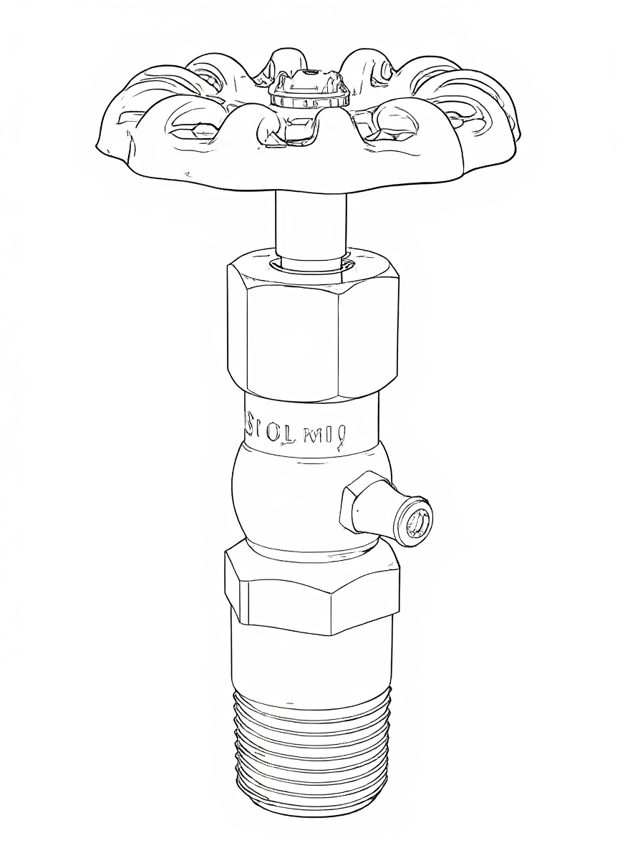
Try Cocks Installation
Steam School Notes | Chapter 3: Safety Features
Try cocks bracket normal waterline on boiler head or water column
• One try cock mounted above normal waterline, one below
• Purpose: verify true water level independently
• Mounting on water column aligns cocks with gauge glass vertically
• Alignment gives cleaner, more stable indication
• Makes verification easier without opening fittings on boiler shell

Slide 12
Operating Try Cocks
Steam School Notes | Chapter 3: Safety Features
Open cocks in sequence to confirm water level between them
• Open top try cock first: steady steam stream indicates water below that level
• Open bottom try cock next: steady water stream indicates water above that level
• Correct water level lies between the two cocks
• If top blows water and bottom blows steam, gauge glass is faulty—shut down and investigate

Slide 13
Try Cock Safety Precautions
Steam School Notes | Chapter 3: Safety Features
Crack valve slowly and stand clear to prevent scalding and water hammer
• Crack valve open slowly: try cocks discharge forcefully
• Slow opening prevents water hammer and avoids scalding spray
• Stand to the side, never directly in front of discharge
• Hot water or wet steam can eject violently
• Use short, controlled bursts to avoid wasting water
• Long openings drop level unnecessarily
Hot water or wet steam can eject violently from try cock discharge. Never stand directly in front. Open slowly to prevent water hammer and scalding spray.

Slide 14
Try Cocks as Independent Check
Steam School Notes | Chapter 3: Safety Features
Try cocks detect plugged, broken, or false-reading gauge glass
• Confirm gauge glass reading independently
• Detect plugged or broken glass
• Detect false readings caused by glass failure
• Two try cocks required to bracket safe operating level
• Three try cocks are common practice
• Term tricock is traditional but only two are required

Slide 15
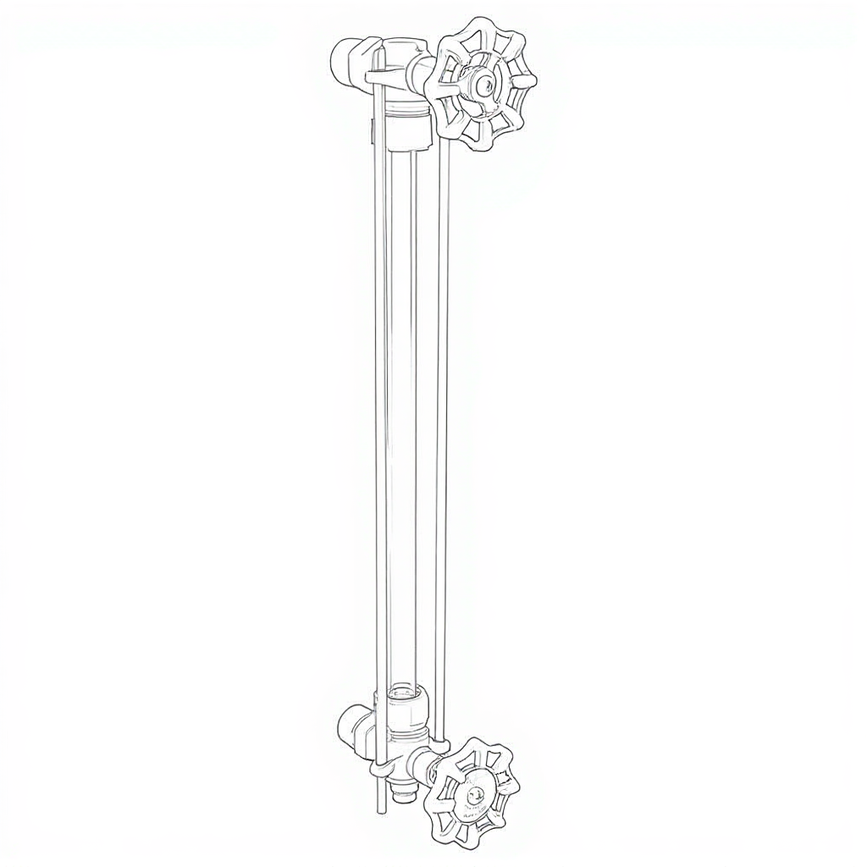
Gauge Glass Structure
Steam School Notes | Chapter 3: Safety Features
Vertical sight tube connected to boiler through steam and water connections
• Vertical sight tube mounted on boiler shows true water level inside
• Top connection: steam line to boiler
• Bottom connection: water line to boiler
• Water in glass rises and falls to same height as boiler interior
• Open to boiler pressure at both ends
• Acts as simple, pressure-balanced water column
• Gives direct, continuous water-level indication while steaming

Slide 16
Proving Gauge Glass: Preparation
Steam School Notes | Chapter 3: Safety Features
Before applying pressure, ensure all cocks move freely and discharge is safe
• Ensure steam cock, water cock, and drain cock move freely before applying pressure
• Stand to the side of the gauge glass
• Confirm handles operate smoothly
• Ensure drain pipe is directed to safe discharge point

Slide 17
Proving Gauge Glass: Blowdown
Steam School Notes | Chapter 3: Safety Features
Open drain cock to confirm all passages are clear and reset water level
• Keep both steam and water cocks open
• Open drain cock fully
• Observe strong discharge of water followed by steam
• Close drain cock; glass should refill to true level
• Confirms drain passage is clear

Slide 18
Proving Gauge Glass: Steam Connection
Steam School Notes | Chapter 3: Safety Features
Close water cock and verify top fitting is not blocked by scale or sludge
• Close water cock
• Open drain cock briefly
• Glass should blow clean steam from top connection
• Close drain cock
• Confirms top fitting is not blocked

Slide 19
Proving Gauge Glass: Water Connection
Steam School Notes | Chapter 3: Safety Features
Close steam cock and verify bottom fitting is clear and supplying water
• Close steam cock
• Open drain cock briefly
• Glass should blow solid water from bottom connection
• Close drain cock
• Confirms bottom fitting is clear and supplying water

Slide 20
Returning Gauge Glass to Service
Steam School Notes | Chapter 3: Safety Features
Open steam cock first to prevent water from being forced violently up the glass
• Confirm water level stabilizes at believable height
• Open steam cock first (prevents violent water forcing)
• Crack steam cock slightly
• Allow steam to warm and pressurize glass
• Once stable, open steam cock fully
• Then open water cock slowly to admit water
If both cocks are closed under pressure, water will be forced violently up the glass if water cock is opened first. Always open steam cock first.

