Slide 1
What Is an MTR?
Steam School Notes | 20 Material Test Reports (MTRs)
MTR documents evidence that material meets specified standards
• Commonly used for pipe, fittings, flanges, valves, pressure vessel components
• Answers: How do we know this material is what the supplier claims?
• Without documentation, appearance alone cannot determine material suitability

Slide 2
Why MTRs Matter
Steam School Notes | 20 Material Test Reports (MTRs)
Identical-appearing materials possess different mechanical and chemical properties
• ASTM A53 pipe, ASTM A106 pipe, stainless steel pipe, and alloy steel pipe may appear similar yet have very different service limitations
MTR documents provide
• Chemical composition
• Mechanical properties
• Manufacturing information
• Traceability information
MTRs are essential for quality control and pressure equipment safety

Slide 3
What Is a Heat?
Steam School Notes | 20 Material Test Reports (MTRs)
Steel manufactured in batches called heats, each assigned unique heat number
• Molten steel processed in furnace during production
• Heat number identifies specific batch from which component was produced

Slide 4
Heat Numbers
Steam School Notes | 20 Material Test Reports (MTRs)
Heat number provides connection between physical component and its documentation
• Pipe Marking:
• ASTM A106 GR B
• HEAT 12345
• Allows inspectors to locate corresponding MTR
• Enables verification of material properties for that batch
• Process is called material traceability

Slide 5
Information on an MTR
Steam School Notes | 20 Material Test Reports (MTRs)
MTRs contain manufacturer, specification, grade, heat number, composition, and test results
• Manufacturer name
• Material specification
• Material grade
• Heat number
• Chemical composition
• Mechanical test results
• Applicable standards
• Certification information

Slide 6
Chemical Composition
Steam School Notes | 20 Material Test Reports (MTRs)
MTR lists chemical composition elements compared against specification limits
• Carbon (C)
• Manganese (Mn)
• Silicon (Si)
• Phosphorus (P)
• Sulfur (S)
• Additional alloying elements may be listed
• Reported values compared against limits established by applicable specification

Slide 7
Mechanical Properties
Steam School Notes | 20 Material Test Reports (MTRs)
MTR includes test results for tensile strength, yield strength, and elongation
• Tensile strength
• Yield strength
• Elongation
• Demonstrate material has required strength and ductility

Slide 8
Reading an MTR
Steam School Notes | 20 Material Test Reports (MTRs)
Inspector verifies specification, grade, heat number, composition, and properties
• The material specification
• The material grade
• The heat number
• Chemical composition
• Mechanical properties
• Heat number on MTR must match heat number marked on component
• If numbers do not match, traceability is lost

Slide 9
Maintaining Traceability
Steam School Notes | 20 Material Test Reports (MTRs)
Heat number transferred to pipe sections using paint, tags, stamping, or records
• Paint markers
• Metal tags
• Stamping
• Traceability records
• If heat number is lost, proving material compliance becomes difficult or impossible

Slide 10
Missing Traceability
Steam School Notes | 20 Material Test Reports (MTRs)
Lost heat number prevents proof of specification, heat origin, or applicable MTR
• Component may not be defective if heat number is lost
Cannot prove
• What specification it meets
• Which heat it came from
• Which MTR applies to it
• In code work, lack of traceability creates significant problems during inspection

Slide 11
Pipefitters and Traceability
Steam School Notes | 20 Material Test Reports (MTRs)
Removing or discarding markings breaks connection between component and documentation
• Material traceability is not solely an engineering concern
• Markings may be removed, painted over, or discarded
• Maintaining traceability ensures correct materials installed
• Enables compliance demonstration during inspections

Slide 12
Key Takeaway
Steam School Notes | 20 Material Test Reports (MTRs)
MTR proves material meets specifications; heat number links component to MTR; link essential for compliance
A Material Test Report is the document that proves a material meets its specified requirements. The heat number provides the link between the physical component and the MTR. Maintaining that link is essential for material traceability, quality control, and code compliance.

Slide 13
Sample Documents Overview
Steam School Notes | 20 Material Test Reports (MTRs)
Invoice, material certificates, and heat numbers work together to establish traceability chain
• No single document contains all information
• Invoice, material certificates, and heat numbers create chain of traceability
• Chain links purchased component to manufacturer test records

Slide 14
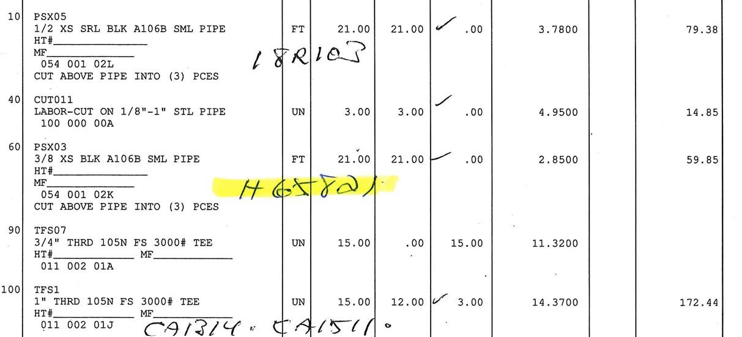
Invoice
Steam School Notes | 20 Material Test Reports (MTRs)
Invoice identifies material purchased and received, with handwritten heat numbers connecting to certificates
• Part number
• Material description
• Size
• Quantity
• Manufacturer
• Purchase information
• Handwritten heat numbers create connection between invoice items and supporting material certificates
• Heat number 18R103 identifies corresponding pipe certificate
• Heat code CA1314 identifies corresponding tee certificate

Slide 15
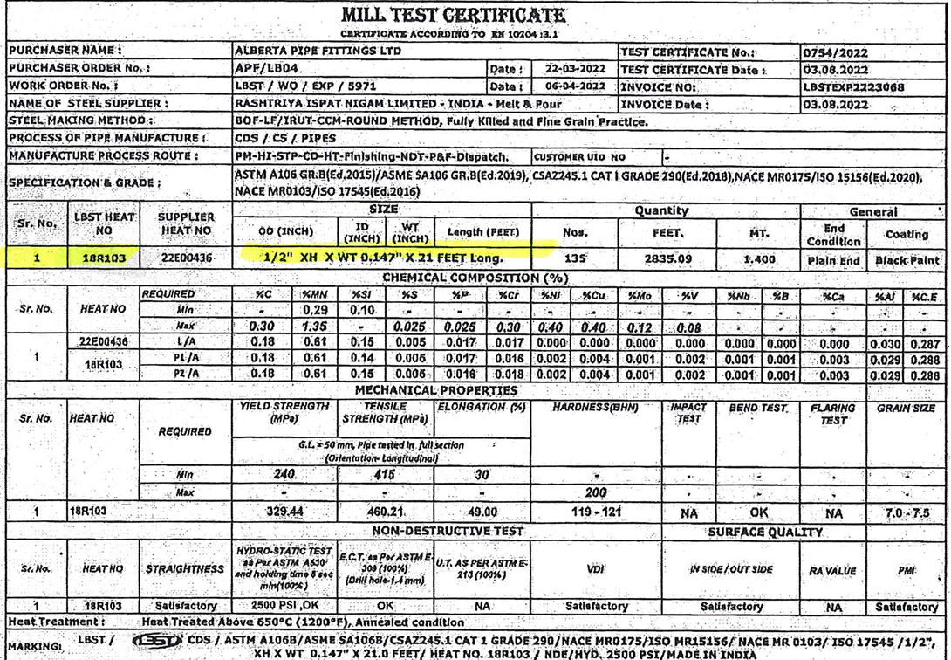
Mill Test Certificate
Steam School Notes | 20 Material Test Reports (MTRs)
Heat number 18R103 and description connect certificate to invoice line 10
Certificate contains
• Manufacturer information
• Material specification
• Material grade
• Heat number
• Size and dimensions
• Chemical composition
• Mechanical properties
• Heat treatment information
• Hydrostatic test results
• Non-destructive examination results
• Certification statement
Identifies pipe as
• ASTM A106 Grade B
• ASME SA106 Grade B
• Heat Number 18R103
• 1/2" extra-heavy seamless pipe
• Chemical analysis demonstrates composition meets specification
• Mechanical test results demonstrate required strength properties achieved

Slide 16
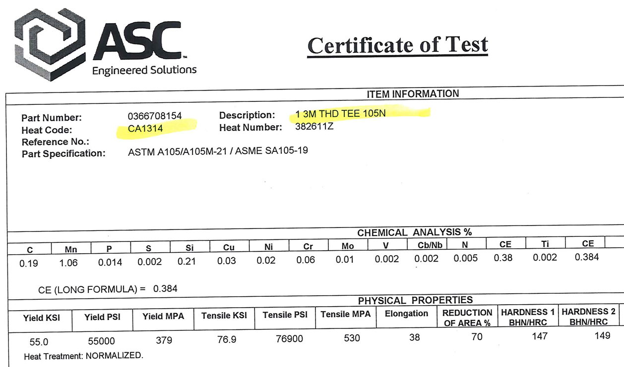
Certificate of Test
Steam School Notes | 20 Material Test Reports (MTRs)
Heat code CA1314 and heat number 382611Z connect certificate to invoice line 100
Certificate typically contains
• Manufacturer information
• Part number
• Material specification
• Heat code
• Heat number
• Chemical composition
• Mechanical properties
• Heat treatment information
Identifies fitting as
• ASTM A105 / ASME SA105 forged carbon steel
• 1" threaded tee
• Class 3000 fitting
• Heat Code CA1314
• Heat Number 382611Z
• Document provides chemical analysis and mechanical properties

Slide 17
Following the Traceability Chain
Steam School Notes | 20 Material Test Reports (MTRs)
Chain flows from invoice through heat numbers to mill certificates and test certificates
• Invoice
• ↓
• Heat Number 18R103
• ↓
• Pipe Mill Test Certificate
• Invoice
• ↓
• Heat Code CA1314
• ↓
• Certificate of Test for Tee
Inspector can verify
• What material was purchased
• Which heat the material came from
• The chemical composition of the material
• The mechanical properties of the material
• Compliance with the specified standard
• Ability to follow chain from component to certificate is foundation of material traceability

Slide 18
Material Identification vs Certification
Steam School Notes | 20 Material Test Reports (MTRs)
Marking identifies component; MTR documents and supports that identification
• Pipe marked ASTM A106 Grade B may appear suitable without MTR
• Without corresponding MTR, no way to verify chemistry, mechanical properties, or traceability
• Markings and documentation work together; one does not replace the other

Slide 19
MTR Requirements
Steam School Notes | 20 Material Test Reports (MTRs)
Not every component requires MTR; requirements depend on code, quality program, and service
• MTRs common for pressure-retaining components: pipe, fittings, flanges, valves in code construction
• Not every plant item has associated MTR
• Requirements depend on governing code, quality program, purchaser requirements, and intended service

Slide 20
Inspector's Question
Steam School Notes | 20 Material Test Reports (MTRs)
Inspector asks: Can you prove this component is what you say it is?
• Purpose of markings, heat numbers, and MTRs is to provide proof
• If traceability chain followed from installed component to supporting documentation, material verified
• If chain broken, verification may no longer be possible
The ability to follow the traceability chain from the installed component back to the supporting documentation is essential for material verification.

