Slide 1
Types of Lubricators
Steam School Notes | Chapter 5: Lubrication Points
Recognize lubricator types on warm engines
• Fittings are small, varied, and resemble ordinary hardware
• Identification requires knowing lubricator type and function
• Each type delivers different lubricant to specific locations

Slide 2
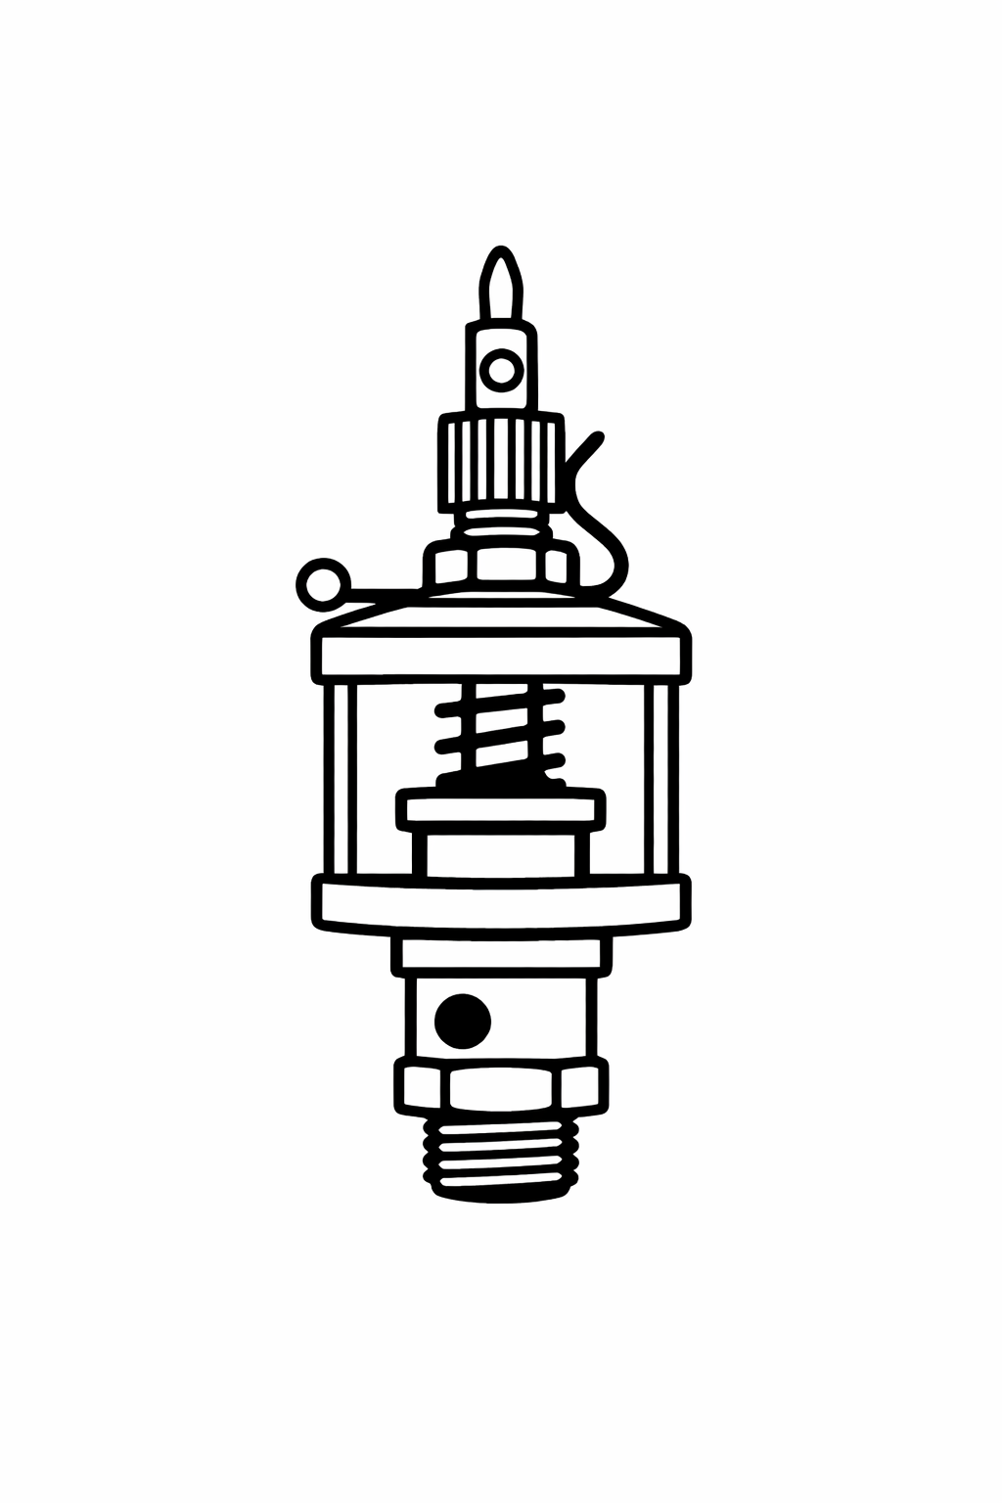
Oil Cups
Steam School Notes | Chapter 5: Lubrication Points
Oil cups deliver light machine oil by gravity
• Small upright cups with cap or flip-lid
• Knurled knob controls drip rate
• Lever flips to turn off oil entirely
• Found: main bearings, crank pins, valve-gear pivots, governor bearings

Slide 3
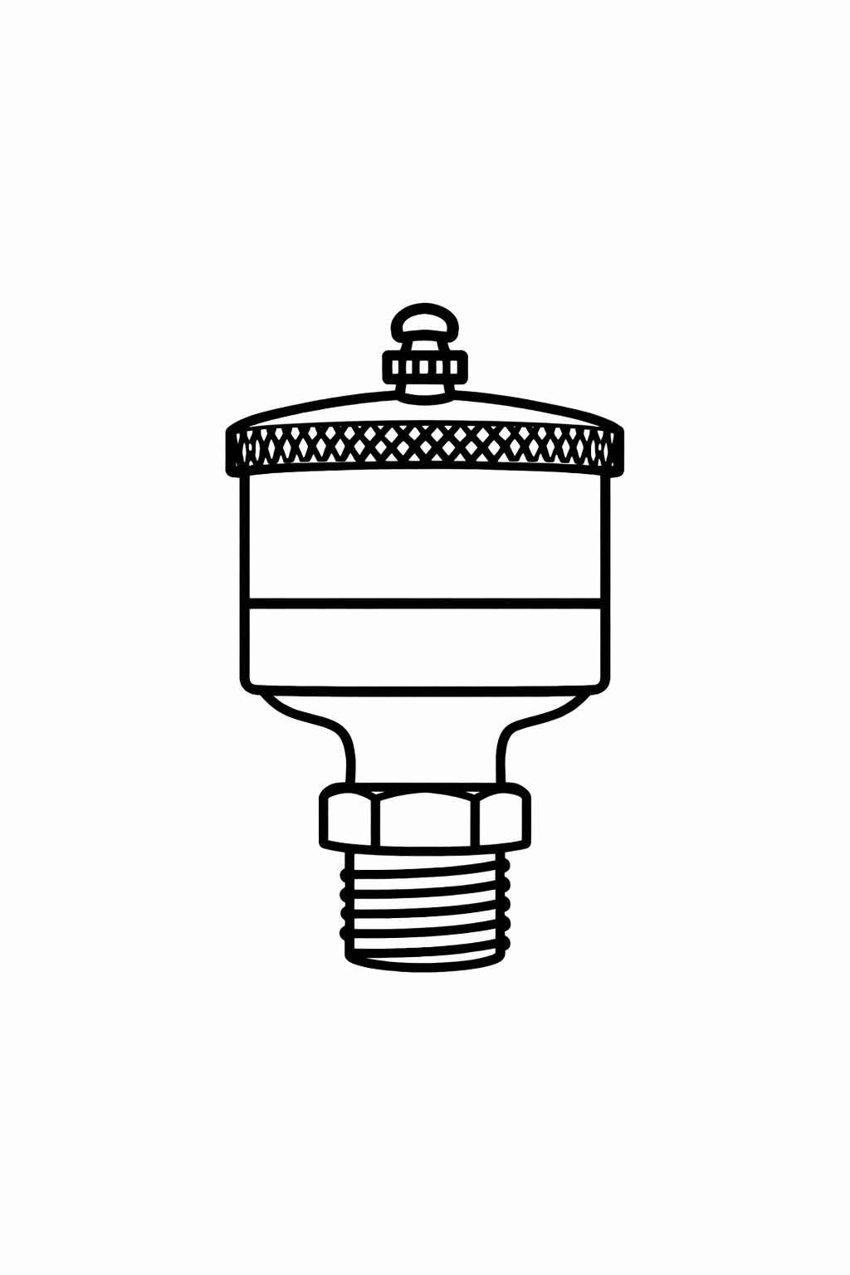
Screw-down Grease Cups
Steam School Notes | Chapter 5: Lubrication Points
Screw-down grease cups force grease into slow-moving bearings
• Filled with hard grease
• Screw cap down one turn to force grease into bearing
• Found: steering gear, axle bearings, some valve-gear joints
• Short, squat cup with threaded cap that screws downward

Slide 4
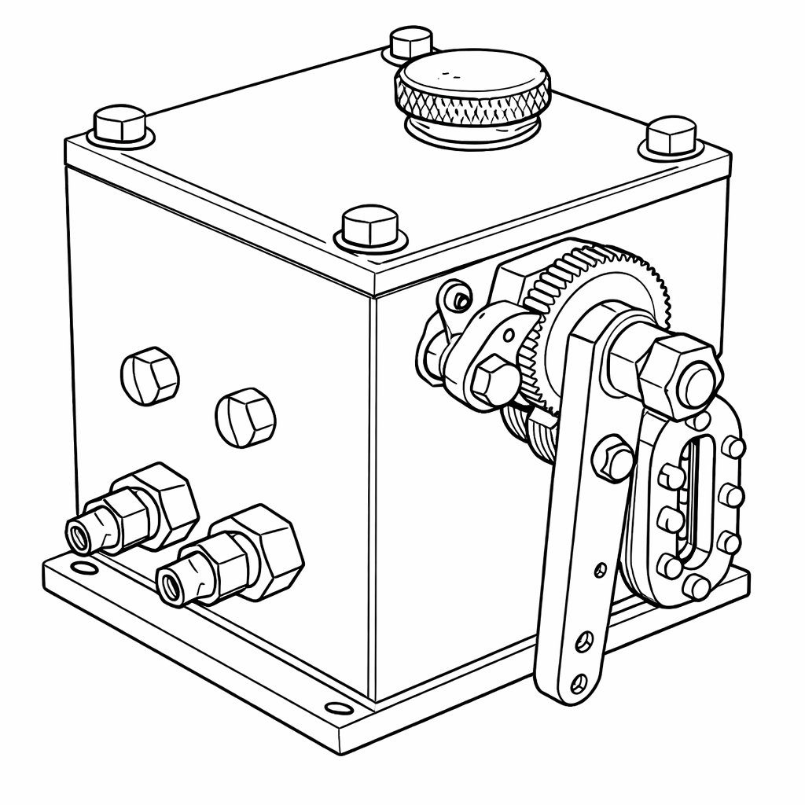
Mechanical Lubricators
Steam School Notes | Chapter 5: Lubrication Points
Mechanical lubricators deliver measured oil strokes driven by engine motion
• Ratchet or displacement type
• Found: cylinder lubrication, governor drive, high-load bearings
• Recognition: small box with ratchet arm or linkage; oil lines leading away

Slide 5
Hydrostatic Lubricators
Steam School Notes | Chapter 5: Lubrication Points
Hydrostatic lubricators feed cylinder oil using steam pressure and sight glass
• Sight-feed lubricators with glass column and needle valve
• Feed lines visible; usually mounted on turret
• Found: cylinder lubrication on many engines; water pumps
• See drops through sight glass

Slide 6
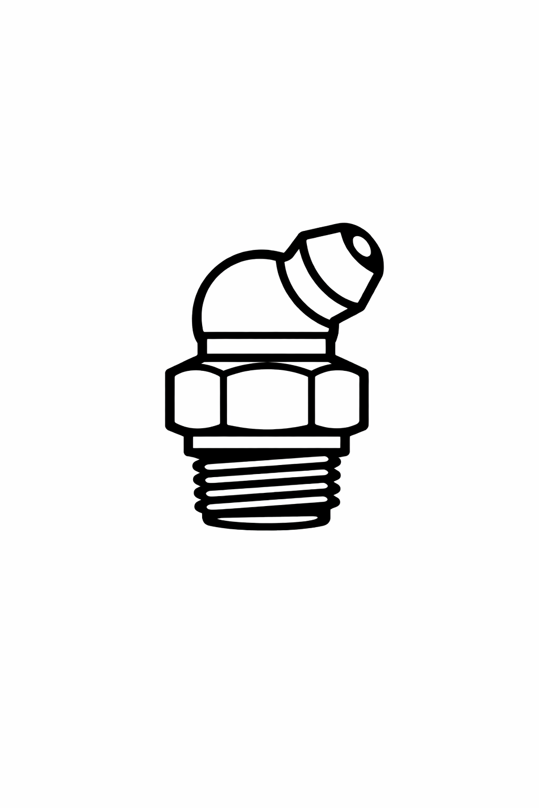
Alemite/Zerk Fittings
Steam School Notes | Chapter 5: Lubrication Points
Alemite and Zerk fittings are modern grease nipple retrofits
• Small conical or ball-type grease nipples
• Found: anywhere previous owner wanted easier greasing
• Modern retrofits replacing original lubricators

Slide 7
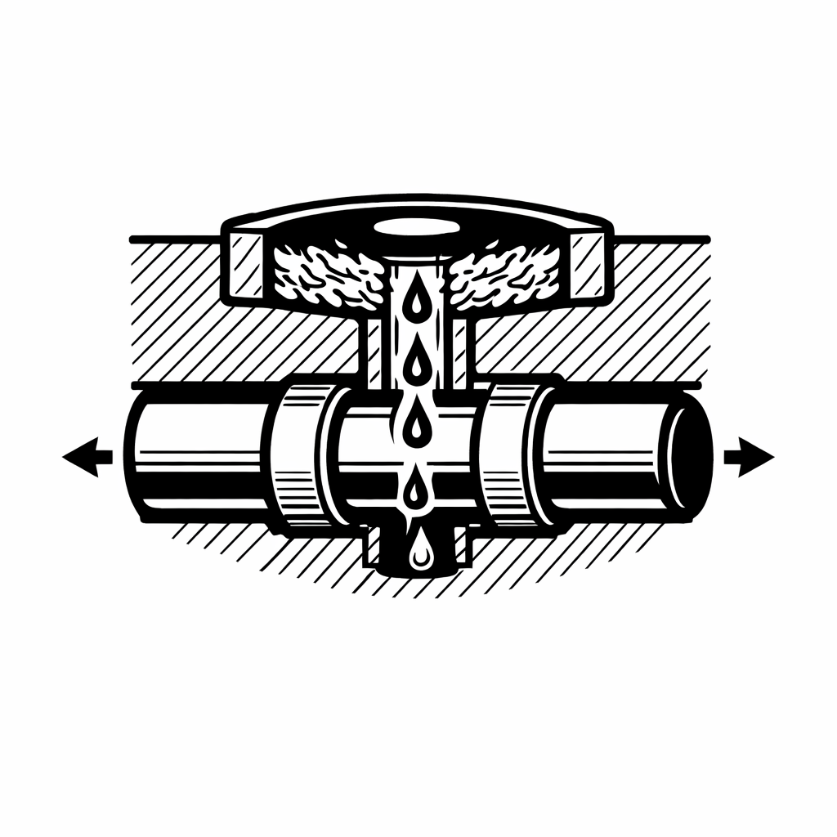
Wick Lubricators
Steam School Notes | Chapter 5: Lubrication Points
Wick lubricators meter oil slowly through felt or cotton wick
• Felt or cotton wick meters oil slowly
• Found: valve rocker arm, upper and lower cannon bearings
• Reservoir in casting filled with cotton waste

Slide 8
Cylinder Oil
Steam School Notes | Chapter 5: Lubrication Points
Cylinder oil is very heavy, high-temperature oil for steam contact
• Used only where steam enters (cylinders, valves)
• Formulated to dissolve in water
• Delivered by hydrostatic or mechanical lubricators

Slide 9
Engine Oil
Steam School Notes | Chapter 5: Lubrication Points
Engine oil is medium-weight light machine oil for bearings and joints
• Used for bearings, pins, and moving joints
• Delivered by oil cups, wicks, or mechanical lubricators

Slide 10
Grease for Bearings
Steam School Notes | Chapter 5: Lubrication Points
Grease lubricates slow, high-load bearings
• Delivered by grease cups or Zerk fittings

Slide 11
Matching Lubricant to Lubricator
Steam School Notes | Chapter 5: Lubrication Points
Wrong lubricant with wrong lubricator is as bad as missing the point
Matching the wrong lubricant to the wrong lubricator is as bad as missing the point entirely

Slide 12
Cold Engine Lubrication Challenge
Steam School Notes | Chapter 5: Lubrication Points
Cold engines require manual oiling because self-lubrication systems fail to function
• Oil is thick when engine is cold
• Grease is stiff when engine is cold
• Wicks don't draw when engine is cold
• Mechanical lubricators may not stroke when engine is cold
• Hydrostatic lubricators won't feed until steam is up

Slide 13
Manual Oiling During Warm-up
Steam School Notes | Chapter 5: Lubrication Points
Operators hand-oil every point during warm-up because automatic systems are inactive
• Know where each point is located
• Know what type of lubricator it uses
• Know what lubricant belongs there
• Know whether it needs manual priming before engine moves
Experienced operators walk the engine with an oil can during warm-up knowing exactly what they are looking at

