Slide 1
What an Injector Does
Steam School Notes | 15 Injector Fundamentals
Injector forces water into boiler against pressure using steam momentum
• Uses steam from boiler to force feedwater into boiler against boiler pressure
• Contains no moving mechanical parts
• Converts boiler pressure into steam momentum, transfers momentum to water, converts back to pressure

Slide 2
The Intuition
Steam School Notes | 15 Injector Fundamentals
Steam and water escape at different velocities due to compressibility differences
• Steam escapes at very high velocity (approximately speed of sound) because compressible expansion accelerates it
• Water escapes at much lower velocity (tens of m/s) because it is incompressible; pressure energy converts directly to kinetic energy
• Simple connection between steam and water spaces produces no motion because it transmits pressure only

Slide 3
Injector Converts Pressure to Momentum
Steam School Notes | 15 Injector Fundamentals
Injector forces steam through nozzle to create high-velocity jet that entrains and accelerates water
• Forces steam through nozzle, deliberately converting pressure into velocity
• High-velocity steam jet carries significant momentum
• Steam condenses upon contact with cold water; momentum collapses and transfers to water
• Combined jet enters diffuser where velocity converts back into pressure
• Exploits different pressure responses: steam supplies velocity through expansion, water accepts momentum and recovers pressure

Slide 4
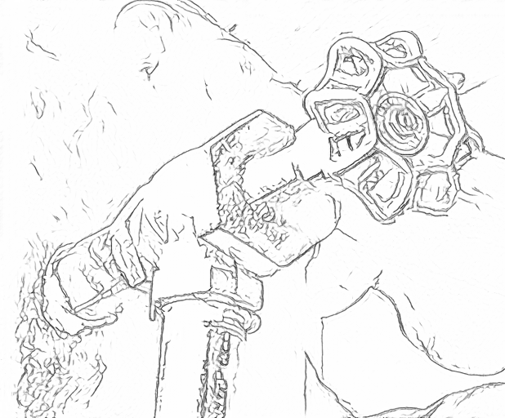
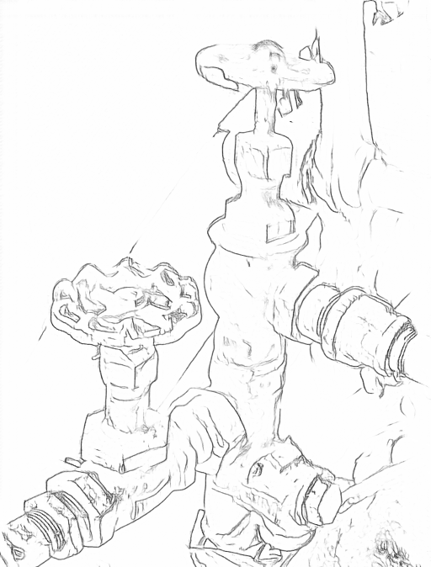
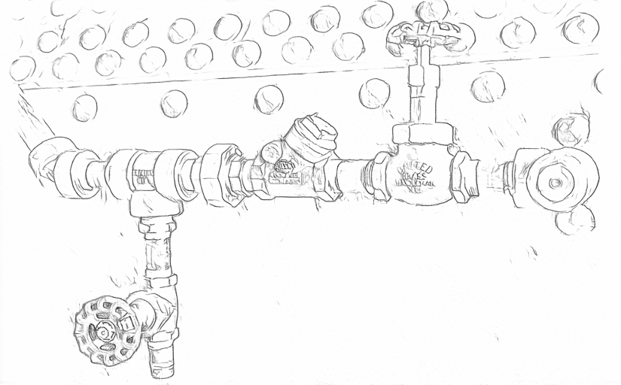
Injector Circuit
Steam School Notes | 15 Injector Fundamentals
Injector circuit consists of steam supply, injector with controls, and inlet to boiler
• Steam supply from dome or wagon top with isolation valve
• Injector with steam throttle, water throttle, and overflow check
• Inlet with inspection tee, isolation valve, check valve, and cheater

Slide 5
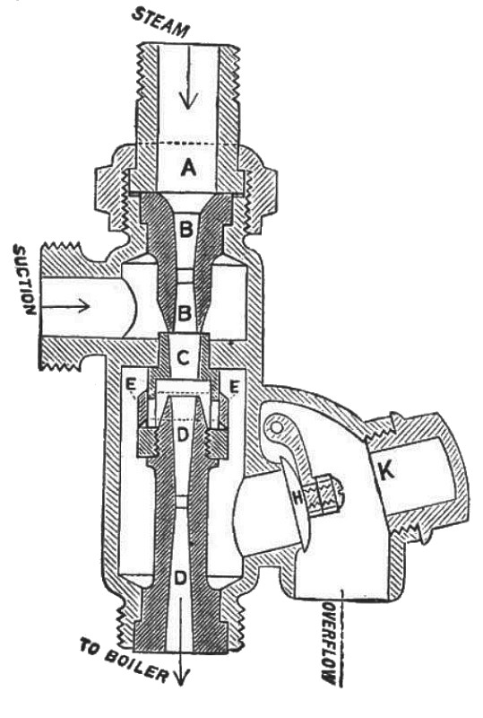
Penberthy Injector Internal Structure
Steam School Notes | 15 Injector Fundamentals
Penberthy injector contains steam nozzle, combining cone, delivery cone, and overflow system
Steam inlet
Converging steam nozzle
Combining cone where steam entrains water
Delivery cone leading toward the boiler
Overflow passages
K. Overflow valve assembly

Slide 6
Penberthy Flow Path
Steam School Notes | 15 Injector Fundamentals
High-velocity steam creates vacuum to draw water, mixes in combining cone, forces through delivery cone
• High-velocity steam from nozzle creates vacuum that draws water from suction side
• Steam and water mix in combining cone
• Condensation restores pressure balance
• Combined flow forced through delivery cone into boiler
• Overflow valve vents excess water or steam during startup

Slide 7
Overflow System Purpose
Steam School Notes | 15 Injector Fundamentals
Overflow valve allows water and steam escape during startup, closes when injector begins delivering water
• Safety and priming system for injector
• Allows water and steam escape when injector not yet working
• Automatically closes once injector begins delivering water to boiler

Slide 8
Startup Phase: Steam Enters Nozzle
Steam School Notes | 15 Injector Fundamentals
High-velocity steam enters nozzle creating vacuum but mixture remains chaotic with insufficient pressure
• High-velocity steam shoots down nozzle, creating partial vacuum in combining cone
• Vacuum draws water from suction side
• Steam jet not yet fully condensed; mixture contains slugs of water and steam
• Pressure in delivery cone nowhere near boiler pressure
• Injector cannot yet push water into boiler

Slide 9
Startup Phase: Overflow Valve Open
Steam School Notes | 15 Injector Fundamentals
Overflow valve remains open during startup allowing uncondensed steam and water to escape
• Pressure in combining and delivery cones is below atmospheric, oscillating, or insufficient to lift boiler check valve
• Overflow valve stays open venting excess steam, uncondensed steam, water slugs, and air
• Visible spitting or overflowing indicates this phase
• Without open overflow valve, injector would never prime

Slide 10
Pickup Phase: Complete Condensation
Steam School Notes | 15 Injector Fundamentals
Steam condenses completely inside combining cone, mixture accelerates, velocity converts to pressure
• Water flow stabilizes and steam jet condenses completely inside combining cone
• Sudden condensation collapses steam volume
• Mixture accelerates through delivery cone
• Velocity converts into pressure
• Injector transitions from spitting to working

Slide 11
Pickup Phase: Overflow Valve Closes
Steam School Notes | 15 Injector Fundamentals
Pressure rise above atmospheric closes overflow valve, directing all flow toward boiler check valve
• Once pressure in delivery cone rises above atmospheric, overflow valve is pushed shut
• Injector stops discharging through overflow
• All flow now directed toward boiler check valve
• Injector becomes silent and smooth
• Overflow valve now acts as check valve preventing backflow

Slide 12
Loss of Pickup: Overflow Valve Reopens
Steam School Notes | 15 Injector Fundamentals
If condensation process interrupts, pressure collapse causes overflow valve to reopen
• Interruptions include water supply faltering, steam pressure fluctuating, scale/debris disrupting jet, incorrect throttling
• Pressure in delivery cone collapses if condensation fails
• Overflow valve reopens and injector begins spitting
• Operator knows instantly that injector has dropped out
• Prevents boiler pressure from forcing water backward through injector

Slide 13
Stuck Closed Overflow Valve
Steam School Notes | 15 Injector Fundamentals
If overflow valve stuck closed at startup, circuit becomes closed loop with no motion
• Circuit from steam to water becomes closed loop, like a gauge glass
• No sustained motion results

Slide 14
Flow Continuation After Startup
Steam School Notes | 15 Injector Fundamentals
Once started, injector functions as water pump because internal pressure exceeds atmospheric
• Boiler check valve opens and overflow valve closes because internal pressure exceeds atmospheric
• Injector transitions from steam jet device to pure water pump powered by steam volume collapse
• Pumps do not require open discharge to atmosphere to continue flow

Slide 15
Three Functional Stages
Steam School Notes | 15 Injector Fundamentals
Injector contains steam nozzle, combining cone, and delivery cone for momentum transfer and recovery
Steam Nozzle
• Expands steam to very high velocity (hundreds of m/s)
• Steam jet entrains surrounding water
Combining Cone
• Steam condenses inside water stream
• Momentum of mixture increases
• Pressure begins to recover
Three nozzle system achieves complete momentum transfer and pressure recovery

Slide 16
Delivery Cone Function
Steam School Notes | 15 Injector Fundamentals
Delivery cone converts velocity back into pressure exceeding boiler pressure
• Converts velocity back into pressure
• Final pressure exceeds boiler pressure
• Water flows into boiler

Slide 17
Water Velocity from Pressure Drop
Steam School Notes | 15 Injector Fundamentals
Bernoulli relation converts pressure energy to kinetic energy in incompressible water
• Pressure drop does work on water fluid, work appears as velocity
• Velocity scaled by mass density being accelerated
• Water velocity much lower than steam velocity because liquids store pressure energy as mass acceleration not compressible expansion

Slide 18
Water Velocity Calculation
Steam School Notes | 15 Injector Fundamentals
Water velocity from 8 bar pressure drop equals 40 m/s
• Conversion: 1 bar = 100,000 kg/(bar·m·s²)
• Bernoulli equation: v = √(2·ΔP/ρ)
• Water density ρ = 1000 kg/m³
• At 8 bar pressure drop: v = 40 m/s

Slide 19
Steam Velocity at Operating Pressure
Steam School Notes | 15 Injector Fundamentals
Steam nozzle operates under choked-flow conditions at sonic velocity
Typical Conditions (100–150 psig)
• Saturated steam specific volume: 0.2–0.3 m³/kg
• Speed of sound: 450–500 m/s
• Nozzle exit velocity: 300–500 m/s
• Steam velocity increases as it expands from boiler pressure until reaching local speed of sound
• Further acceleration impossible beyond sonic velocity
• Steam enters injector at approximately sonic velocity
• Provides high momentum needed to entrain feedwater

Slide 20
Condensation as Power Source
Steam School Notes | 15 Injector Fundamentals
Steam volume collapse during condensation conserves momentum while raising pressure
• Steam jet condenses into water inside combining cone
• Steam enormous volume collapses
• Momentum is conserved
• Mixture pressure rises sharply
Injectors deliver water above boiler pressure because condensation collapses steam volume while conserving momentum

Slide 21
Operating Sensitivities
Steam School Notes | 15 Injector Fundamentals
Injector performance depends on steam pressure, water supply, cleanliness, temperature, and absence of air leaks
• Correct steam pressure
• Adequate water supply
• Clean cones
• Proper temperature (too hot causes failure)
• No air leaks on suction side
• All sensitivities trace back to same physics: steam velocity, condensation, and momentum transfer

Slide 22
Connection to Boiler Heating Physics
Steam School Notes | 15 Injector Fundamentals
Injector exploits same physics as rapid boiler pressure rise when boiling begins
• Steam has enormous specific volume
• Steam accelerates to extreme velocities
• Condensation collapses that volume
• Pressure is recovered from velocity
• Boiler rapid pressure rise during boiling is other side of same phenomenon

Slide 23
Low-Pressure vs High-Pressure Injectors
Steam School Notes | 15 Injector Fundamentals
Injector type determined by boiler pressure range for which it is designed
• Low-pressure: Designed to start and operate with low boiler pressure
• High-pressure: Designed to operate efficiently at high boiler pressure
• Terms refer to boiler steam pressure range, not pressure delivered to boiler

Slide 24
Low-Pressure Injector Characteristics
Steam School Notes | 15 Injector Fundamentals
Low-pressure injectors operate at 15–100 psi with larger passages and gentler geometry
Design
• Larger steam nozzle
• Larger combining cone
• Larger water passages
• Gentler cone angles
Operating
• Easy starting at low pressure
• Tolerant of cold feedwater
• Tolerant of minor scale or dirt
• Less sensitive to adjustment

Slide 25
Low-Pressure Injector Limitations and Applications
Steam School Notes | 15 Injector Fundamentals
Low-pressure injectors inefficient at high pressure but suited to early locomotives and traction engines
Limitations
• Inefficient at high pressure
• Tendency to overflow above design pressure
Typical Applications
• Early locomotives
• Traction engines
• Stationary boilers
• Systems with slowly rising boiler pressure

Slide 26
High-Pressure Injector Characteristics
Steam School Notes | 15 Injector Fundamentals
High-pressure injectors operate at 125–300+ psi with small nozzles and precise geometry
Design
• Smaller steam nozzle
• Tighter combining cone throat
• Sharper delivery cone geometry
• More precise internal dimensions
Operating
• High efficiency at rated pressure
• Smooth delivery at high boiler pressure
• Minimal steam waste once running

Slide 27
High-Pressure Injector Limitations and Applications
Steam School Notes | 15 Injector Fundamentals
High-pressure injectors difficult to start but suited to later locomotives and high-pressure stationary boilers
Limitations
• Difficult or impossible to start at low pressure
• Sensitive to warm feedwater
• Sensitive to scale or dirt
• Sensitive to incorrect nozzle sizing
Typical Applications
• Later steam locomotives
• High-pressure stationary boilers
• Marine boilers
• Systems with steady operating pressure

Slide 28
Low vs High-Pressure Injector Comparison
Steam School Notes | 15 Injector Fundamentals
Low-pressure injectors easy to start but less efficient; high-pressure efficient but difficult to start
Feature | Low-Pressure Injector | High-Pressure Injector
Starting pressure | Very low | Moderate to high
Steam nozzle size | Large | Small
Dirt/scale tolerance | High | Low
Feedwater temp tolerance | Good | Poor
Efficiency at pressure | Lower | Higher
Ease of starting | Easy | Difficult

Slide 29
Dual Injector Practice
Steam School Notes | 15 Injector Fundamentals
Locomotives often fitted with two injectors for different operating phases
• Low-pressure injector for starting and low-pressure operation
• High-pressure injector for efficient running at road pressure

Slide 30
Injector Pressure Range Fixed by Geometry
Steam School Notes | 15 Injector Fundamentals
Injector pressure range determined by nozzle geometry, not adjustable by valves
• Pressure range fixed by steam cone diameter
• Pressure range fixed by combining cone throat
• Pressure range fixed by delivery cone shape
• Changing pressure range requires changing nozzles, not valve adjustment
Injector pressure capability depends on internal geometry and cannot be changed through operational adjustment

