Slide 1
Overview
Steam School Notes | 19 Fittings
Fittings direct flow and connect pipe sections
• Change direction
• Create branches
• Change pipe size
• Connect or disconnect equipment
• Close pipe ends
Fittings are essential components that make piping systems practical and functional.

Slide 2
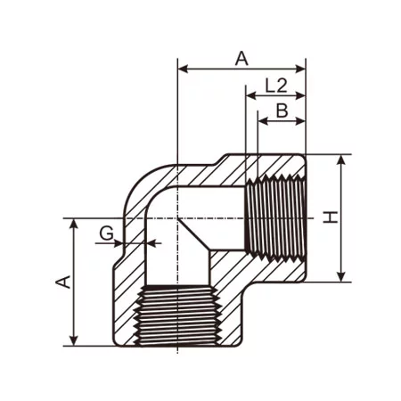
90-Degree Elbow
Steam School Notes | 19 Fittings
90° elbow changes flow direction by ninety degrees
• Commonly used where space is limited
• Creates resistance to flow
• Increases turbulence and pressure loss

Slide 3
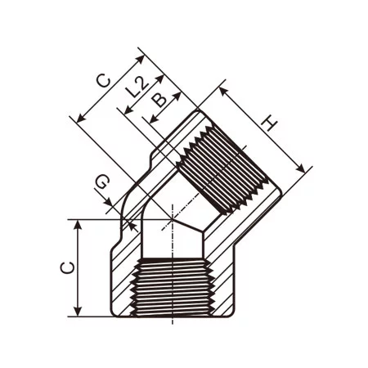
45-Degree Elbow
Steam School Notes | 19 Fittings
45° elbow produces less pressure loss than 90° elbow
• Changes direction more gradually
• Reduced pressure loss compared to 90° elbow
• Better for systems requiring lower resistance

Slide 4
Long-Radius vs Short-Radius Elbows
Steam School Notes | 19 Fittings
Elbow radius affects turbulence and pressure loss
Type | Centerline Radius | Characteristics
Long-radius (LR) | 1.5 × pipe diameter | Less turbulence, lower pressure loss
Short-radius (SR) | Pipe diameter | Higher turbulence, higher pressure loss
Long-radius elbows are commonly used in steam and process piping systems.

Slide 5
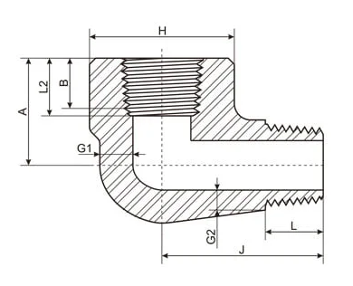
Street Elbow
Steam School Notes | 19 Fittings
Street elbow connects to fittings without intermediate pipe
• Male connection on one end
• Female connection on other end
• Saves space in tight installations

Slide 6
Direction Changes Create Flow Resistance
Steam School Notes | 19 Fittings
Every elbow increases turbulence and pressure loss
• Velocity distribution changes
• Turbulence increases
• Pressure is lost
Piping systems should avoid unnecessary direction changes whenever practical.

Slide 7
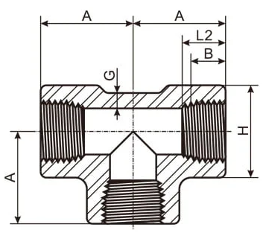
Tee Fitting
Steam School Notes | 19 Fittings
Tee is most common branch fitting with three openings
• Three openings in tee configuration
• Branch connection equals run size
• Primary branch fitting in most systems

Slide 8
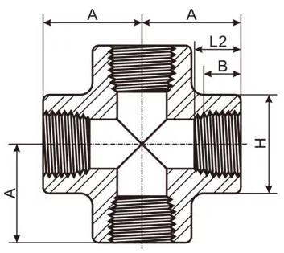
Cross Fitting
Steam School Notes | 19 Fittings
Cross provides four openings for multiple branches
• Four openings arranged in cross pattern
• Allows two branch connections from single fitting
• Less common than tee in typical systems

Slide 9
Reducing Tee
Steam School Notes | 19 Fittings
Reducing tee provides smaller branch than main run
• Run: 2"
• Branch: 1"

Slide 10
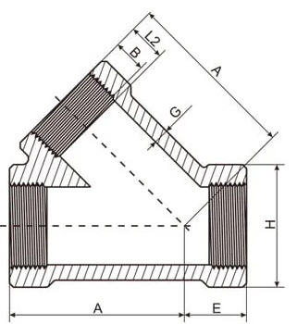
Lateral Fitting
Steam School Notes | 19 Fittings
Lateral creates angled branch with smoother flow path
• Typically angled at 45°
• Smoother flow path than standard tee
• May reduce pressure losses

Slide 11
Branch Connection Stresses
Steam School Notes | 19 Fittings
Branch connections experience multiple stress sources
• Internal pressure
• Thermal expansion
• Vibration
• External loads
As pipe size and pressure increase, branch reinforcement becomes increasingly important.

Slide 12
Changing Pipe Size
Steam School Notes | 19 Fittings
Size changes require reducers or bushings
• Size reductions accommodate changing flow rates
• Choice depends on space, flow characteristics, service conditions
• Bushings reduce fittings; reducers reduce pipe

Slide 13
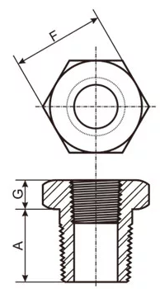
Bushing
Steam School Notes | 19 Fittings
Bushing threads into fitting to reduce opening size
Aspect | Details
Function | Threads into larger fitting, provides smaller opening
Example | 1" × 3/4" bushing connects 3/4" pipe to 1" fitting
Space requirement | Very compact installation

Slide 14
Bushing Advantages and Disadvantages
Steam School Notes | 19 Fittings
Bushings offer compact installation but create stress concentration
Advantages | Disadvantages
Compact installation | Abrupt change in flow area
Lower cost | Concentrates stress in small area
Fewer fittings required | Difficult to remove after long service
Bushings are commonly used on instrument connections, drain lines, vent connections, and small auxiliary piping.

Slide 15
Reducing Coupling
Steam School Notes | 19 Fittings
Reducing coupling joins different pipe sizes in straight run
• Joins two different pipe sizes
• Examples: 1" × 3/4", 1-1/4" × 1", 2" × 1-1/2"
• Stronger and more conventional than bushing

Slide 16
Reducing Coupling Advantages and Disadvantages
Steam School Notes | 19 Fittings
Reducing couplings provide better support at cost of space
Advantages | Disadvantages
Better mechanical support | Requires more space
Easier maintenance | Adds another fitting
Commonly accepted practice

Slide 17
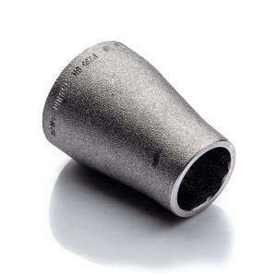
Reducers in Welded Systems
Steam School Notes | 19 Fittings
Reducers connect different pipe sizes in welded piping
• Used in welded piping systems
• Examples: 2" × 1-1/2", 4" × 3", 6" × 4"
• Available in concentric and eccentric styles

Slide 18
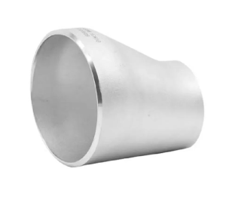
Concentric vs Eccentric Reducers
Steam School Notes | 19 Fittings
Reducer style selection affects flow characteristics
• Concentric: centered symmetrical reduction
• Eccentric: offset reduction maintains one edge level
• Choice depends on application and orientation

Slide 19
Reducer Selection Consequences
Steam School Notes | 19 Fittings
Poor reducer selection creates flow and pressure problems
• Condensate pockets
• Air traps
• Increased turbulence
• Water hammer conditions
Proper orientation is especially important in steam service.

Slide 20
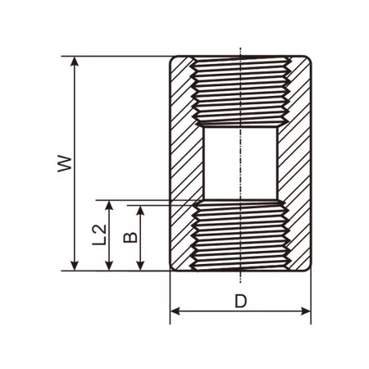
Coupling Fitting
Steam School Notes | 19 Fittings
Coupling joins two pipe sections in straight line
• Common in smaller piping systems
• Threaded couplings most typical
• Straightforward connection method

Slide 21
Half Coupling
Steam School Notes | 19 Fittings
Half coupling creates branch when welded to vessel
• Half of a standard coupling
• Commonly welded to vessels or larger pipe
• Creates branch connection point

Slide 22
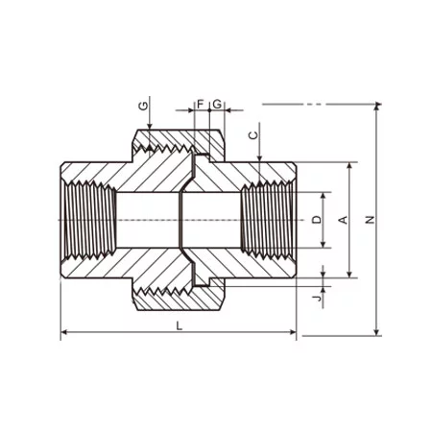
Union Fitting
Steam School Notes | 19 Fittings
Union allows disconnection without rotating pipe
• Provides means of quick disconnect
• Commonly used on valves, steam traps, pumps, instruments
• Simplifies maintenance and replacement

Slide 23
Why Use a Union
Steam School Notes | 19 Fittings
Union avoids removing large piping sections
• Without union, disassembly requires removing large section
• Union allows quick component removal for servicing
• Reduces labor and system downtime

Slide 24
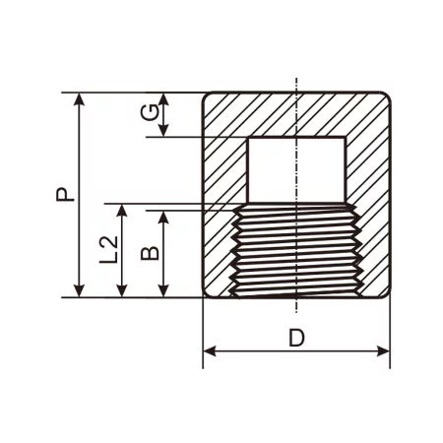
Cap Fitting
Steam School Notes | 19 Fittings
Cap fits over pipe end to close it
• Covers outside of pipe end
• Provides temporary or permanent closure
• Simple capping solution

Slide 25
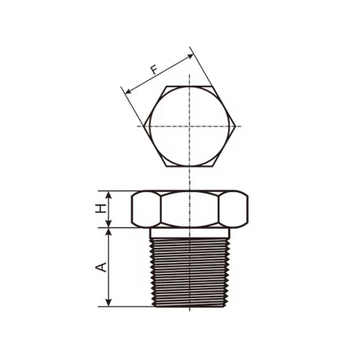
Plug Fitting
Steam School Notes | 19 Fittings
Plug screws into fitting to close opening
• Threads into fitting opening
• Closes threaded holes
• Available as hex-head or square-head styles

Slide 26
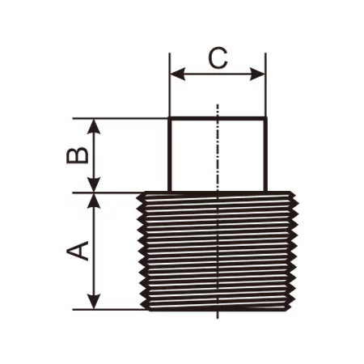
Cap vs Plug Memory Aid
Steam School Notes | 19 Fittings
Distinguish cap and plug by where they fit
• Cap goes over a pipe
• Plug goes into a fitting

Slide 27
Threaded End Connections
Steam School Notes | 19 Fittings
Threaded connections primarily used on smaller pipe sizes
Advantages | Disadvantages
Easy to assemble | Potential leak paths
No welding required | Limited pressure and temperature capability

Slide 28
Socket-Weld End Connections
Steam School Notes | 19 Fittings
Pipe inserted into socket and welded around outside
Advantages | Disadvantages
Strong connection | Requires welding
Suitable for higher-pressure service | More difficult to inspect internally

Slide 29
Butt-Weld End Connections
Steam School Notes | 19 Fittings
Pipe and fitting welded directly end-to-end
Advantages | Disadvantages
Highest strength | Requires qualified welding procedures
Smooth internal bore
Preferred for larger steam systems

Slide 30
Key Takeaway: Fittings Role
Steam School Notes | 19 Fittings
Fittings make piping systems practical and reliable
• Allow pipe to change direction
• Create branches in system
• Change pipe size
• Connect equipment
• Terminate lines
Proper fitting selection affects assembly ease, pressure capability, maintainability, and long-term reliability.

Slide 31
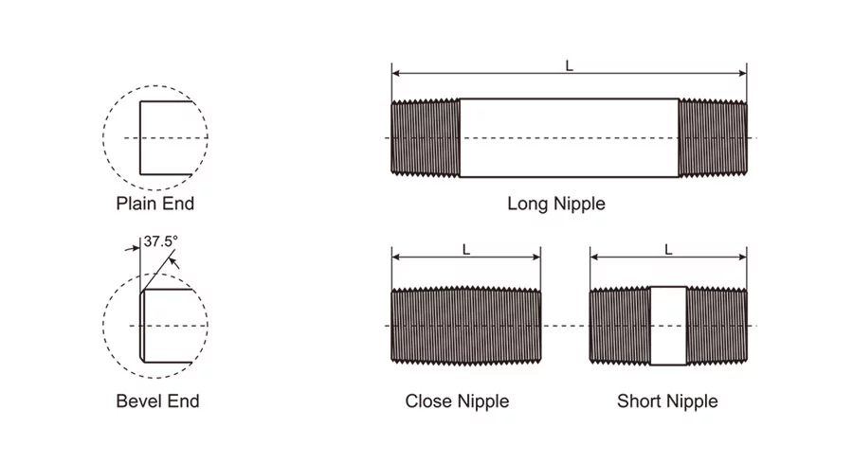
Nipple Definition
Steam School Notes | 19 Fittings
Nipple is short length of pipe with threads on both ends
• External threads on both ends
• Connects two threaded fittings or components
• Short piece of pipe prepared for threaded service

Slide 32
Common Nipple Uses
Steam School Notes | 19 Fittings
Nipples connect valves, instruments, and components
• Connecting valves to fittings
• Extending a branch line
• Installing pressure gauges
• Connecting steam traps
• Creating spacing between components

Slide 33
Nipple Length Standards
Steam School Notes | 19 Fittings
Nipples available in standard lengths for different applications
• Close
• Short (shoulder)
• Long
• Custom-cut
Exact dimensions vary by manufacturer and pipe size.

Slide 34
Close Nipple
Steam School Notes | 19 Fittings
Close nipple has threads over entire length
• Threads cover entire length
• Very little visible between fittings when assembled
• Useful where space is limited
• Difficult to remove because no unthreaded grip section

Slide 35
Short Nipple
Steam School Notes | 19 Fittings
Short nipple has short unthreaded section between threaded ends
• Also called shoulder nipple
• Unthreaded section visible after assembly
• May provide limited wrench grip

Slide 36
Long Nipple
Steam School Notes | 19 Fittings
Long nipple extends spacing between components
• Simply longer sections of threaded pipe
• Create space between components
• Bridge short distances
• Position instruments or valves for easier access

Slide 37
Barrel Nipple
Steam School Notes | 19 Fittings
Barrel nipple has threads only near ends
• Threads only at both ends
• Large unthreaded section in middle
• Used when greater length needed with minimal threading

Slide 38
Running Nipple
Steam School Notes | 19 Fittings
Running nipple is threaded continuously end to end
• Threaded continuously from end to end
• Similar to long close nipple
• Useful when one fitting must rotate onto nipple during assembly

Slide 39
Why Pipefitters Care About Nipples
Steam School Notes | 19 Fittings
Correct nipple length determines assembly and maintenance efficiency
• Provide wrench clearance
• Allow valve handles to move freely
• Improve accessibility
• Simplify future maintenance
Poor nipple selection can leave components difficult or impossible to service.

Slide 40
Nipples in Common Steam Service
Steam School Notes | 19 Fittings
Nipples frequently connect steam system components
• Between steam trap and isolation valve
• Between pressure gauge and gauge valve
• Between tee and drain valve
• Between boiler nozzle and valve assembly
• In instrument and control piping

Slide 41
Key Takeaway: Nipples Importance
Steam School Notes | 19 Fittings
Nipple selection is important for accessibility and system layout
• Short piece of threaded pipe
• Connects fittings and components
• Simple in appearance but critical in function
Proper nipple selection is important for accessibility, assembly, maintenance, and overall piping layout.

Slide 42
Flange Definition
Steam School Notes | 19 Fittings
Flange mechanically connects pipe and equipment with bolts
• Two mating flanges with gasket between
• Bolts and nuts compress gasket for seal
• Easily disassembled for inspection and maintenance
Flanges are ideal for equipment requiring periodic inspection or replacement.

Slide 43
When to Use Flanges
Steam School Notes | 19 Fittings
Flanges used where equipment must be removable
• Valves
• Steam traps
• Pumps
• Heat exchangers
• Pressure vessels
• Boilers
Without flanges, removing large equipment would require cutting and rewelding piping.

Slide 44
Weld Neck Flange
Steam School Notes | 19 Fittings
Weld neck flange is preferred for many pressure applications
Characteristic | Detail
Tapered hub | Smooth transition between pipe and flange
Stress characteristics | Reduces stress concentrations
Service suitability | High pressure and temperature service
Common applications | Steam systems, process piping, high-pressure service
Weld neck flange provides excellent strength and good fatigue resistance.

Slide 45
Slip-On Flange
Steam School Notes | 19 Fittings
Slip-on flange slides over pipe and is welded in place
Advantages | Disadvantages
Easy alignment | Lower strength than weld neck
Lower cost | More susceptible to fatigue
Simplified fit-up

Slide 46
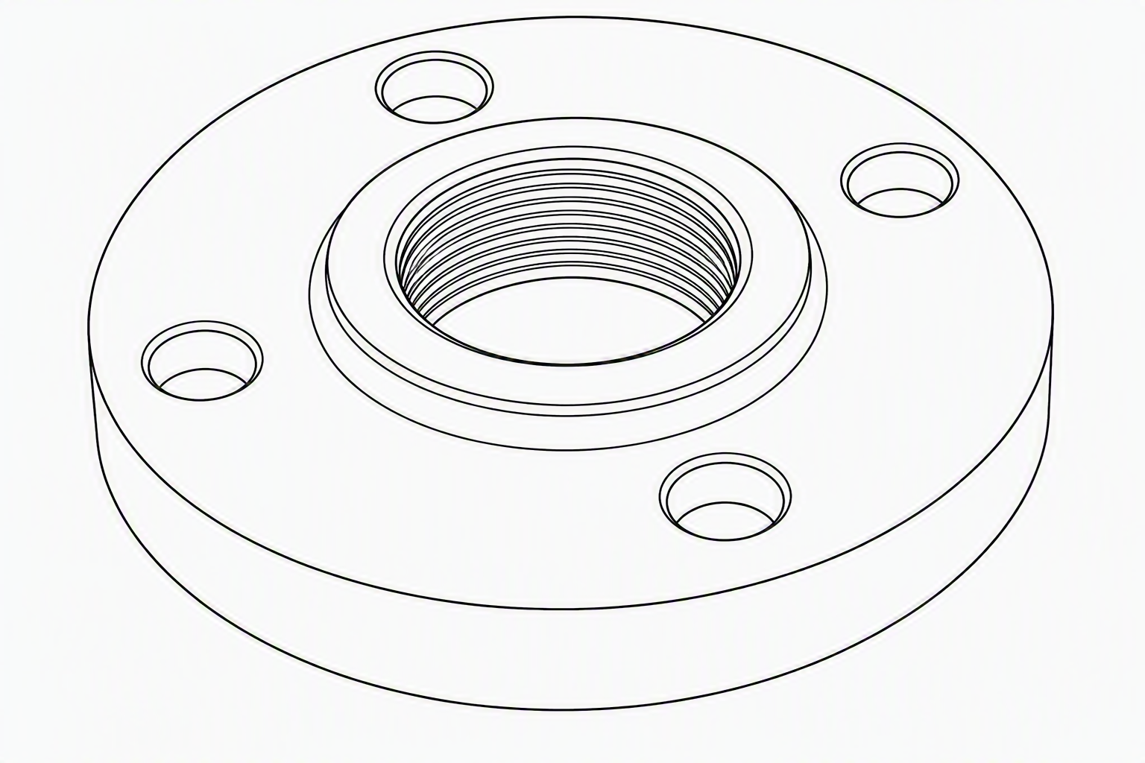
Threaded Flange
Steam School Notes | 19 Fittings
Threaded flange contains internal pipe threads
Advantages | Disadvantages
No welding required | Limited pressure and temperature capability
Convenient for small piping systems | Potential leak paths through threads

Slide 47
Socket Weld Flange
Steam School Notes | 19 Fittings
Socket weld flange contains recessed socket for pipe
• Pipe inserted into recessed socket
• Then welded in place
• Used on smaller high-pressure piping

Slide 48
Blind Flange
Steam School Notes | 19 Fittings
Blind flange is solid plate closing flanged connection
• Solid plate with no opening
• Closes end of flanged connection
• Used for future expansion, isolation, or testing

Slide 49
Gaskets
Steam School Notes | 19 Fittings
Gasket compressed between flange faces creates seal
• Flange alone does not normally provide seal
• Seal created by gasket compression
• Material must suit system temperature, pressure, and fluid

Slide 50
Gasket Materials
Steam School Notes | 19 Fittings
Gasket material selection affects sealing performance
• Compressed fiber
• Graphite
• PTFE
• Spiral wound metal gaskets

Slide 51
Gasket Selection Consequences
Steam School Notes | 19 Fittings
Improper gasket selection results in serious problems
• Steam leaks
• Blowouts
• Loss of pressure
• Equipment damage
In steam service, gasket selection is often as important as flange selection.

Slide 52
Flat Face Flange
Steam School Notes | 19 Fittings
Flat-face flange has completely flat sealing surface
• Completely flat sealing surface
• Commonly used with cast-iron equipment
• Simple sealing geometry

Slide 53
Raised Face Flange
Steam School Notes | 19 Fittings
Raised-face flange has small raised sealing surface
• Small raised surface around bore
• Most common type in industrial piping
• Concentrates gasket loading for better performance

Slide 54
Ring-Type Joint Flange
Steam School Notes | 19 Fittings
RTJ flange uses machined metal ring in precision grooves
• Metal ring seated in precision-machined grooves
• Reserved for specialized applications
• Very high-pressure or high-temperature service

Slide 55
Flange Bolting
Steam School Notes | 19 Fittings
Bolts compress gasket to maintain seal
• Bolts do not directly seal; they compress gasket
• Uneven tightening can damage gasket
• Excessive tightening can crush gasket
• Insufficient tightening causes leaks

Slide 56
Proper Flange Tightening
Steam School Notes | 19 Fittings
Tighten bolts in crisscross pattern for even compression
• Use crisscross or star pattern
• Ensures even gasket compression
• Distributes load evenly around flange

Slide 57
Flange Pressure-Temperature Ratings
Steam School Notes | 19 Fittings
Flange ratings called classes indicate pressure capability
• Class 150
• Class 300
• Class 600
• Class 900
• Class 1500
• Class 2500
Higher class generally indicates capability for higher pressure service.

Slide 58
Flange Rating Misunderstanding
Steam School Notes | 19 Fittings
Flange class does not equal maximum psi rating
• Class 150 flange not limited to 150 psi
• Rating varies with material and temperature
• Actual allowable pressure from applicable standard
Flange ratings must be determined from applicable standards for specific applications.

Slide 59
Why Pipefitters Should Understand Flanges
Steam School Notes | 19 Fittings
Proper flanged joint assembly affects system safety and reliability
• Alignment, gasket selection important
• Bolting techniques critical
• Pressure-class selection affects capability
• Many steam leaks from incorrect assembly, not defects

Slide 60
Key Takeaway: Flanged Connections
Steam School Notes | 19 Fittings
Flanges provide removable connection method for equipment
• Two flanges, gasket, and bolting
• Understanding flange types essential
• Gasket selection critical
• Proper assembly practices required
Understanding flange types, gasket selection, flange ratings, and proper assembly practices is essential for steam systems.

Slide 61
Fitting Markings Overview
Steam School Notes | 19 Fittings
Fittings marked with size, material, pressure class information
• Size markings
• Material specifications
• Pressure class
• Manufacturing standard
• Manufacturer identification
Understanding markings ensures correct fitting selection.

Slide 62
Why Fitting Markings Matter
Steam School Notes | 19 Fittings
Identical-appearing fittings may have different ratings
• Verify size before installation
• Check material specification
• Confirm pressure class
• Ensure manufacturing standard compliance
• Wrong fitting compromises system safety

Slide 63
Pressure Classes
Steam School Notes | 19 Fittings
Forged steel fittings marked with pressure class
• Examples: 3000, 6000, 9000
• Called three-thousand pound fitting, etc.
• Not maximum allowable psi

Slide 64
Pressure Class Misconception
Steam School Notes | 19 Fittings
Pressure class is rating category, not maximum psi
• Class 3000 not automatically 3000 psi limit
• Rating depends on material
• Temperature affects rating
• Applicable standards determine actual pressure
Pressure class identifies fitting rating category only.

Slide 65
Material Markings
Steam School Notes | 19 Fittings
Fittings marked with material specification
Marking | Material
A105 | Forged carbon steel for steam and process piping
A182 F304 | Forged 304 stainless steel
A182 F316 | Forged 316 stainless steel

Slide 66
Manufacturing Standards
Steam School Notes | 19 Fittings
Fittings marked with standard to which manufactured
• Examples: B16.11, B16.9
• Standard identifies fitting type and specifications
• Helps verify suitability for piping system

Slide 67
ASME B16.11 Standard
Steam School Notes | 19 Fittings
B16.11 applies to forged threaded and socket-weld fittings
• Forged threaded fittings
• Socket-weld fittings
• Examples: couplings, unions, tees, elbows, bushings

Slide 68
ASME B16.9 Standard
Steam School Notes | 19 Fittings
B16.9 applies to butt-weld fittings
• Factory-made wrought butt-weld fittings
• Examples: welded elbows, reducers, tees, caps
• Helps verify suitability for piping system

Slide 69
Size Markings
Steam School Notes | 19 Fittings
Fittings marked with nominal pipe size
• Straight fittings show single size
• Reducing fittings show both sizes
• Examples: 1, 1-1/2, 2"; 2 × 1, 1-1/2 × 3/4

Slide 70
Manufacturer Identification
Steam School Notes | 19 Fittings
Fitting carries manufacturer trademark or identification
• Provides product identification
• Enables traceability
• Supports quality-control verification
• Aids in finding material certifications

Slide 71
Heat Numbers and Traceability
Steam School Notes | 19 Fittings
Higher-grade systems use heat numbers for material traceability
• Heat number links to material test reports
• Provides chemical analysis records
• Includes mechanical test records
• Shows material certifications

Slide 72
Canadian Registration Numbers
Steam School Notes | 19 Fittings
CRN indicates design accepted for Canadian pressure systems
• Required for pressure-retaining components in Canada
• Example marking: CRN 0C12345.5C
• Regulatory authority acceptance indicator

Slide 73
Reading Fitting Markings
Steam School Notes | 19 Fittings
Fitting markings provide multiple pieces of information
• Marking: ABC 3000 A105 1 B16.11
• Manufacturer: ABC
• Pressure class: 3000
• Material: ASTM A105 forged carbon steel
• Size: 1 inch
• Standard: ASME B16.11

Slide 74
Key Takeaway: Fitting Markings
Steam School Notes | 19 Fittings
Fitting markings are identification card for component
• Provide size information
• Identify material
• Show pressure class
• Indicate manufacturing standard
• Enable traceability
Learning to read fitting markings is important because many fittings appear similar even though their pressure ratings and applications may differ.

Slide 75
Cast vs Forged Fittings Overview
Steam School Notes | 19 Fittings
Manufacturing method affects strength and capability
• Affects strength
• Affects pressure capability
• Affects toughness
• Affects reliability
• Affects suitable service applications

Slide 76
Cast Fittings
Steam School Notes | 19 Fittings
Cast fittings poured into mold and solidified
• Molten metal poured into mold
• Allowed to solidify
• Materials: cast iron, malleable iron, cast steel, bronze
• Complex shapes produced with minimal machining

Slide 77
Cast Fitting Advantages
Steam School Notes | 19 Fittings
Cast fittings offer cost and manufacturing benefits
• Lower manufacturing cost
• Complex shapes easy to produce
• Suitable for many low-pressure applications

Slide 78
Cast Fitting Disadvantages
Steam School Notes | 19 Fittings
Cast fittings have lower strength and reliability
• Generally lower toughness
• More susceptible to casting defects
• Less resistant to shock loading
• Lower pressure ratings than forged equivalents

Slide 79
Forged Fittings
Steam School Notes | 19 Fittings
Forged fittings formed by mechanical compression
• Heated metal compressed under high pressure
• Metal formed by compression, not pouring
• Improves grain structure and strength

Slide 80
Forged Fitting Advantages
Steam School Notes | 19 Fittings
Forged fittings provide superior strength and reliability
• Higher strength
• Better toughness
• Improved fatigue resistance
• Higher pressure capability
• Greater reliability in severe service

Slide 81
Forged Fitting Disadvantages
Steam School Notes | 19 Fittings
Forged fittings have cost and machining tradeoffs
• Higher cost than cast fittings
• More machining may be required

Slide 82
Visual Differences Between Types
Steam School Notes | 19 Fittings
Forged and cast fittings have distinctive appearances
Characteristic | Forged Fitting | Cast Fitting
Surface finish | Smooth machined surfaces | Rougher surface finish
Markings | Clearly stamped | Cast-in markings
Class ratings | 3000, 6000, 9000 | 125 lb, 150 lb
Appearance provides clues but markings should be used for positive identification.

Slide 83
Forged Fittings in Steam Service
Steam School Notes | 19 Fittings
Forged steel fittings preferred for industrial steam systems
• ASTM A105 forged carbon steel fittings
• ASME B16.11 threaded fittings
• ASME B16.11 socket-weld fittings
• ASME B16.9 butt-weld fittings
Forged fittings designed to withstand temperatures and pressures in steam service.

Slide 84
Malleable Iron Fittings
Steam School Notes | 19 Fittings
Malleable iron common in lower-pressure utility piping
• Common in compressed-air systems
• Used in water systems
• Used in low-pressure utility piping
• Historically used in low-pressure steam
Many industrial facilities now prefer forged steel fittings for superior strength and durability.

Slide 85
Cast Iron Fittings in Steam Service
Steam School Notes | 19 Fittings
Cast iron fittings should be viewed cautiously in steam
• Strong in compression
• Relatively brittle
• Less tolerant of thermal stress
• Less tolerant of mechanical shock
Cast iron fitting satisfactory in water service may not be suitable for higher-temperature steam.

Slide 86
Typical Cast vs Forged Comparison
Steam School Notes | 19 Fittings
Same-size fittings may have vastly different capabilities
Characteristic | 110 lb Malleable Iron Elbow | 3000 lb A105 Forged Elbow
Construction | Cast | Forged
Pressure rating | Lower | Higher
Service application | Utility service | Industrial steam
Identical-appearing fittings may have vastly different operating capabilities.

Slide 87
Why Pipefitters Should Care
Steam School Notes | 19 Fittings
Two identical-appearing fittings may differ in capability
• Verify material before installation
• Check pressure class
• Confirm manufacturing standard
• Ensure service suitability
• Never assume fitting is acceptable just because it fits

Slide 88
Key Takeaway: Cast vs Forged
Steam School Notes | 19 Fittings
Fitting manufacturing method determines performance
• Cast and forged fittings look similar
• Performance can be very different
• Forged steel preferred for steam systems
• Cast and malleable for lower-pressure utility
Forged steel fittings provide greater strength, toughness, and pressure capability for industrial steam applications.

