Slide 1
Steam Engine Development
Steam School Notes | 22 Engine Types
Steam engines converted heat to mechanical power at scale
• First practical large-scale heat-to-power conversion machine
• Powered mines, factories, railways, and ships
• Piston reciprocation converted to rotary motion via connecting rod and crank
Steam engines powered industrial development through controlled heat expansion.

Slide 2
Expansive Working Principle
Steam School Notes | 22 Engine Types
Steam admission stops before piston stroke ends
• Admission valve closes after piston travels 25-33% of stroke
• Trapped steam continues expanding and pushing piston
• Reduces steam consumption and fuel use
• More efficient than continuous steam admission
Expansive working extracts additional useful work from already-admitted steam.

Slide 3
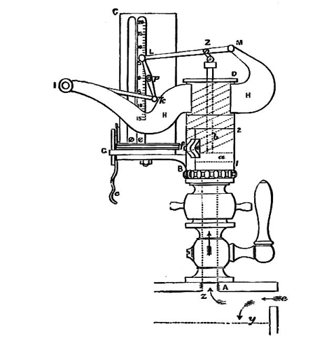
Steam Indicator Function
Steam School Notes | 22 Engine Types
Indicator records cylinder pressure throughout piston cycle
• Spring-loaded piston responds to pressure changes
• Pencil traces pressure against piston position
• Produces indicator diagram showing engine cycle events
• Enables diagnosis and optimization of engine performance
The indicator diagram transformed steam engine operation from guesswork into measurable engineering.

Slide 4
Principal Cycle Events
Steam School Notes | 22 Engine Types
Five sequential events occur in each piston cycle
• Steam admission: pressure rises as valve opens
• Steam cut-off: admission valve closes partway through stroke
• Expansion: trapped steam expands as piston moves
• Exhaust release: remaining steam vented near stroke end
• Compression: trapped steam compressed during return stroke
These events reveal how pressure changes and energy is used during engine operation.

Slide 5
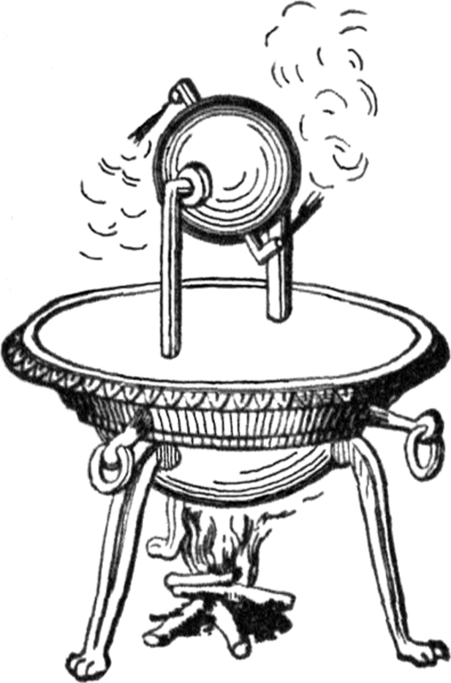
The Aeolipile
Steam School Notes | 22 Engine Types
Early steam device demonstrating reaction force principle
• Hollow sphere that rotates freely
• Steam escapes through bent nozzles
• Reaction force of escaping steam causes rotation
• Described by Hero of Alexandria in first century AD
Aeolipile demonstrated steam power concept but could not perform useful work.

Slide 6
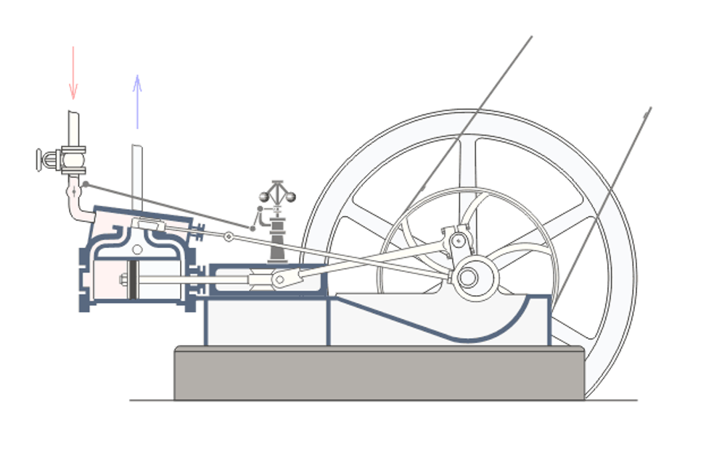
Double-Acting Simple Engine
Steam School Notes | 22 Engine Types
Steam acts on both piston sides for continuous power
• Steam produces power during outward and return strokes
• Smoother operation than single-acting engines
• Flywheel stores and releases energy for uniform speed
• Principal components: cylinder, piston, connecting rod, crankshaft, valve

Slide 7
Power Stroke Frequency Comparison
Steam School Notes | 22 Engine Types
Double-acting steam engine delivers more power strokes than combustion engines
Engine Type | Power Strokes per Revolution
Four-stroke internal-combustion | 0.5
Two-stroke internal-combustion | 1
Double-acting steam | 2
Frequent power strokes explain steam engine smoothness and reduce flywheel size requirements.

Slide 8
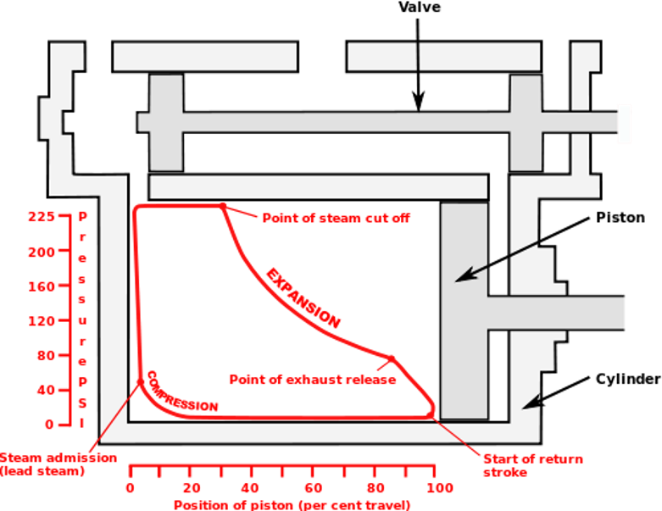
Indicator Diagram Visualization
Steam School Notes | 22 Engine Types
Diagram shows pressure changes as piston moves through stroke
Horizontal axis represents piston position in cylinder
Vertical axis represents steam pressure
Closed loop traces one complete piston cycle
Shape reveals engine operation efficiency and valve settings

Slide 9
Steam Admission Event
Steam School Notes | 22 Engine Types
Pressure rises rapidly when admission valve opens
• Admission valve opens at stroke beginning
• High-pressure steam enters cylinder
• Pressure rises and exerts force on piston
• Appears as near-vertical rise on indicator diagram

Slide 10
Steam Cut-Off Event
Steam School Notes | 22 Engine Types
Admission valve closes partway through stroke
• Valve closes after piston travels portion of stroke
• No additional steam enters cylinder
• Marks beginning of expansive working
• Cut-off position is critical to engine economy and performance

Slide 11
Expansion Event
Steam School Notes | 22 Engine Types
Trapped steam continues pushing piston as pressure decreases
• Steam expands as piston moves toward cylinder end
• Pressure and temperature decrease during expansion
• Steam continues exerting force and producing work
• Curved upper portion of indicator diagram shows expansion
Expanding steam performing work after admission stops is key to steam engine efficiency.

Slide 12
Exhaust Release Event
Steam School Notes | 22 Engine Types
Remaining steam expelled near stroke end
• Exhaust valve opens near stroke end
• Sudden pressure drop as steam released
• Reduces opposing pressure on piston return
• Steep drop appears on right side of indicator diagram

Slide 13
Compression Event
Steam School Notes | 22 Engine Types
Trapped steam compressed during return stroke
• Exhaust valve closes before piston reaches end
• Small steam quantity remains in cylinder
• Compression raises pressure before fresh steam admitted
• Cushions piston motion and reduces mechanical shock

Slide 14
Complete Piston Cycle
Steam School Notes | 22 Engine Types
Five events form continuous cycle converting steam energy to work
• Steam admission: pressure rises
• Cut-off: admission closes
• Expansion: pressure falls but work continues
• Release: exhaust opens
• Compression: trapped steam prepares for next cycle
Cut-off and expansion are particularly important for economy and efficiency.

Slide 15
Expansive Working Efficiency
Steam School Notes | 22 Engine Types
Early cut-off improves economy by using more steam per piston stroke
• High-pressure steam enters; admission closes early
• Trapped steam expands as piston moves to end
• More work extracted from same steam quantity
• Reduces fuel and water consumption

Slide 16
Expansion Temperature Changes
Steam School Notes | 22 Engine Types
Steam temperature decreases as pressure falls during expansion
• Pressure decreases as steam expands
• Temperature drops as energy transferred to piston
• Process approaches adiabatic expansion ideally
• Little heat exchanged with surroundings during expansion

Slide 17
Cylinder Heating and Cooling Inefficiency
Steam School Notes | 22 Engine Types
Repeated temperature cycling of cylinder walls wastes energy
• Hot admission steam heats cylinder walls
• Cooler expansion steam allows walls to cool
• Cycling repeats with each engine stroke
• Energy transferred into and out of metal rather than to work
Continuous cylinder heating and cooling is principal efficiency loss in simple steam engines.

Slide 18
Cut-Off Trade-Off Challenge
Steam School Notes | 22 Engine Types
Early cut-off improves economy but reduces uniform turning effort
• Early cut-off reduces steam consumption
• Falling pressure during expansion reduces uniform force
• Torque on crankshaft becomes less uniform
• Larger flywheel required to maintain steady speed

Slide 19
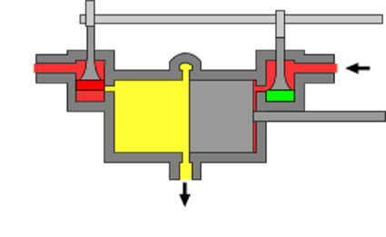
Uniflow Engine Design
Steam School Notes | 22 Engine Types
Steam flows in one direction to reduce temperature cycling
• Inlet valves at cylinder ends; exhaust ports at center
• Steam enters hot ends, exhausts at cooler center
• Piston uncovers central exhaust ports near stroke end
• Temperature variations within cylinder reduced

Slide 20
Uniflow Engine Benefits
Steam School Notes | 22 Engine Types
One-direction flow improves thermal efficiency
• Cylinder ends remain relatively hot
• Central exhaust region remains relatively cool
• Temperature variations reduced
• Condensation losses decreased
Uniflow principle demonstrated significant efficiency improvements were still possible in late steam engine development.

Slide 21
Simple Engine Limitations
Steam School Notes | 22 Engine Types
Single cylinder engine shows temperature range inefficiency
• Steam admitted at high temperature and pressure
• Large temperature drop during expansion
• Large temperature range causes energy loss
• Repeated heating and cooling of cylinder walls

Slide 22
Compound Engine Concept
Steam School Notes | 22 Engine Types
Multiple cylinders divide expansion into stages
• High-pressure steam expands in first cylinder
• Partially expanded steam passes to larger cylinder
• Additional expansion occurs in larger cylinder
• Process reduces cylinder temperature variations
Compounding obtains more work from steam and improves overall economy.

Slide 23
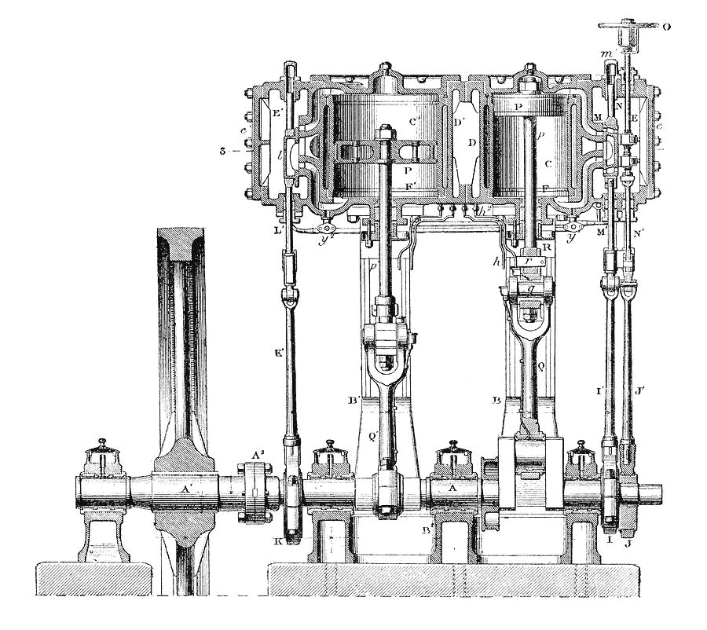
Cross-Compound Engine
Steam School Notes | 22 Engine Types
High and low-pressure cylinders mounted side by side
• Cylinders drive separate crank throws on common shaft
• Low-pressure cylinder larger than high-pressure
• Distributes turning effort around crankshaft
• Smoother operation than single-cylinder engine

Slide 24
Steam Path in Cross-Compound
Steam School Notes | 22 Engine Types
Steam flows from boiler through cylinders to exhaust
• Boiler supplies high-pressure steam
• High-pressure cylinder: initial expansion stage
• Low-pressure cylinder: continued expansion
• Exhaust: remaining steam released

Slide 25
Triple-Expansion Engine Development
Steam School Notes | 22 Engine Types
Three-stage expansion achieves greater economy than compound
• Developed as boiler pressures increased in 19th century
• Steam passes through three progressively larger cylinders
• Each cylinder handles portion of total expansion
• Reduces temperature range further than two-stage expansion
Triple-expansion engines became preferred for marine applications.

Slide 26
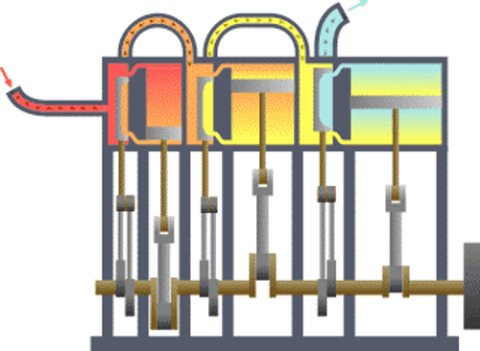
Triple-Expansion Cylinder Sequence
Steam School Notes | 22 Engine Types
Three cylinders handle sequential expansion stages
• High-pressure cylinder: initial expansion
• Intermediate-pressure cylinder: secondary expansion
• Low-pressure cylinder: final expansion stage

Slide 27
Triple-Expansion Steam Path
Steam School Notes | 22 Engine Types
Sequential steam flow through three cylinders
• Boiler supplies high-pressure steam
• High-pressure cylinder: partial work extraction
• Intermediate-pressure cylinder: further expansion
• Low-pressure cylinder: final expansion stage
• Condenser or atmosphere: exhaust

Slide 28
Triple-Expansion Cylinder Sizing
Steam School Notes | 22 Engine Types
Each cylinder larger than previous due to volume increase
• Steam expands as pressure drops
• Each successive cylinder must accommodate larger volume
• Low-pressure cylinder often several times larger than high-pressure
• Size proportionate to expansion ratio

Slide 29
Triple-Expansion Efficiency Advantage
Steam School Notes | 22 Engine Types
Three-stage expansion reduces condensation losses
• Temperature range experienced by each cylinder reduced
• Decreased condensation within cylinders
• More useful work extracted before exhaust
• Improved fuel economy for long-distance service

Slide 30
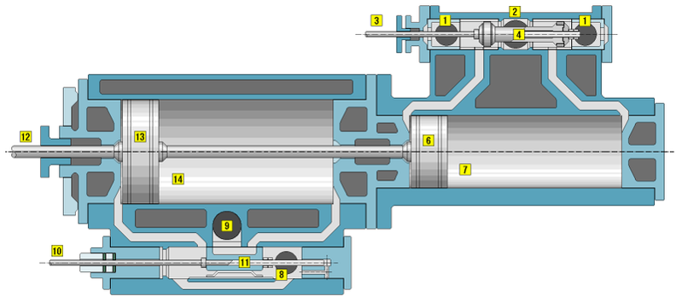
Tandem Compound Engine
Steam School Notes | 22 Engine Types
High and low-pressure cylinders arranged in line
• Cylinders mounted on same centerline
• Share common piston rod
• Both pistons drive same connecting rod and crankshaft
• More compact than cross-compound design

Slide 31
Tandem Compound Advantages
Steam School Notes | 22 Engine Types
Compact design with fewer moving parts
• Combined force from both pistons reaches crankshaft
• Simplified mechanical arrangement
• Retains economic advantages of compounding
• Suitable for applications requiring compact layout

Slide 32
Tandem Compound Applications
Steam School Notes | 22 Engine Types
Widely used for stationary and portable engines
• Stationary engines requiring compact layout
• Traction engines for agricultural use
• Portable steam engines
• Demonstrated adaptability of compound principle

Slide 33
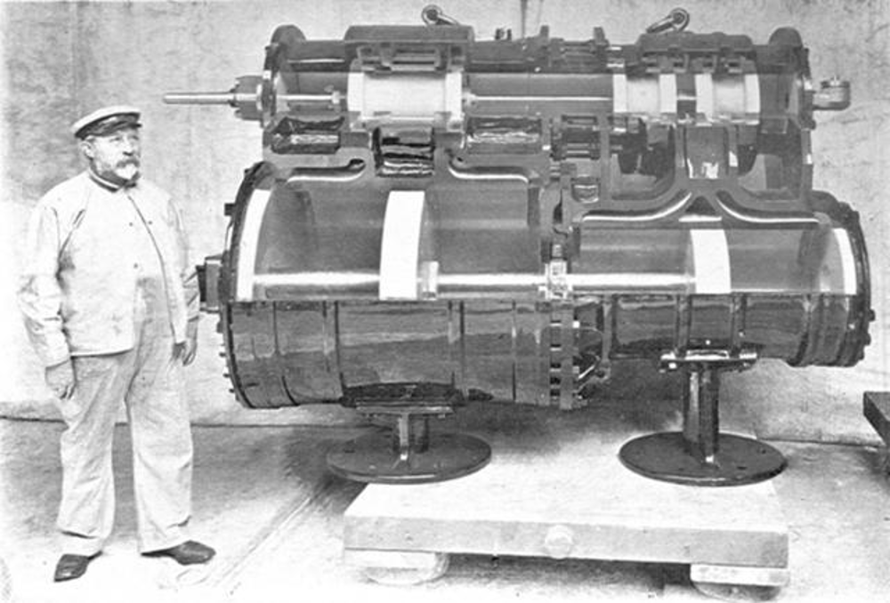
Vauclain Compound Engine
Steam School Notes | 22 Engine Types
High and low-pressure cylinders mounted vertically for locomotives
• Developed by Baldwin Locomotive Works
• Cylinders mounted above one another on locomotive sides
• Share common crosshead and single connecting rod
• Compact design suited to locomotive frame constraints

Slide 34
Vauclain Steam Path
Steam School Notes | 22 Engine Types
Sequential expansion through stacked cylinders
• Boiler supplies high-pressure steam
• Smaller high-pressure cylinder: partial expansion
• Larger low-pressure cylinder: continued expansion
• Exhaust: steam released

Slide 35
Vauclain Compound Characteristics
Steam School Notes | 22 Engine Types
Combines cross-compound and tandem advantages
• Closely grouped cylinders for space efficiency
• Compact installation between frame rails
• Mechanically ingenious design
• Improved fuel economy for locomotives

Slide 36
Quadruple-Expansion Engine
Steam School Notes | 22 Engine Types
Four-stage expansion represents ultimate reciprocating steam engine development
• Developed as boiler pressures continued increasing
• Expands steam through four cylinders
• Further reduces temperature range within each cylinder
• Represents most highly developed compound form
Quadruple-expansion engines achieved maximum efficiency but modest gains over triple-expansion.

Slide 37
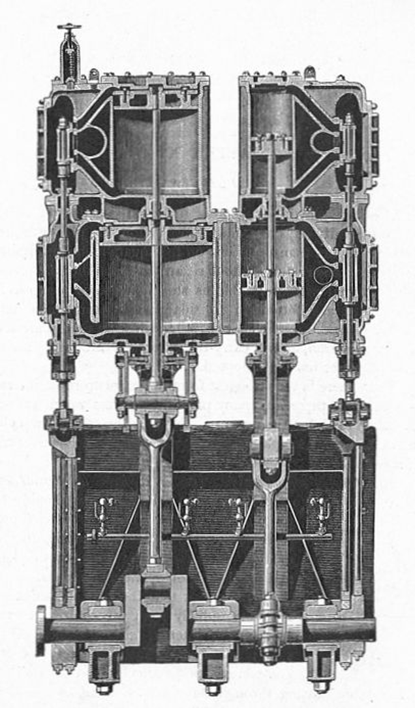
Quadruple-Expansion Cylinder Stages
Steam School Notes | 22 Engine Types
Four cylinders handle sequential expansion
• High-pressure cylinder: initial expansion
• First intermediate-pressure cylinder: secondary stage
• Second intermediate-pressure cylinder: tertiary stage
• Low-pressure cylinder: final expansion stage

Slide 38
Quadruple-Expansion Steam Path
Steam School Notes | 22 Engine Types
Sequential flow through four cylinders maximizes work extraction
• Boiler: high-pressure steam source
• High-pressure cylinder: initial work extraction
• First intermediate cylinder: secondary expansion
• Second intermediate cylinder: tertiary expansion
• Low-pressure cylinder: final expansion stage
• Condenser: exhaust collection

Slide 39
Quadruple-Expansion Example: Fleming & Ferguson Engine
Steam School Notes | 22 Engine Types
Practical example shows cylinder sizing for steam expansion
• Boiler pressure: 200 psi
• Indicated horsepower: approximately 360

Slide 40
Quadruple-Expansion Efficiency Impact
Steam School Notes | 22 Engine Types
Four-stage expansion minimizes temperature cycling losses
• Temperature range within each cylinder further reduced
• Condensation losses minimized
• More complete use of boiler-supplied energy
• Modest efficiency gain over triple-expansion

Slide 41
Quadruple-Expansion Marine Service
Steam School Notes | 22 Engine Types
Pinnacle marine reciprocating engine design
• Justified where fuel economy paramount
• Long-distance marine service applications
• Increased operating range and cargo capacity
• Reduced coal consumption for extended voyages

Slide 42
Steam Engine Development Summary
Steam School Notes | 22 Engine Types
History driven by improving steam expansion efficiency
• From Aeolipile to refined uniflow engine
• Progressive learning to extract more work per steam pound
• Reduced fuel consumption and mechanical losses
• Underlying objective: convert maximum heat energy to work
Steam engine evolution represents systematic effort to extract more useful work from each pound of steam.

