Slide 1
MTRs and CRNs
Steam School Notes | 21 Canadian Registration Numbers (CRNs)
Material Test Reports prove material; CRNs prove design
• MTR: Demonstrates material acceptability
• CRN: Demonstrates design acceptability
• Both may be required before component installation
An MTR and a CRN answer different compliance questions and serve complementary purposes.

Slide 2
What Is a CRN?
Steam School Notes | 21 Canadian Registration Numbers (CRNs)
CRN stands for Canadian Registration Number
• CRN: Issued after pressure-retaining design reviewed and accepted by applicable regulatory authority
• Valves
• Fittings
• Pressure vessels
• Boilers
• Heat exchangers
• Pressure piping components
A component requiring registration may not be legally installable without an appropriate CRN.

Slide 3
Why CRNs Exist
Steam School Notes | 21 Canadian Registration Numbers (CRNs)
Pressure equipment failure consequences drive regulatory design review
• Serious injury
• Property damage
• Loss of production
• Environmental damage
CRNs verify that pressure-containing designs meet code and standard requirements before service.

Slide 4
Distinguishing MTRs and CRNs
Steam School Notes | 21 Canadian Registration Numbers (CRNs)
MTRs and CRNs answer different compliance questions
Question | Document
Is the material acceptable? | MTR
Is the design acceptable? | CRN
• A valve may have both a valid MTR for material and a valid CRN for design
• Both forms of documentation may be required

Slide 5
Typical CRN Format
Steam School Notes | 21 Canadian Registration Numbers (CRNs)
CRNs contain registration number and jurisdiction identifiers
• Example: 0C12345.5C
• Example: 0F56789.2
• Registration number
• One or more jurisdiction identifiers

Slide 6
CRN Physical Locations
Steam School Notes | 21 Canadian Registration Numbers (CRNs)
CRNs appear on components and supporting documentation
• Nameplate
• Casting
• Stamping
• Manufacturer's data report
• Product documentation
Examples
• Pressure vessels
• Safety valves
• Fittings
• Strainers
• Heat exchangers
Both physical markings and supporting documentation should be reviewed during component inspection.

Slide 7
Components with CRNs: Valves
Steam School Notes | 21 Canadian Registration Numbers (CRNs)
Steam operators commonly encounter CRNs on valve designs
• Safety valves
• Pressure reducing valves
• Control valves

Slide 8
Components with CRNs: Fittings
Steam School Notes | 21 Canadian Registration Numbers (CRNs)
Fittings commonly carry CRN registration
• Forged steel fittings
• Specialized branch fittings
• Strainers

Slide 9
Components with CRNs: Pressure Vessels
Steam School Notes | 21 Canadian Registration Numbers (CRNs)
Pressure vessels regularly require CRN documentation
• Air receivers
• Steam separators
• Heat exchangers
• Boiler components

Slide 10
Reading a CRN
Steam School Notes | 21 Canadian Registration Numbers (CRNs)
CRN links component design to regulatory registration records
• Does not provide material properties
• Does not provide operating pressures
• Acts as reference to registration records maintained by regulatory authority
CRN does not replace
• MTRs
• Pressure ratings
• Nameplate information
• Code markings
CRN supplements but does not replace Material Test Reports and other component documentation.

Slide 11
Why Pipefitters Should Care
Steam School Notes | 21 Canadian Registration Numbers (CRNs)
Pipefitters verify correct components during installation and inspection
• Does this component require a CRN?
• Is a CRN present?
• Does the documentation match the component?
Understanding CRNs helps avoid delays during inspection and certification.

Slide 12
Common Misconception about CRNs
Steam School Notes | 21 Canadian Registration Numbers (CRNs)
CRN proves design acceptance, not component condition
• CRN demonstrates design reviewed and accepted
• Component condition must be verified by inspection, testing, and maintenance
A valve with valid CRN may still be
• Worn
• Damaged
• Improperly installed
• Unsuitable for the intended service
A CRN demonstrates acceptance of the design, not the condition of the individual component.

Slide 13
CRN Registration Example
Steam School Notes | 21 Canadian Registration Numbers (CRNs)
CRN issued for family of designs, not individual components
• Manufacturer
• Applicable design standard
• Types of valves covered
• Materials of construction
• Pressure ratings
• Size ranges
• Manufacturer model numbers
Figure
CRN registration applies to a variety of component configurations within approved scope.

Slide 14
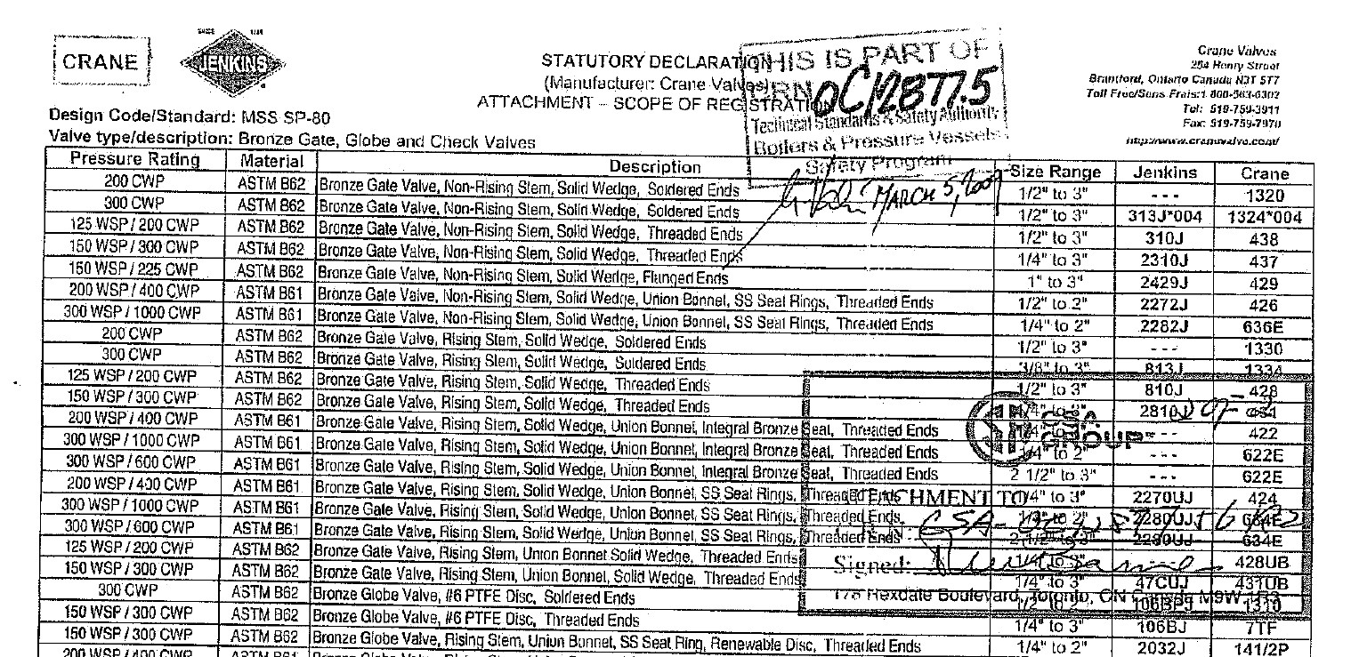
CRN Registration Example
Steam School Notes | 21 Canadian Registration Numbers (CRNs)
CRN issued for family of designs

Slide 15
What CRN Registration Covers
Steam School Notes | 21 Canadian Registration Numbers (CRNs)
CRN applies to design configurations within approved scope
• Several sizes
• Multiple pressure ratings
• Different end connections
All configurations falling within approved scope are covered by same registration.

Slide 16
What CRN Registration Does Not Cover
Steam School Notes | 21 Canadian Registration Numbers (CRNs)
CRN does not verify material, condition, or installation
• Prove the material composition
• Replace the MTR
• Verify the condition of a valve
• Guarantee proper installation
Material certification, inspection, testing, and maintenance address matters outside CRN scope.

Slide 17
MTR and CRN Relationship
Steam School Notes | 21 Canadian Registration Numbers (CRNs)
MTR proves material; CRN proves design for service acceptability
• MTR: Proves the material
• CRN: Proves the design
Both MTR and CRN may be required to demonstrate pressure-retaining component acceptability.

Slide 18
Province and Territory Suffix Codes
Steam School Notes | 21 Canadian Registration Numbers (CRNs)
CRN suffix identifies jurisdictions accepting the design
Code | Province or Territory
1 | British Columbia
2 | Alberta
3 | Saskatchewan
4 | Manitoba
5 | Ontario
6 | Quebec
7 | New Brunswick
8 | Nova Scotia
9 | Prince Edward Island
0 | Newfoundland and Labrador
N | Nunavut
T | Northwest Territories
Y | Yukon

Slide 19
Reading CRN Suffix Examples
Steam School Notes | 21 Canadian Registration Numbers (CRNs)
CRN suffix order indicates registration history and jurisdiction acceptance
• 4321.5: First registered in Ontario
• 4321.52: First registered in Ontario, subsequently accepted in Alberta
• 4321.15: First registered in British Columbia, later accepted in Ontario
First jurisdiction shown is the original registering authority; suffix order indicates registration history.

Slide 20
Canada-Wide Acceptance Indicator
Steam School Notes | 21 Canadian Registration Numbers (CRNs)
Letter C indicates design accepted in all Canadian jurisdictions
• Example: 0C12877.5C
• C indicates design accepted in all Canadian jurisdictions
• Abbreviation used instead of listing every province and territory
Canada-wide acceptance (C suffix) streamlines CRN notation for multi-jurisdiction designs.

Slide 21
Crane Registration CRN Example
Steam School Notes | 21 Canadian Registration Numbers (CRNs)
Crane valve CRN 0C12877.5 shows Ontario first registration
• 0C12877.5: .5 indicates Ontario was first jurisdiction to register the design
• Upon Canada-wide acceptance, CRN shown as 0C12877.5C
• C suffix indicates Canada-wide acceptance

Slide 22
CRN Suffix Significance for Pipefitters
Steam School Notes | 21 Canadian Registration Numbers (CRNs)
Suffix interpretation determines registration jurisdiction and scope
• Where the design was first registered
• Whether the design has been accepted in multiple jurisdictions
• Whether the design has Canada-wide acceptance
CRN suffix analysis is important when purchasing equipment for installation in different provinces or territories.

Slide 23
Historical Boilers and CRNs
Steam School Notes | 21 Canadian Registration Numbers (CRNs)
Heritage boilers often require unique individual CRN registration
• Modern valves and fittings: CRN applies to entire product family
• Historical boilers: Built as individual machines with unique histories
Heritage boiler considerations
• Modified over operating lives
• Repaired using various methods
• Constructed before modern design standards
• Each may require unique registration

Slide 24
Historical Boiler CRN and MAWP Relationship
Steam School Notes | 21 Canadian Registration Numbers (CRNs)
CRN for historical boiler closely tied to Maximum Allowable Working Pressure
MAWP established through
• Inspection
• Non-destructive examination (NDE)
• Thickness measurements
• Engineering calculations
• Applicable code requirements
As heritage boilers age, inspection may reveal condition changes affecting MAWP and registration.

Slide 25
MAWP Reassessment for Historical Boilers
Steam School Notes | 21 Canadian Registration Numbers (CRNs)
Periodic inspection may require MAWP recalculation and registration updates
• Corrosion, wastage, repairs affect boiler strength
• NBIC requires periodic re-evaluation of historical boilers
MAWP reduction requires
• Change in registered maximum allowable operating pressure
• Revision of safety-valve settings
• Updates to inspection records
• Changes to registration documentation

Slide 26
Historical Boiler CRN vs. Modern Components
Steam School Notes | 21 Canadian Registration Numbers (CRNs)
Historical boiler CRN evolves through ongoing inspection and evaluation
Modern valves and fittings
• CRN is primarily design-registration document
Historical boilers
• CRN part of ongoing inspection and engineering evaluation
• CRN may evolve as new inspection information available
• CRN updated as boiler's allowable operating pressure reassessed

Slide 27
Documentation Consistency for Historical Boilers
Steam School Notes | 21 Canadian Registration Numbers (CRNs)
Pressure ratings, settings, and CRN must remain consistent with MAWP
• Pressure ratings
• Safety-valve settings
• Inspection certificates
• CRN records
All documentation must remain consistent with the boiler's current MAWP.

Slide 28
Key Takeaway: CRN Purpose and Role
Steam School Notes | 21 Canadian Registration Numbers (CRNs)
CRN proves design acceptance; MTR proves material acceptability
Canadian Registration Number demonstrates that a pressure-retaining component design has been reviewed and accepted by applicable regulatory authority, complementing Material Test Report certification for compliance and pressure equipment safety.

