Slide 1
What is Boiler Construction?
Steam School Notes | Chapter 2: Boiler Construction
Study of pressure-retaining part design and support
• Boilers are pressure vessels made from curved shells, flat sheets, openings, seams, tubes, stays, and fittings
• Some surfaces are self-supporting due to shape; others require stays or reinforcement
• Construction analysis determines which surfaces need support and how to calculate regional strength

Slide 2
Boiler Types Overview
Steam School Notes | Chapter 2: Boiler Construction
Historic steam equipment used several boiler arrangements
• Each type places fire, water, steam space, tubes, flues, and pressure-retaining surfaces in different relationships
• Differences are functional, not merely visual

Slide 3
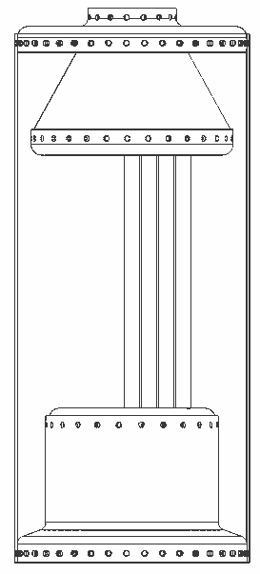
Vertical Boiler
Steam School Notes | Chapter 2: Boiler Construction
Cylindrical shell placed upright for compact design
• Round shell provides relative strength under internal pressure
• Compact and useful where floor space is limited
• Moderate steam output suitable
• Water level management is especially important due to space constraints

Slide 4
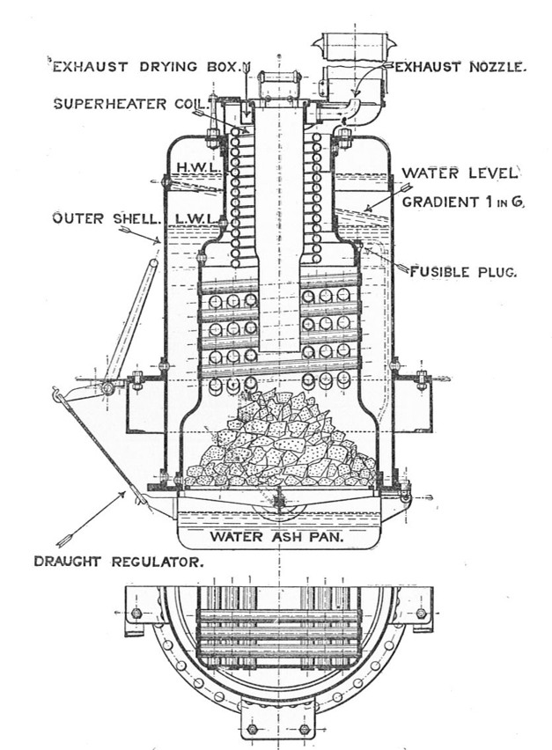
Water-tube Vertical Boiler
Steam School Notes | Chapter 2: Boiler Construction
Water flows inside tubes while hot gases pass outside
• Reverse of firetube boiler arrangement
• Small-diameter pressure parts easier to strengthen than large shells
• Well suited to higher pressures
• Provides large heating surface in compact space
• More complex than simple firetube boilers

Slide 5
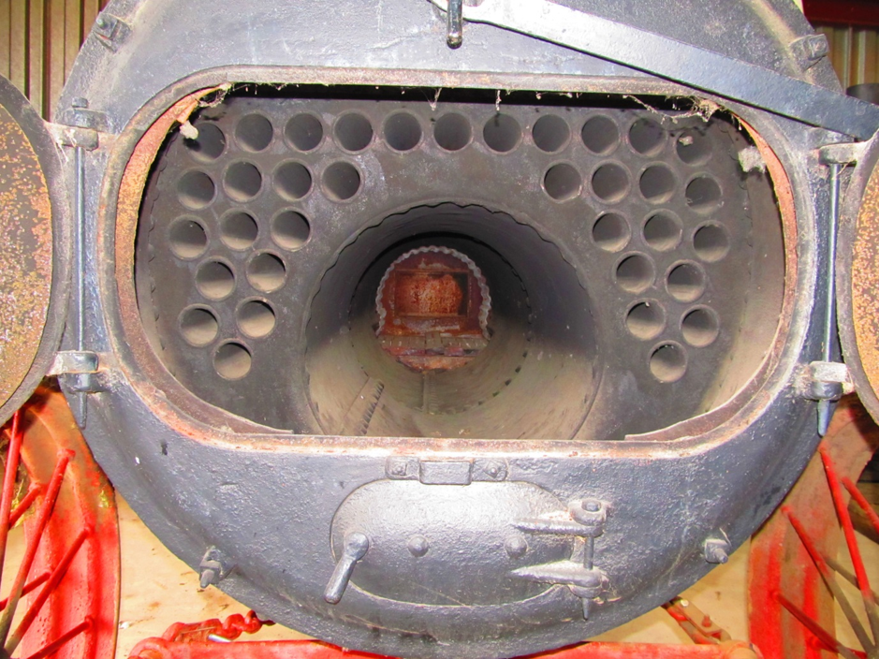
Return Flue Boiler
Steam School Notes | Chapter 2: Boiler Construction
Gas path returns through boiler before discharge
• Increases effective heating path within compact shell
• Firetube-family design with hot gases passing through flues surrounded by water
• Cylindrical shell largely self-supporting
• Flat ends and tube sheets require construction details for adequate strength

Slide 6
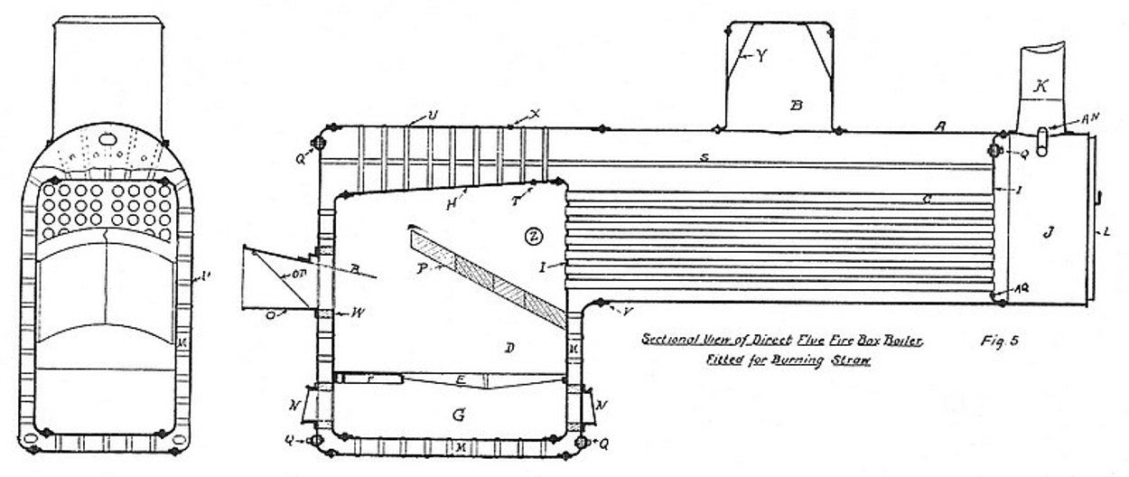
Locomotive-style Firetube Boiler
Steam School Notes | Chapter 2: Boiler Construction
Firebox at rear with tubes extending to front smokebox
• Firebox located at rear; hot gases pass through tubes toward front smokebox
• Water surrounds firebox and tubes; steam collects above water line
• Barrel is round and comparatively efficient as pressure vessel
• Firebox, tube sheets, and backhead contain flat areas requiring stays

Slide 7
Construction Problems in Locomotive Boiler
Steam School Notes | Chapter 2: Boiler Construction
Multiple distinct structural challenges in single vessel
• Cylindrical shell or barrel
• Flat front and rear tube sheets
• Firebox sheets exposed to intense heat
• Water legs around firebox
• Crown sheet over fire
• Staybolts and through stays supporting flat areas
• Smokebox and front flue sheet
• Steam collection through dome and dry pipe

Slide 8
Boiler Parts: Shells and Heads
Steam School Notes | Chapter 2: Boiler Construction
Main cylindrical shell and end plates define pressure boundary
Component | Function
Shell or barrel | Main cylindrical pressure shell containing water and steam
Boiler heads | End plates of shell; may be flat, dished, stayed, or connected to structural parts

Slide 9
Boiler Parts: Tube Sheets
Steam School Notes | Chapter 2: Boiler Construction
Plates supporting tube ends and carrying pressure and installation loads
Component | Function
Tube sheets or flue sheets | Plates into which tubes or flues are expanded; carry tube ends and withstand both pressure loads and tube installation forces

Slide 10
Boiler Parts: Firebox and Water Leg
Steam School Notes | Chapter 2: Boiler Construction
Combustion chamber surrounded by water-filled space
Component | Function
Firebox | Combustion chamber where fuel burns; surrounded by water on sides and top
Water leg | Water-filled space around sides of firebox

Slide 11
Boiler Parts: Crown Sheet
Steam School Notes | Chapter 2: Boiler Construction
Top sheet of firebox exposed to fire below and water above
• Flat surface under pressure and heat
• One of most critical boiler parts
• Requires special staying and reinforcement

Slide 12
Boiler Parts: Smokebox and Steam Dome
Steam School Notes | Chapter 2: Boiler Construction
Front chamber and raised steam collection structure
Component | Function
Smokebox | Chamber at front where hot gases collect after passing through tubes or flues
Steam dome | Raised chamber on top of shell used to collect drier steam from above water line

Slide 13
Boiler Parts: Dry Pipe and Steam Path
Steam School Notes | Chapter 2: Boiler Construction
Internal steam pipe running from dome toward throttle or outlet
• Collects steam from higher, drier part of steam space
• Part of steam collection path normally within steam space
• Position, support, and connection affect steam collection

Slide 14
Boiler Parts: Mud Ring and Ash Pit
Steam School Notes | Chapter 2: Boiler Construction
Lower structures for water containment and combustion support
Component | Function
Mud ring | Lower ring or frame around firebox water legs; closes bottom of water space and ties together lower firebox structure
Ash pit | Space below grate where ash collects and combustion air enters

Slide 15
Boiler Parts: Openings and Jacket
Steam School Notes | Chapter 2: Boiler Construction
Access points and outer covering for inspection and heat management
Component | Function
Manholes and handholes | Openings used for inspection, cleaning, and maintenance
Boiler jacket | Outer covering over insulation to reduce heat loss and improve appearance

Slide 16
Boiler Parts: Grate and Heating Surface
Steam School Notes | Chapter 2: Boiler Construction
Fire support and heat transfer surfaces exposed to flames
Component | Function
Grate surface | Area that supports the fire
Heating surface | Wetted metal surface exposed to fire or hot gases; includes firebox sheets and tube surfaces

Slide 17
Boiler Parts: Water and Steam Space
Steam School Notes | Chapter 2: Boiler Construction
Distinct regions for water and steam within pressure vessel
Region | Description
Steam space | Space above water line where steam collects
Water space | Space occupied by water around firebox, tubes, shell, and internal parts

Slide 18
Boiler Parts: Stay Systems
Steam School Notes | Chapter 2: Boiler Construction
Short and long supports for flat and curved surfaces
Stay Type | Application
Staybolts | Short stays to support flat firebox sheets
Through stays | Longer stays extending through boiler to support larger flat areas
Diagonal stays | Stays installed at angle where direct staying not practical

Slide 19
Boiler Parts: Reinforcement
Steam School Notes | Chapter 2: Boiler Construction
Extra plating added at regions requiring increased strength
• Double plating added at regions requiring extra strength
• Common around openings and fittings
• Reinforcement found where feedwater enters pressure shell

Slide 20
Rear Flue Sheet Purpose
Steam School Notes | Chapter 2: Boiler Construction
Locates and supports tubes while receiving intense firebox heat
• Located at firebox end of tube bank
• Receives intense heat from firebox
• Supports rear ends of tubes or flues

Slide 21
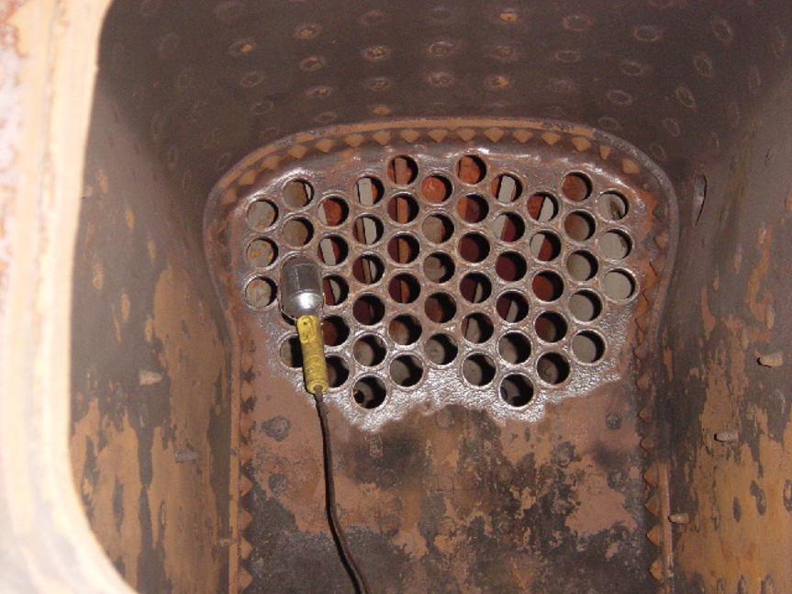
Rear Flue Sheet Strength Factors
Steam School Notes | Chapter 2: Boiler Construction
Multiple elements determine strength of pierced plate
• Not a plain solid plate due to many tube holes
• Strength depends on plate thickness
• Strength depends on tube spacing and ligament width between holes
• Staying and condition of tube-to-sheet joints affect strength

Slide 22
Front Flue Sheet Visibility
Steam School Notes | Chapter 2: Boiler Construction
Visible from smokebox; reveals internal construction features
• Contains front tube ends
• Reveals important internal construction features
• Shows evidence of support systems and fittings

Slide 23
Front Flue Sheet: Observable Features
Steam School Notes | Chapter 2: Boiler Construction
Multiple structural and functional elements visible in smokebox
• Tube or flue ends
• Through stays
• Internal butt cover
• Water inlet details
• Dry pipe emerging from beneath steam dome
• Dry-pipe hanger
• Double plating around water inlet

Slide 24
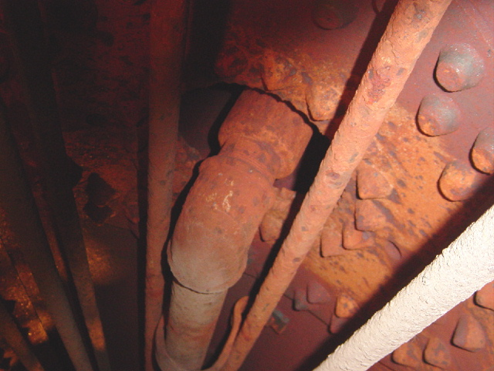
Front Flue Sheet: Dry Pipe Importance
Steam School Notes | Chapter 2: Boiler Construction
Dry pipe is part of steam collection path and affects operation
• Part of steam collection path
• Normally located within steam space
• Position affects how steam is taken from boiler
• Support and connection to dome or throttle arrangement affect operation

Slide 25
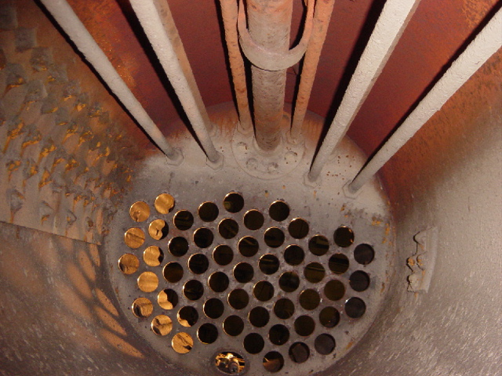
Front Flue Sheet: Water Inlet Reinforcement
Steam School Notes | Chapter 2: Boiler Construction
Feedwater temperature difference requires structural reinforcement
• Feedwater entering boiler may be colder than surrounding boiler water
• Reinforcement or double plating found where fittings enter pressure shell
• Water inlet area requires important construction details

Slide 26
Boiler Analysis: Regional Separation
Steam School Notes | Chapter 2: Boiler Construction
Separate boiler into regions that behave differently under pressure
• Barrel and dome
• Curved shell surfaces
• Longitudinal shell seams
• Firebox sheets
• Flat stayed surfaces
• Semi-curved stayed surfaces
• Crown sheet and wagon-top areas
• Backhead
• Front flue sheet
• Rear flue sheet
• Stayed firebox surfaces

Slide 27
Shell Barrel: Controlling Factors
Steam School Notes | Chapter 2: Boiler Construction
Curved surface strength depends on multiple geometric and material factors
• Diameter affects strength
• Plate thickness affects strength
• Material strength affects strength
• Joint efficiency affects strength
• Safety factor affects strength

Slide 28
Flat Firebox Sheet: Controlling Factors
Steam School Notes | Chapter 2: Boiler Construction
Flat surfaces require stays to resist pressure; strength depends on stay design
• Not self-supporting
• Depends on plate thickness
• Depends on staybolt size
• Depends on staybolt pitch
• Depends on stay attachment method

Slide 29
Stayed Surfaces: Construction Factors
Steam School Notes | Chapter 2: Boiler Construction
Multiple design elements control strength of stayed flat surfaces
• Plate thickness
• Staybolt diameter
• Staybolt pitch
• Stay engagement
• Stay attachment type
• Construction factor
• Condition of plate and stays

Slide 30
Boiler Construction: Central Principle
Steam School Notes | Chapter 2: Boiler Construction
Pressure acts everywhere but not every shape resists equally
• Different surfaces require different analysis methods
• Curved surfaces can be inherently self-supporting
• Flat surfaces always require external support
• Each region has its own controlling factors
Pressure acts everywhere, but not every shape resists pressure in the same way.

